Slide 1
Thursday
WB 8.2.21

Slide 2
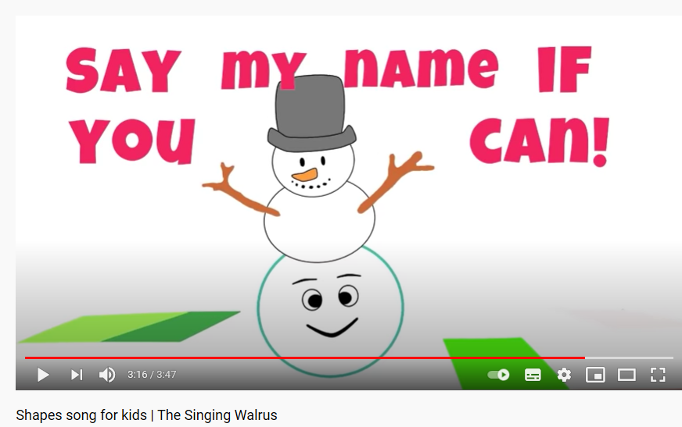
Starter- Lets sing the shape song – Which shapes can you name? Can you talk about the shapes features?
https://www.youtube.com/watch?v=OEbRDtCAFdU

Slide 3
This week is ‘Games Week’ and we are going to be revising our number work across the week during the main inputs.

Slide 4
Main Input -
Let's count together
Count from 0-20, then challenge yourself by counting all the way to 30

Slide 5
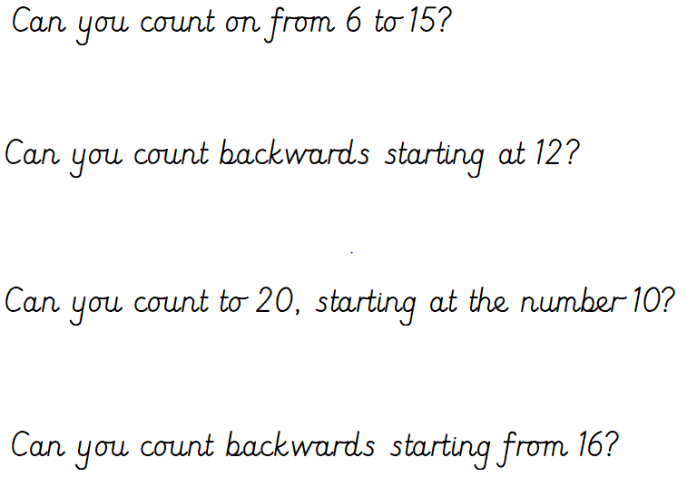
Now answer the question on the screen - how many did you get right?

Slide 6
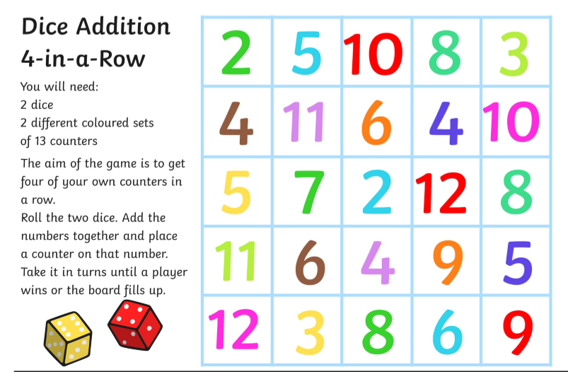
Main Activity -

