Slide 1
Tuesday
WB 8.2.21

Slide 2
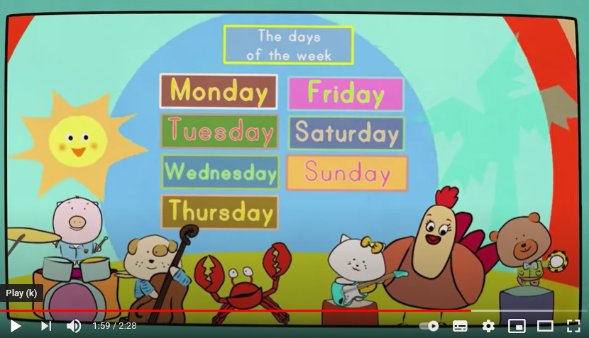
Starter- lets sing our days of the week song – practise makes perfect
Which days have I missed out –
Monday
Wednesday
Thursday
Saturday
https://www.youtube.com/watch?v=mXMofxtDPUQ

Slide 3
This week is ‘Games Week’ and we are going to be revising our number work across the week during the main inputs.

Slide 4
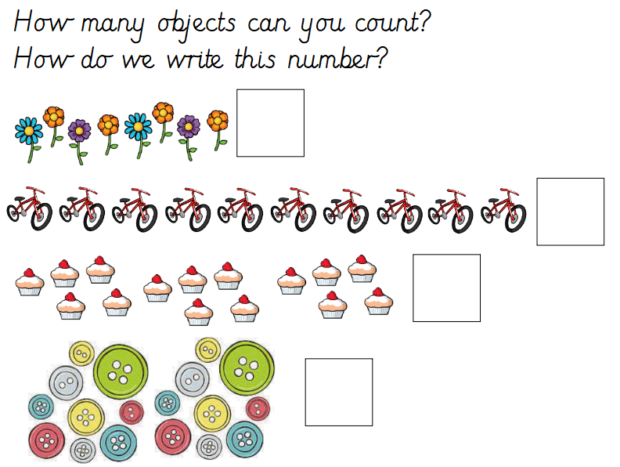
Main Input -
Can you think of your own question?
How many flowers would you have if you picked 1 more?

Slide 5

Can you think of your own question?
If two bikes cycled away how may bikes would be left?

Slide 6
Can you think of your own question?
How many cakes would you have if you ate 2?

Slide 7
Can you think of your own question?
If 1 more button was added to the group – How many buttons would you have?

Slide 8
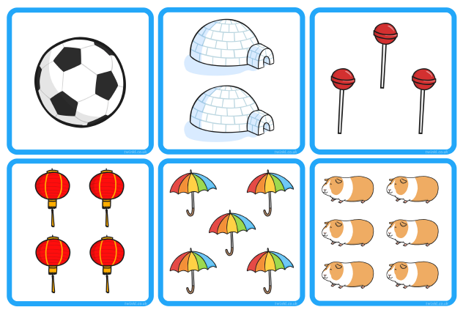
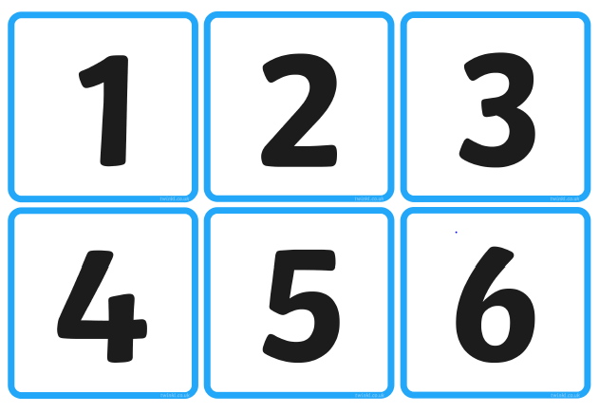
Main Activity - Play object Snap – turn all the cards over face down in two separate groups (number and pictures) take it in turns to turn over a card from each group and if they match you get to keep them.

