Slide 1
Wednesday
WB 8.2.21

Slide 2
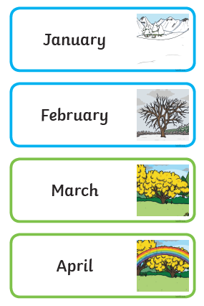
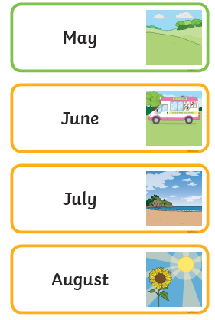
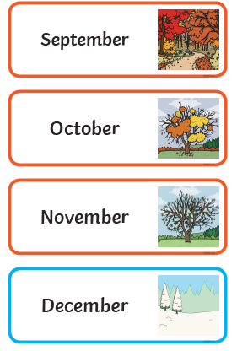
Starter- lets sing our Months of the year song
Can you cut up and order the months of the year cards?
https://www.youtube.com/watch?v=Fe9bnYRzFvk

Slide 3
This week is ‘Games Week’ and we are going to be revising our number work across the week during the main inputs.

Slide 4
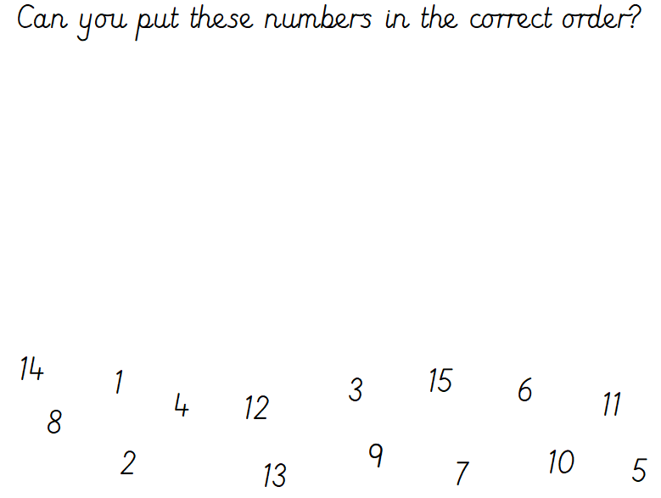
Main Input -
You can re-write them to place them in the correct order – don’t worry not all the numbers are here as that would be too easy!

Slide 5
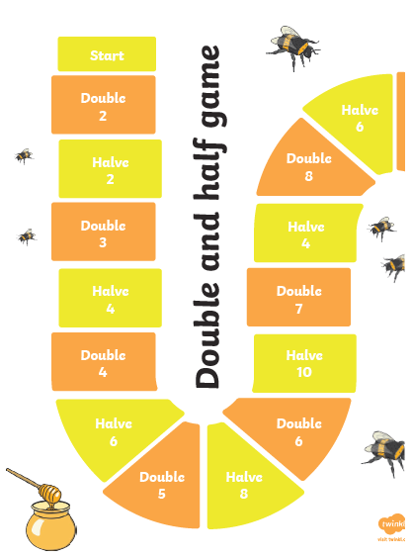
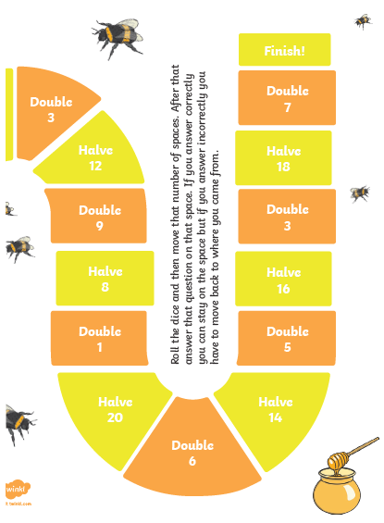
Main Activity -
All you need are some counters and a dice.

