Slide 1
Tuesday 2nd February 2021
Reading/Phonics

Slide 2
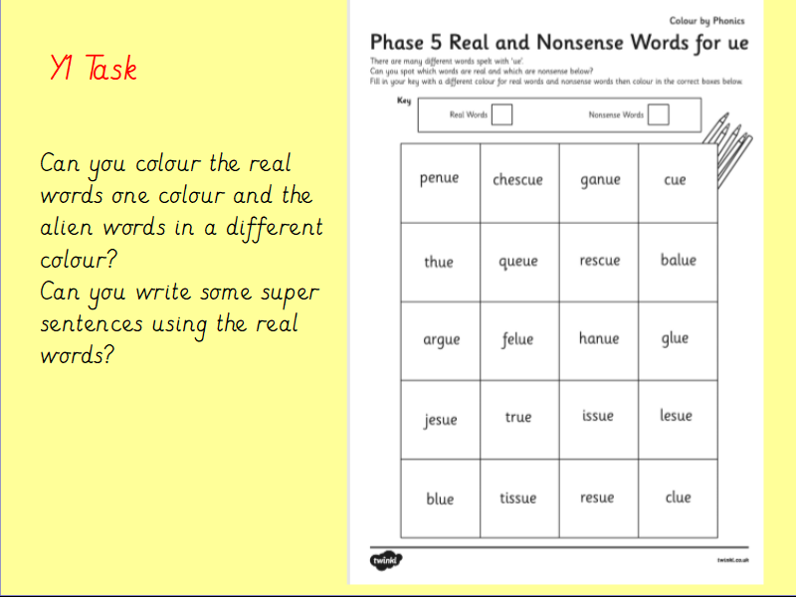

Slide 3
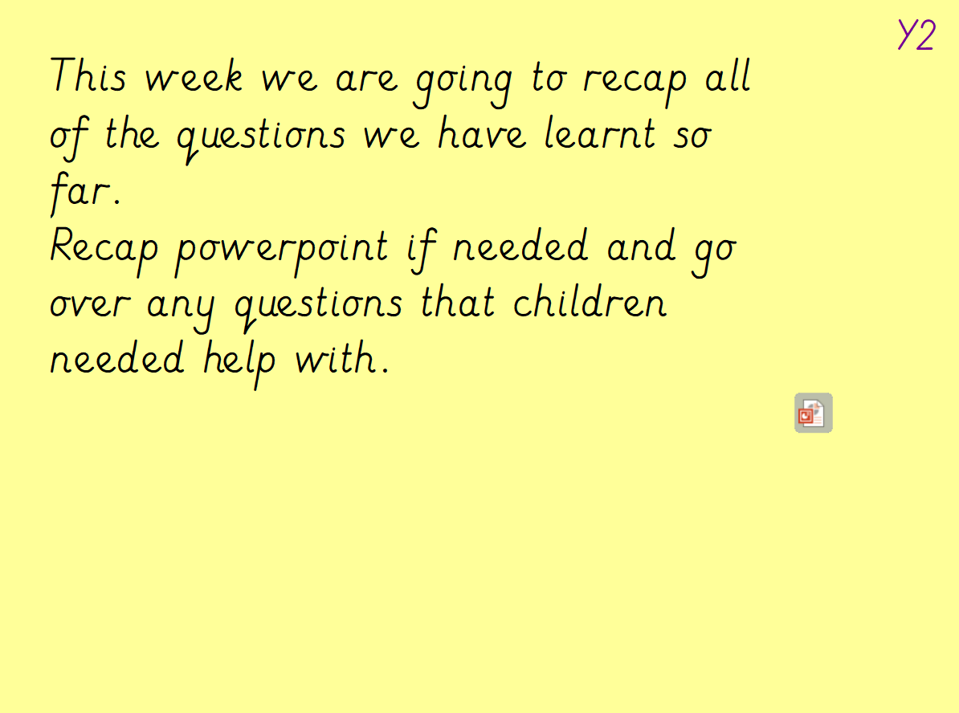
Recap from yesterday

Slide 4
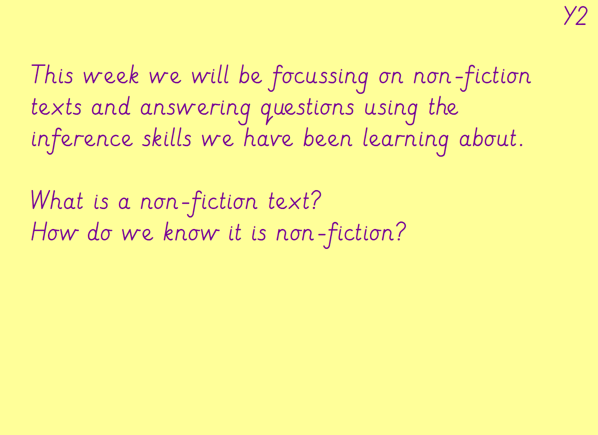
Recap from yesterday

Slide 5
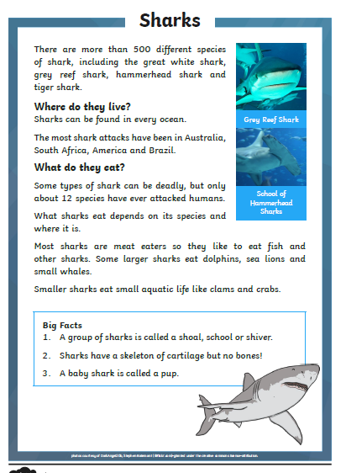
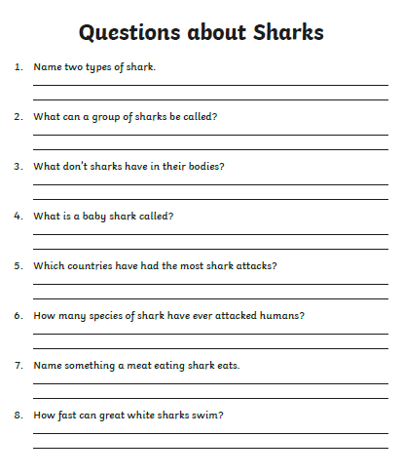
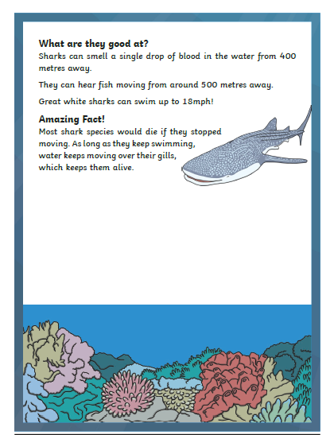
Y2 Task: Can you have a try at reading the non fiction text about sharks? Can you answer the questions in full sentences?
Y2

Slide 6
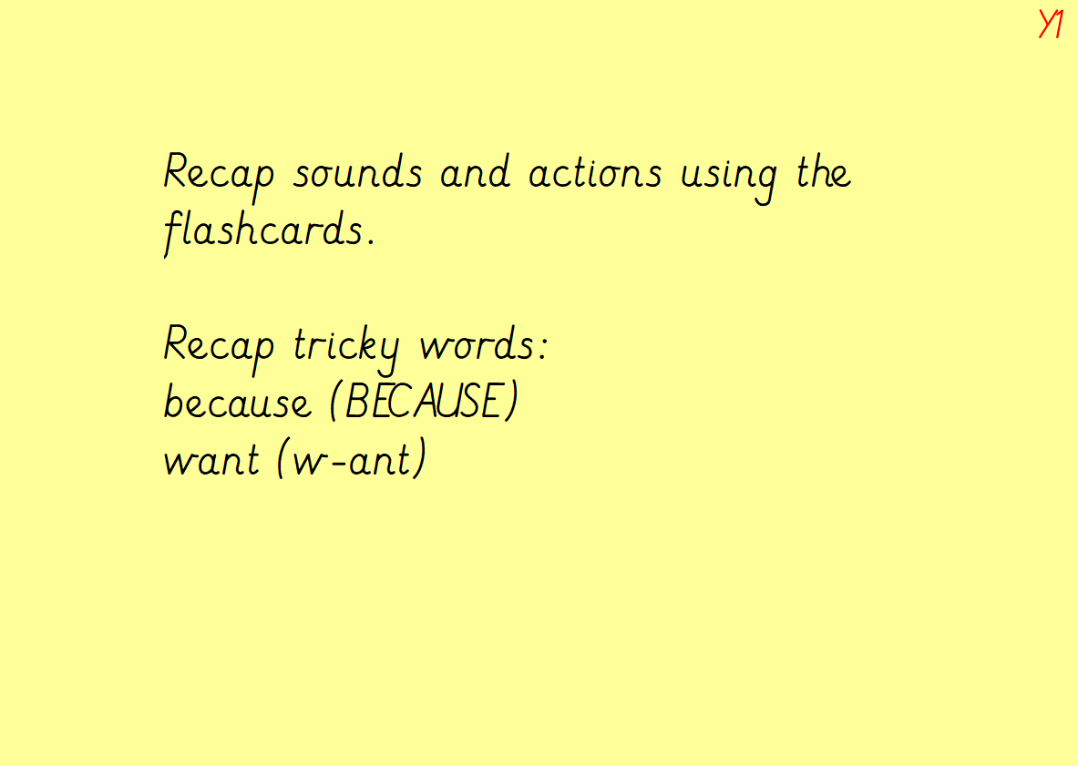

Slide 7
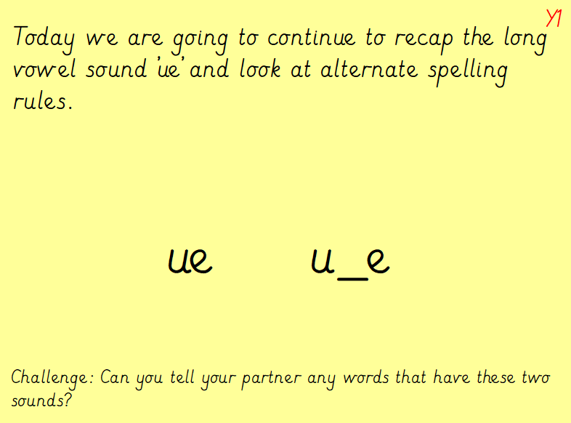

Slide 8
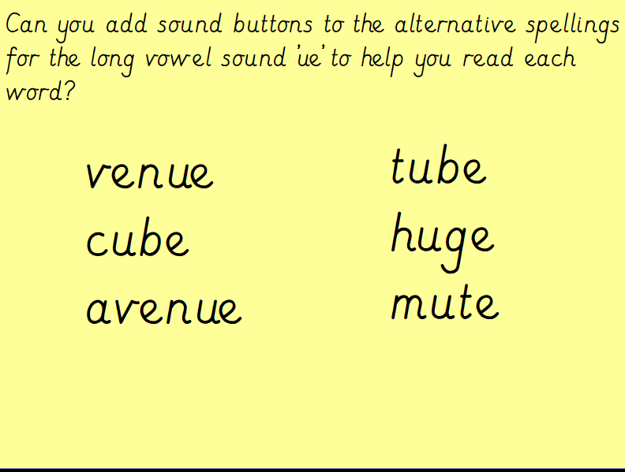
Y1

Slide 9
