Slide 1
Wednesday 3rd February 2021
Reading/Phonics

Slide 2
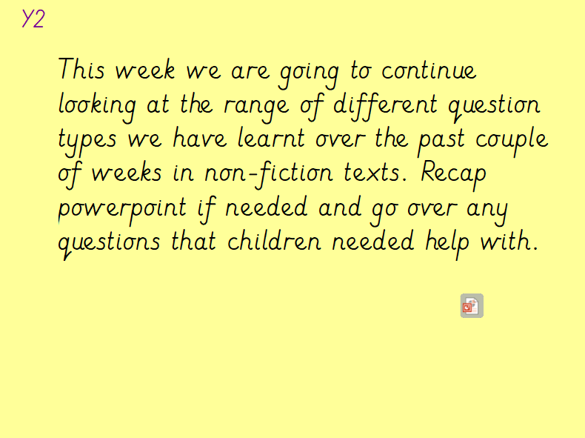

Slide 3
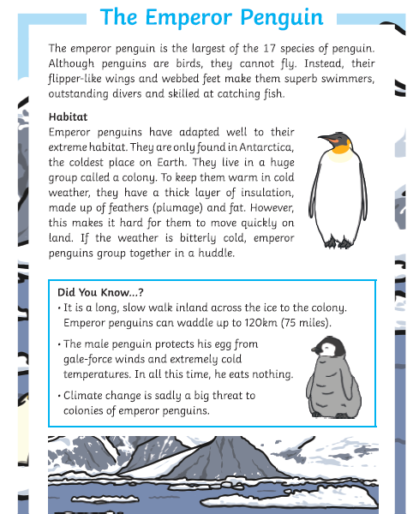
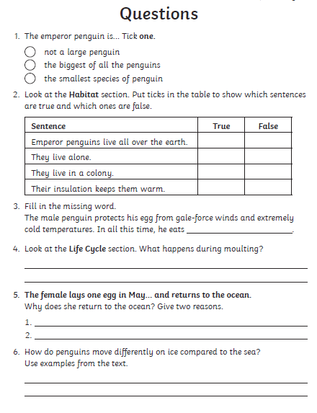
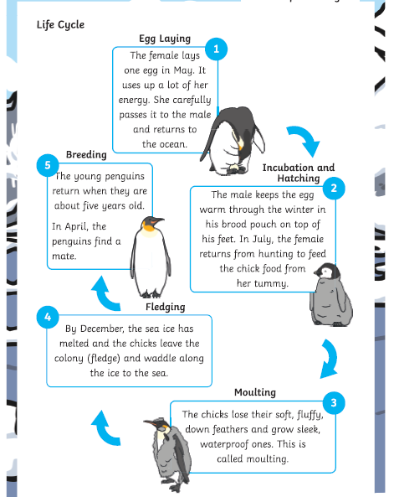
Y2 Task: Can you have a try at reading the non fiction text about penguins? Can you answer the questions in full sentences?
Y2

Slide 4
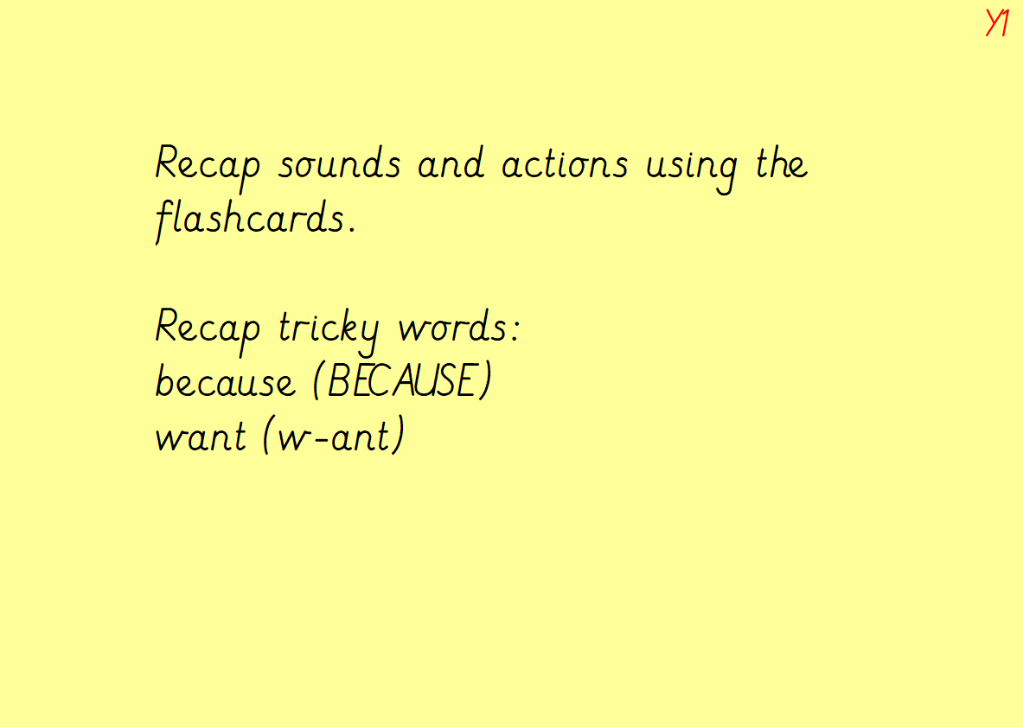

Slide 5
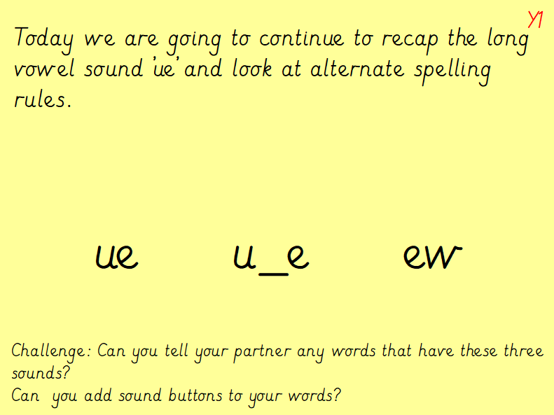
https://www.bing.com/videos/search?q=ue%2c+u_e+and+ew&view=detail&mid=37685B2A2BADB624340237685B2A2BADB6243402&FORM=VIRE – watch video

Slide 6
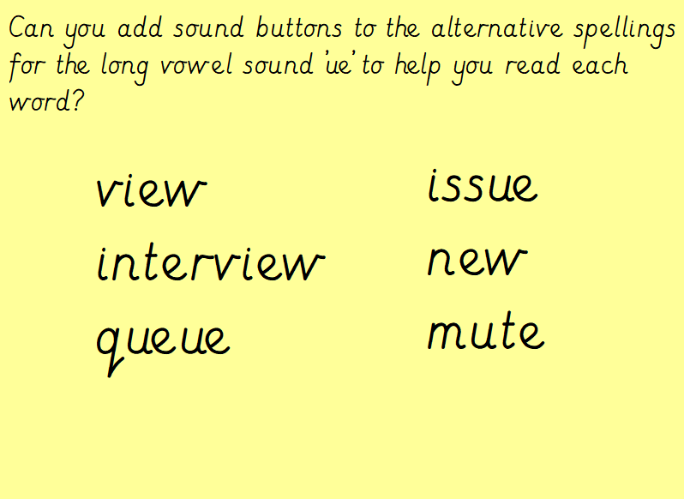
Y1

Slide 7
