Slide 1
Thursday 4th February 2021
Reading/Phonics

Slide 2
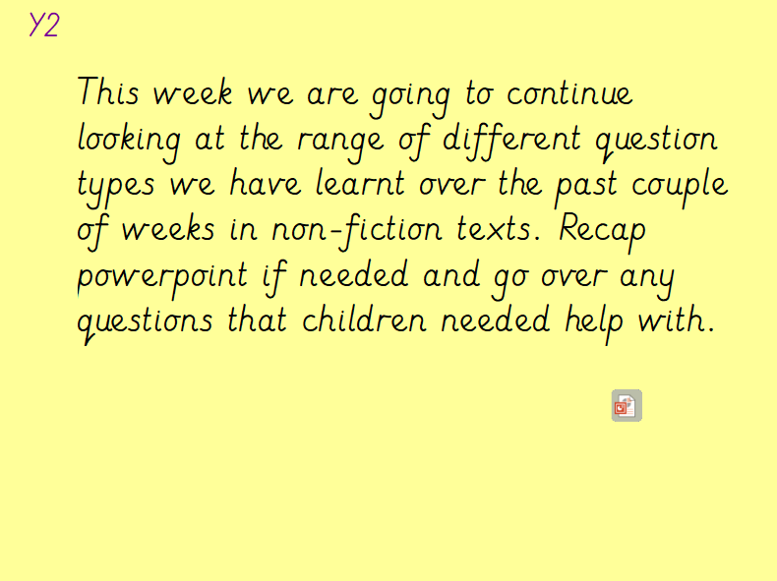

Slide 3
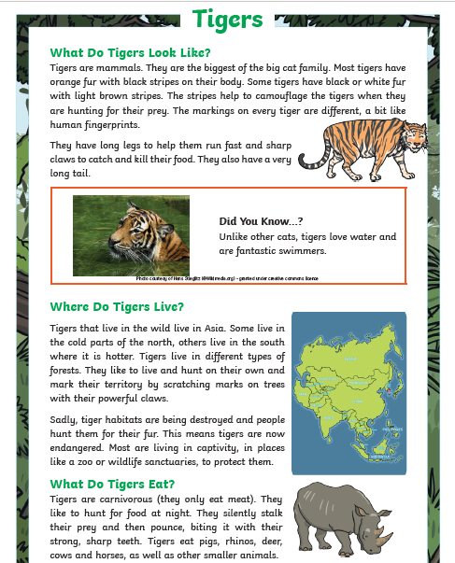
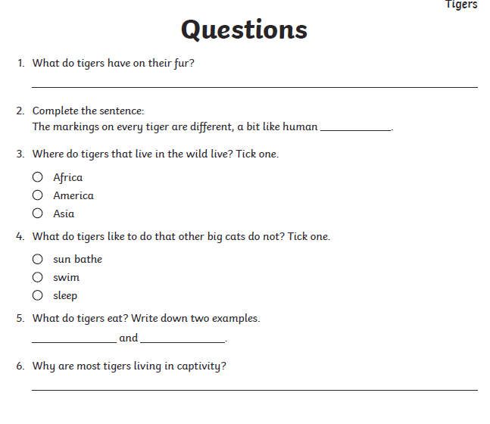
Y2 Task: Can you have a try at reading the non fiction text about tigers? Can you answer the questions in full sentences?
Y2

Slide 4
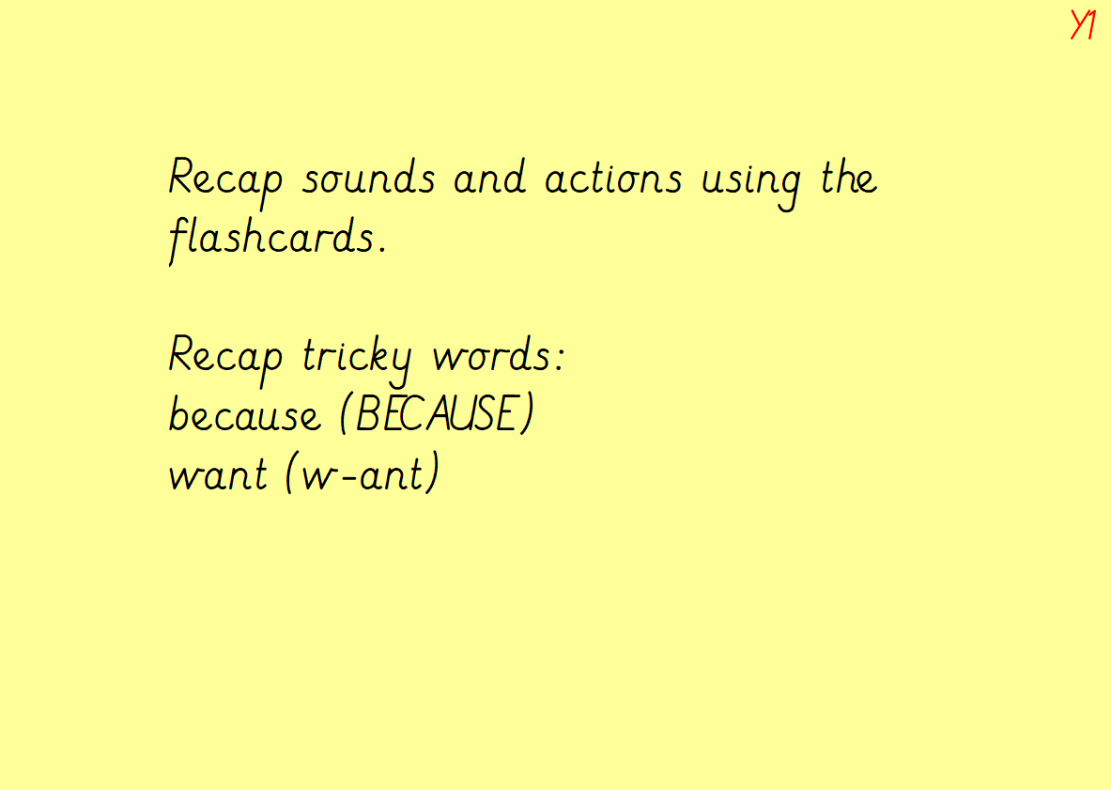

Slide 5
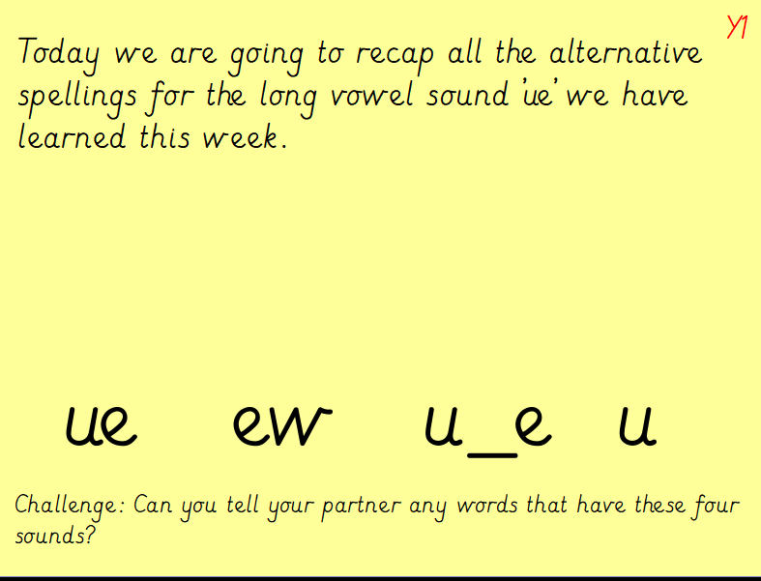

Slide 6
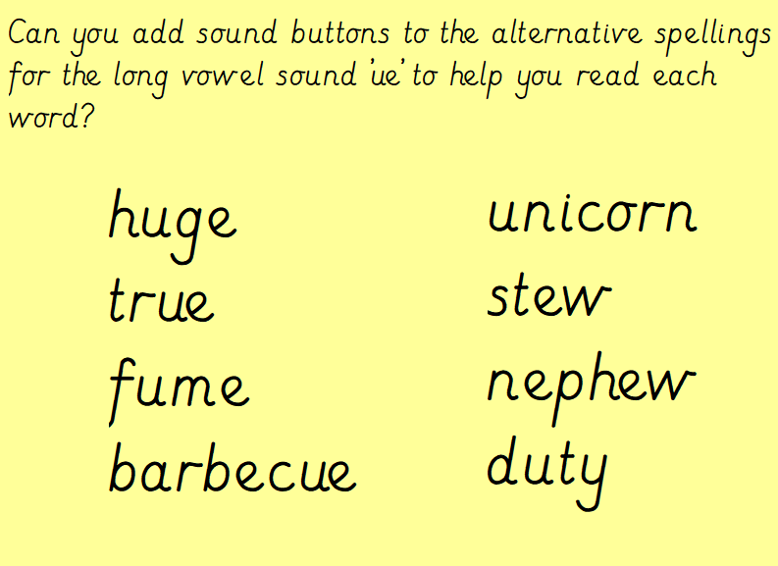
Y1

Slide 7
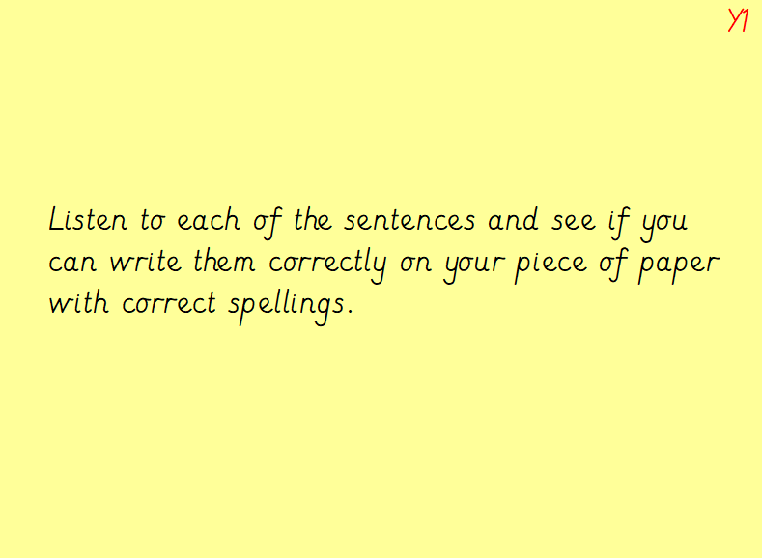

Slide 8
