Slide 1
Wednesday 10th February 2021
Reading/Phonics

Slide 2
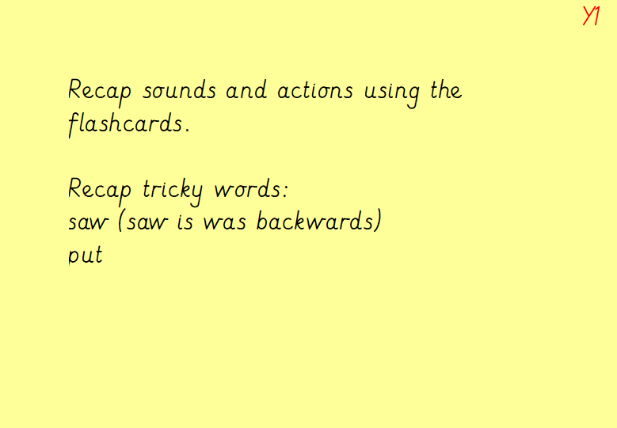

Slide 3
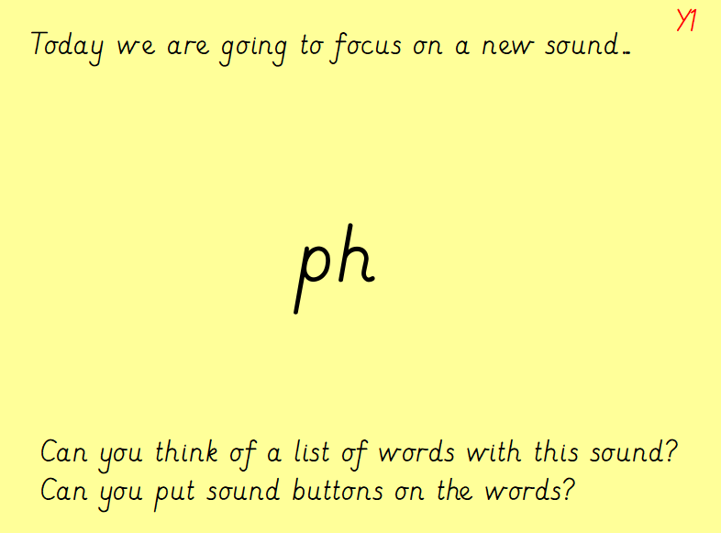

Slide 4
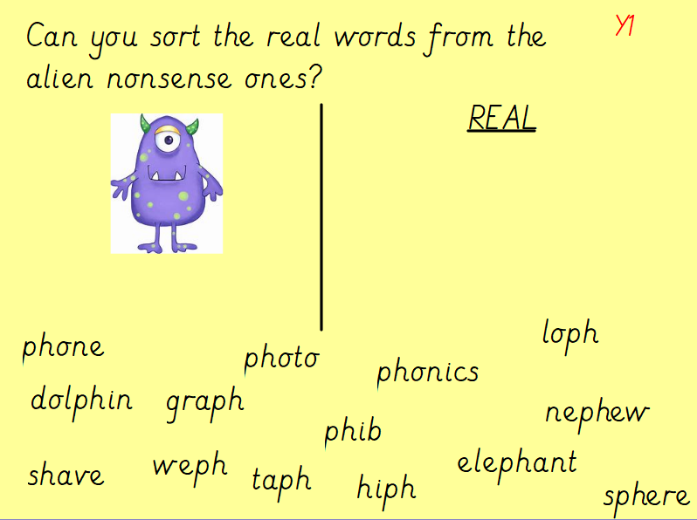

Slide 5
