Slide 1
Monday 18th January 2021
Reading

Slide 2
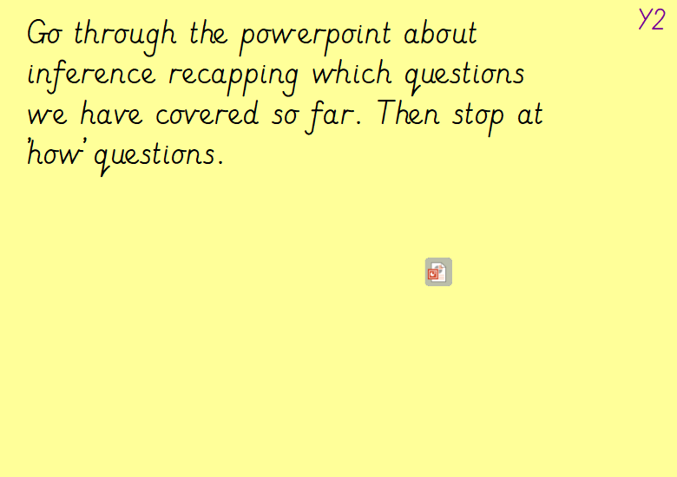

Slide 3
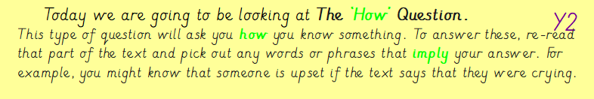

Slide 4
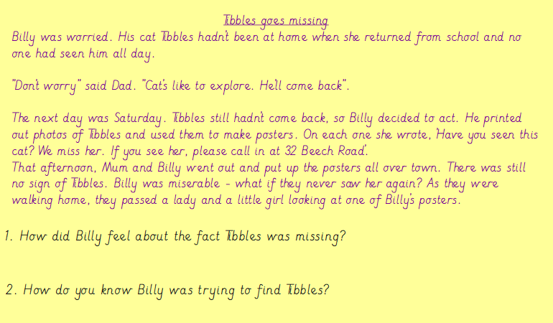
Have a go at completing the example question. Remember to answer the ‘how’ questions, you need to explain your answer.

Slide 5
