Slide 1
Monday 18th January 2021
Phonics/Reading

Slide 2
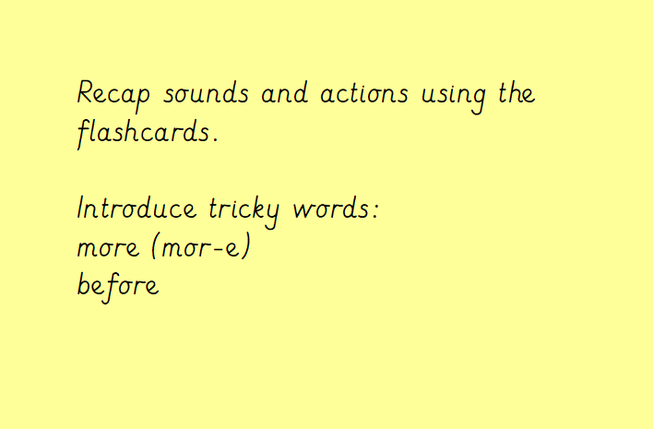
Start with Phase 2 and work through till Phase 5.

Slide 3
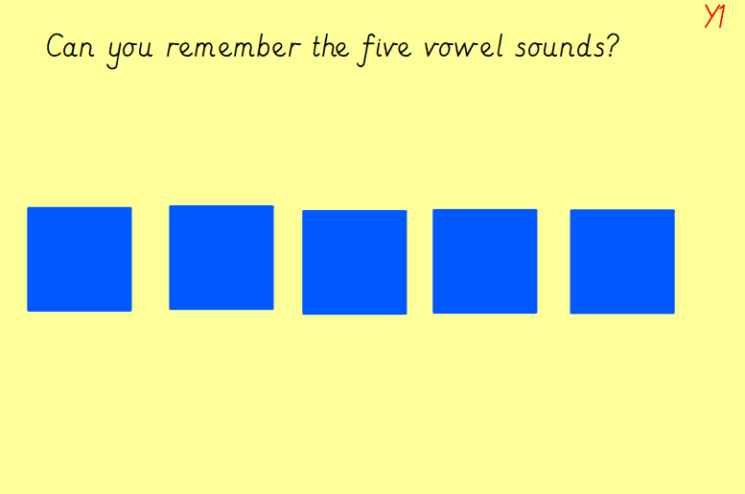
ai
ee
ie
oa
ue

Slide 4
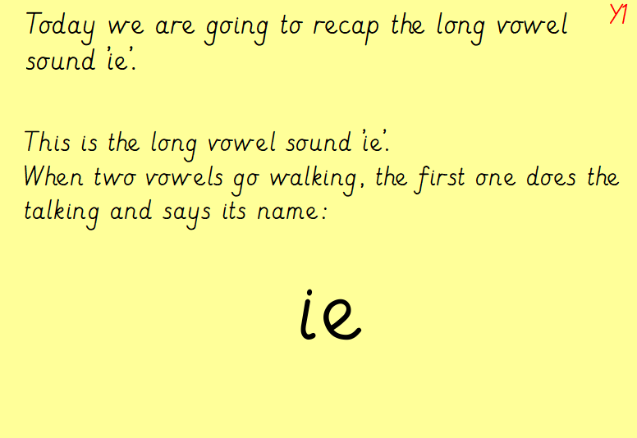
https://www.bing.com/videos/search?q=ie+sound&adlt=strict&view=detail&mid=87893048D1C3D001280C87893048D1C3D001280C&&FORM=VDRVRV - watch video on the ie sound

Slide 5
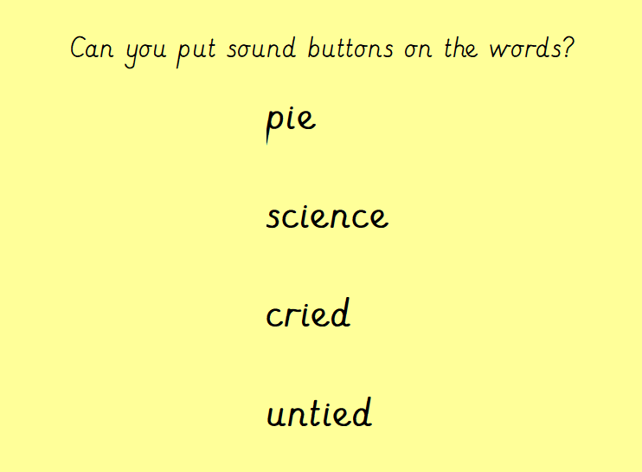

Slide 6
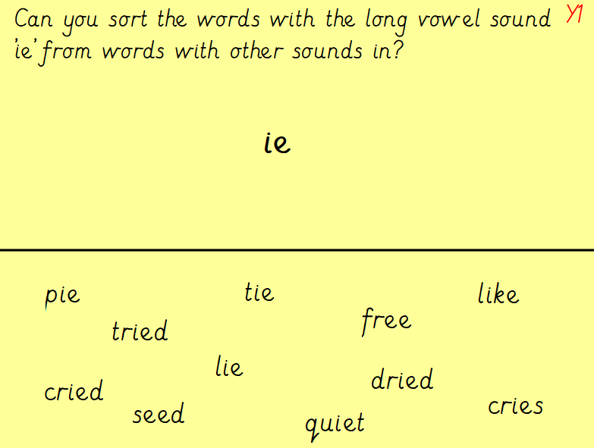

Slide 7
