Slide 1
Wednesday 20th January 2021
Phonics/Reading

Slide 2
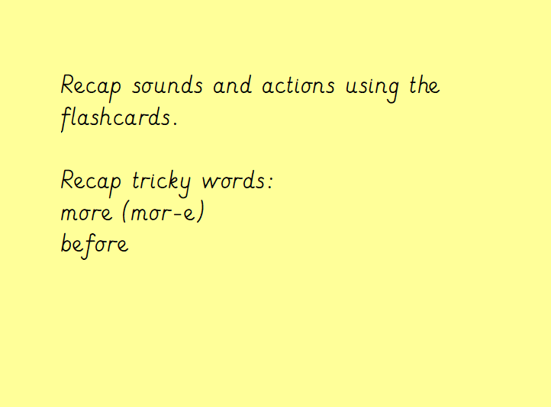

Slide 3
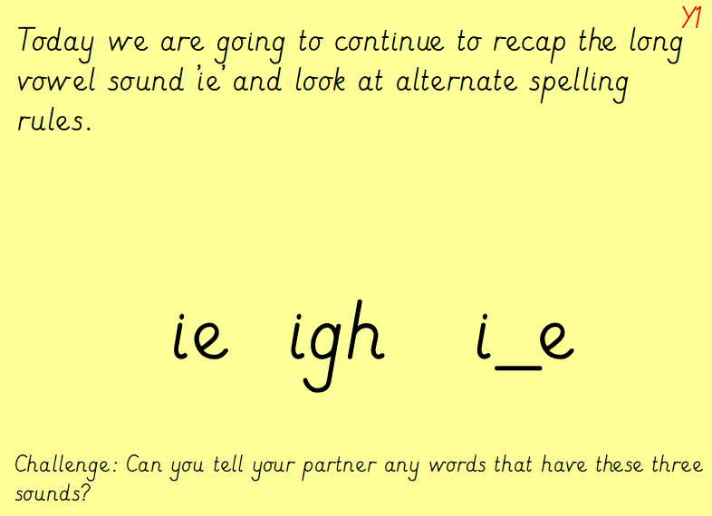

Slide 4
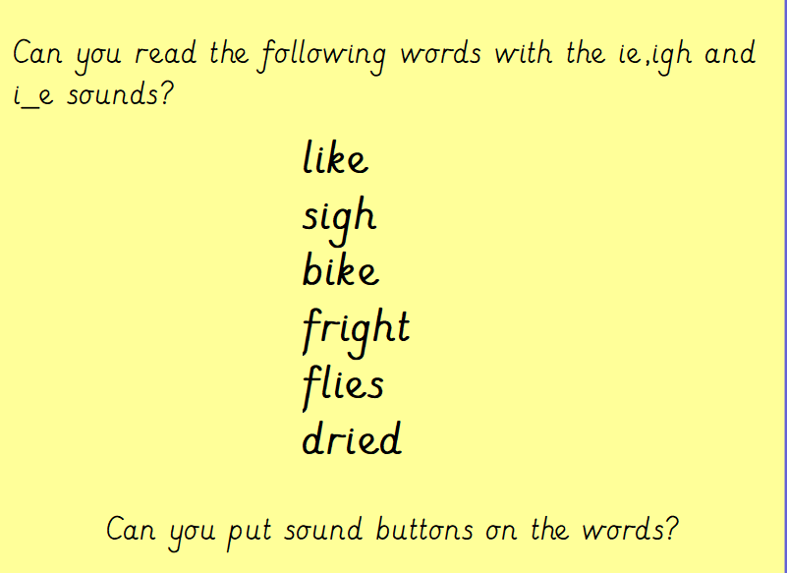

Slide 5
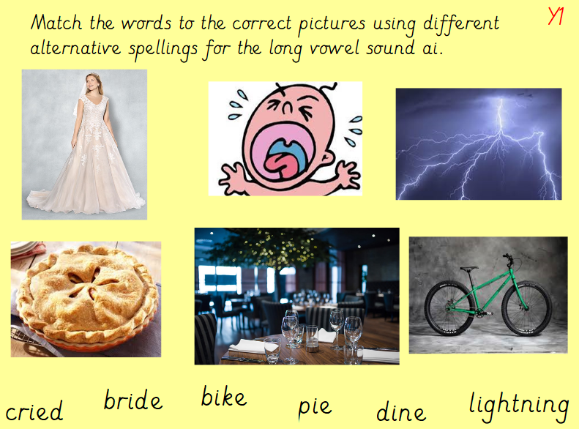

Slide 6
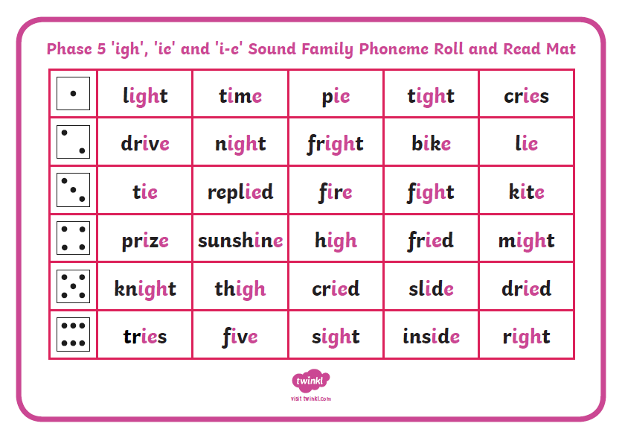
Can you play the roll and read game focussing on ‘ie’, ‘igh’ and i_e? Can you choose 3 of the words and write some super sentences?

