Slide 1
Monday 25th January 2021
Reading/Phonics

Slide 2
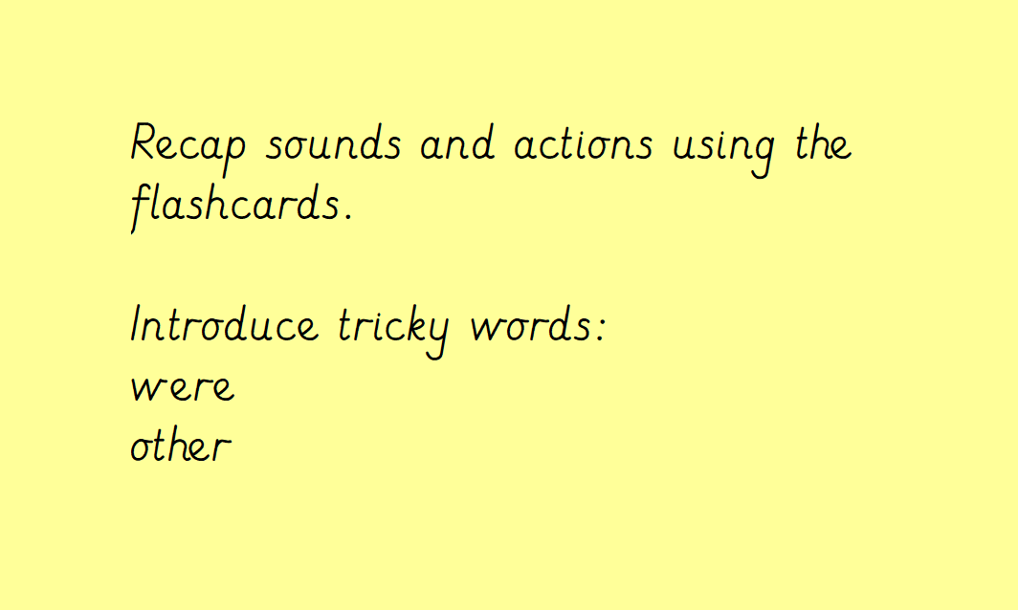

Slide 3
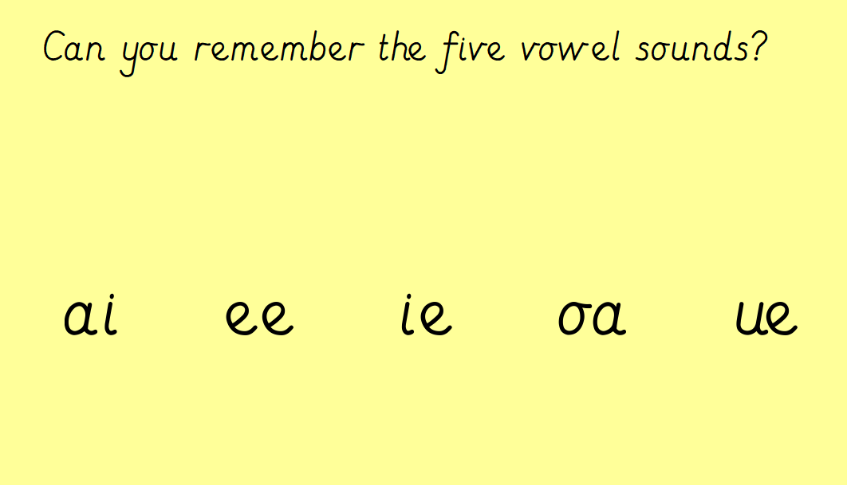
Can you think of some words for each of the long vowel sounds?

Slide 4
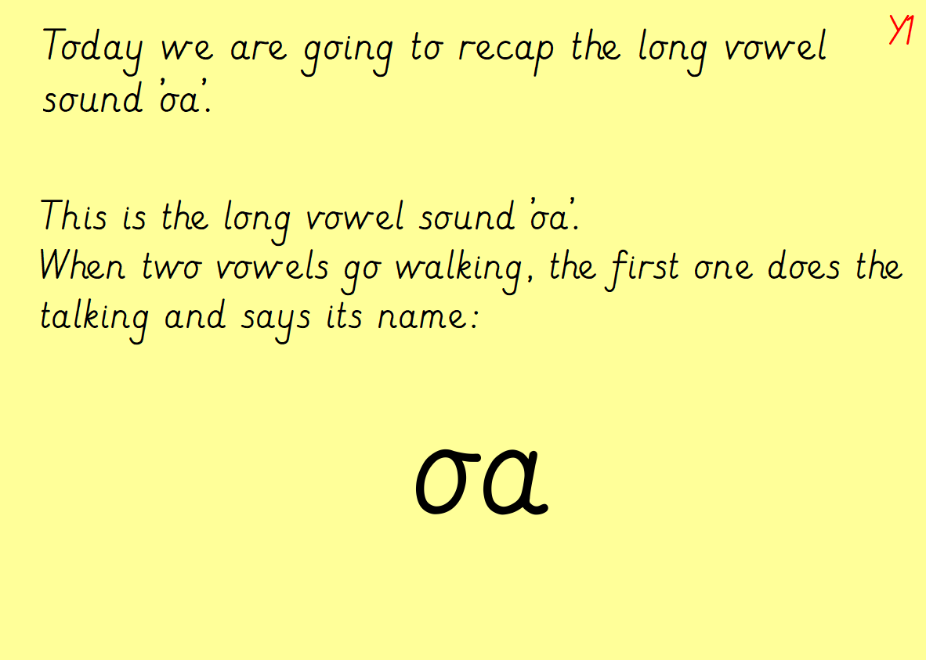

Slide 5
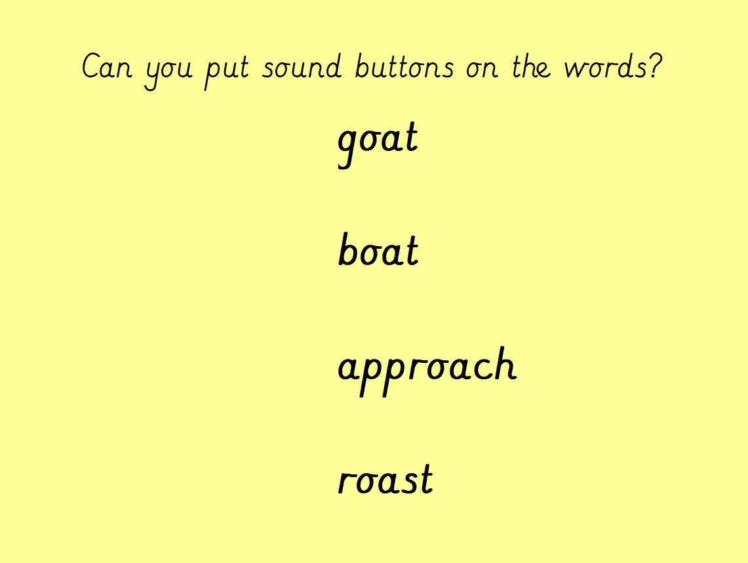

Slide 6
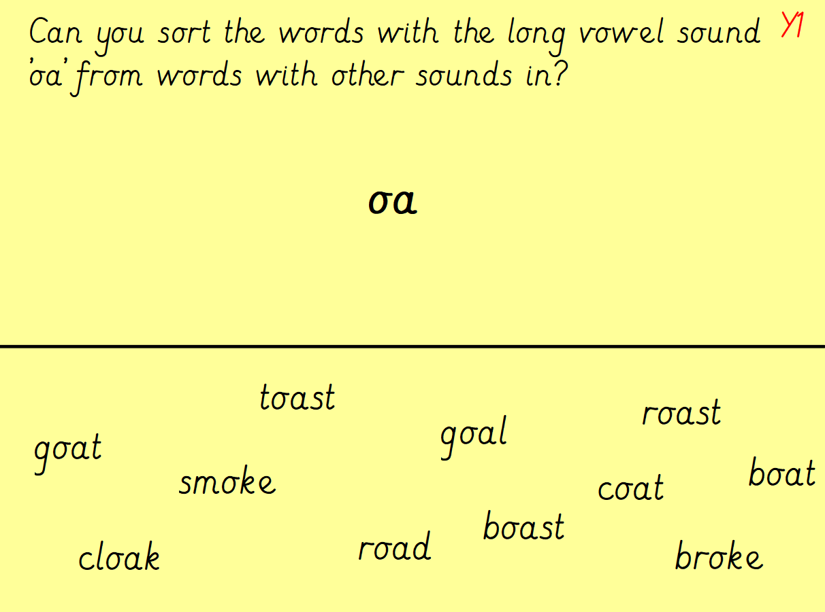

Slide 7
