Slide 1
Monday 25th January 2021
Reading

Slide 2
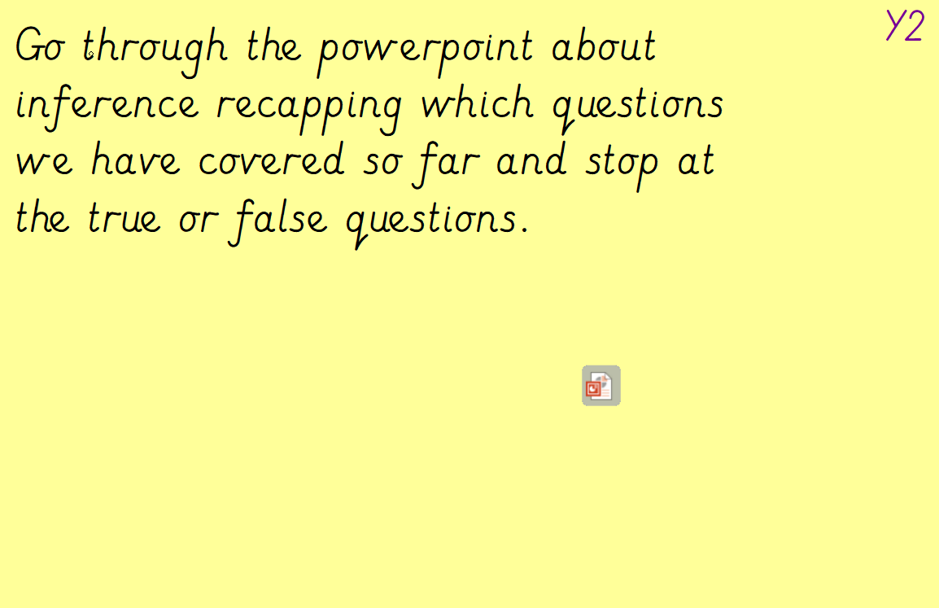

Slide 3
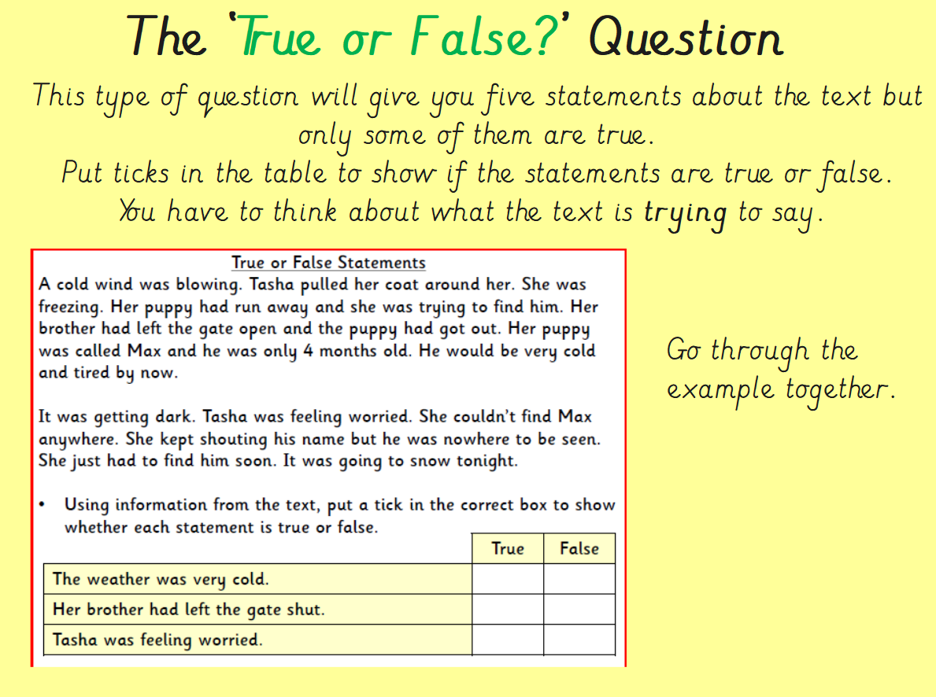

Slide 4
