Slide 1
Wednesday 27th January 2021
Reading/Phonics

Slide 2
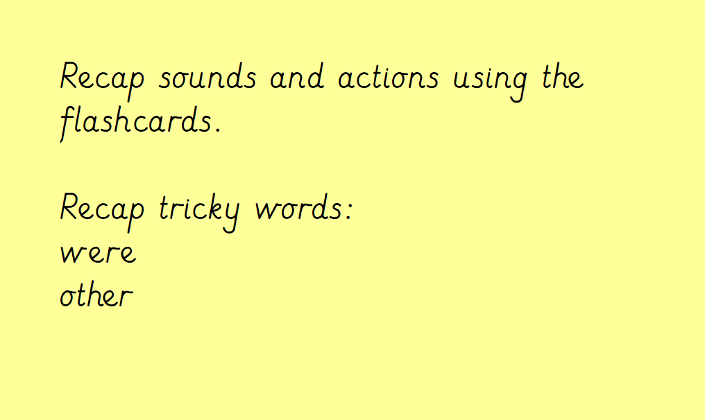

Slide 3
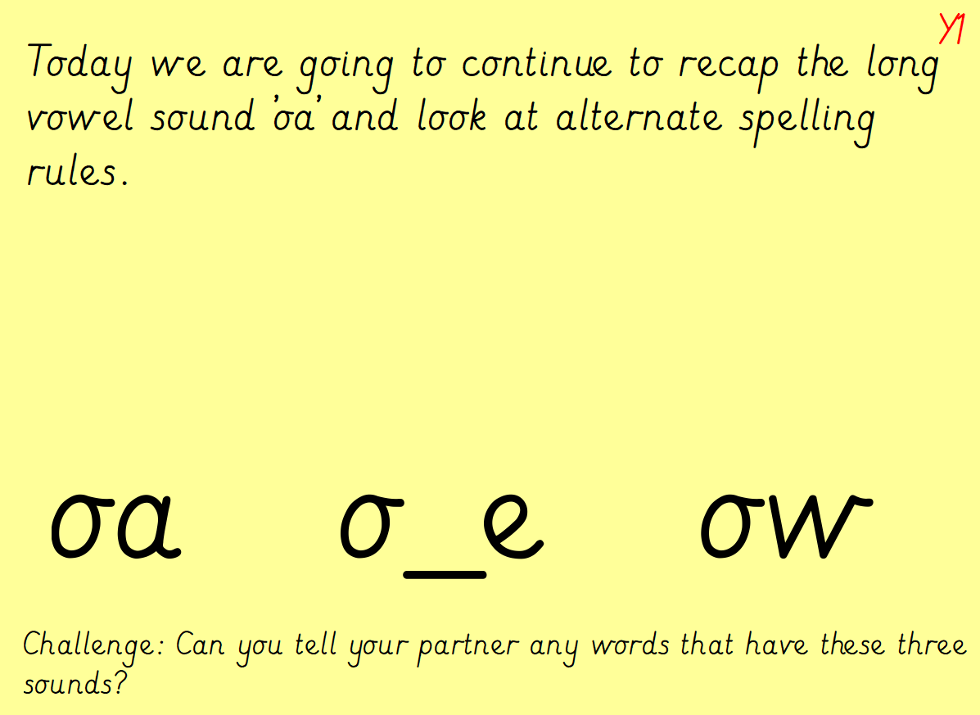

Slide 4
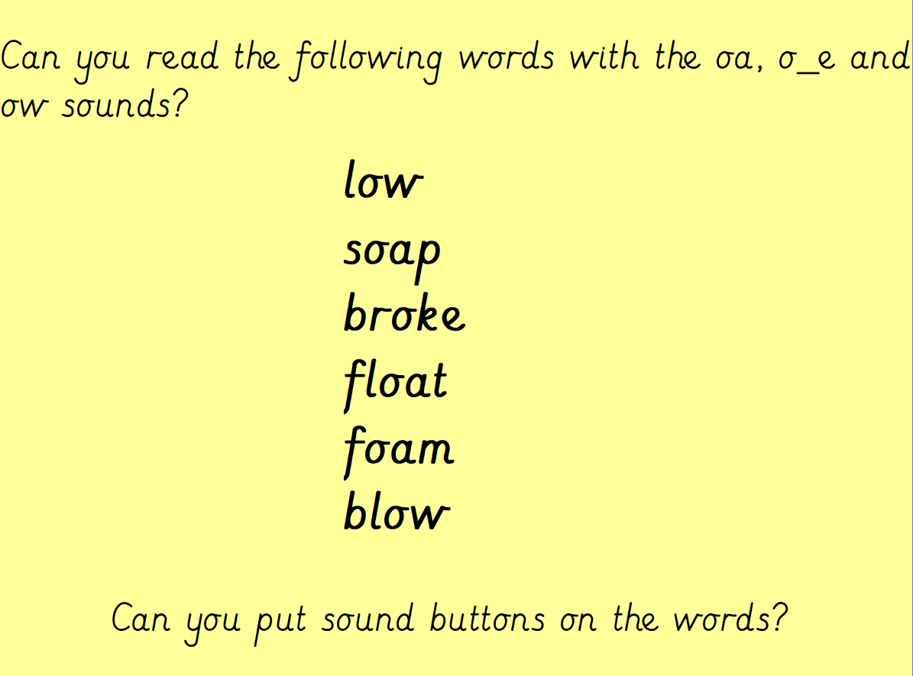

Slide 5
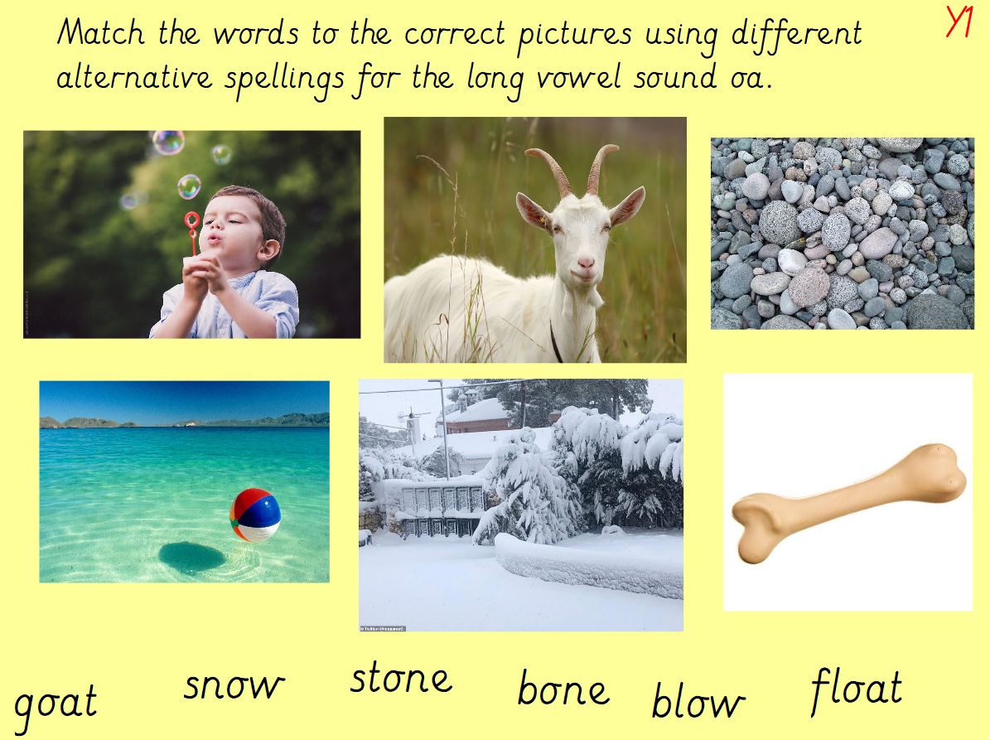

Slide 6
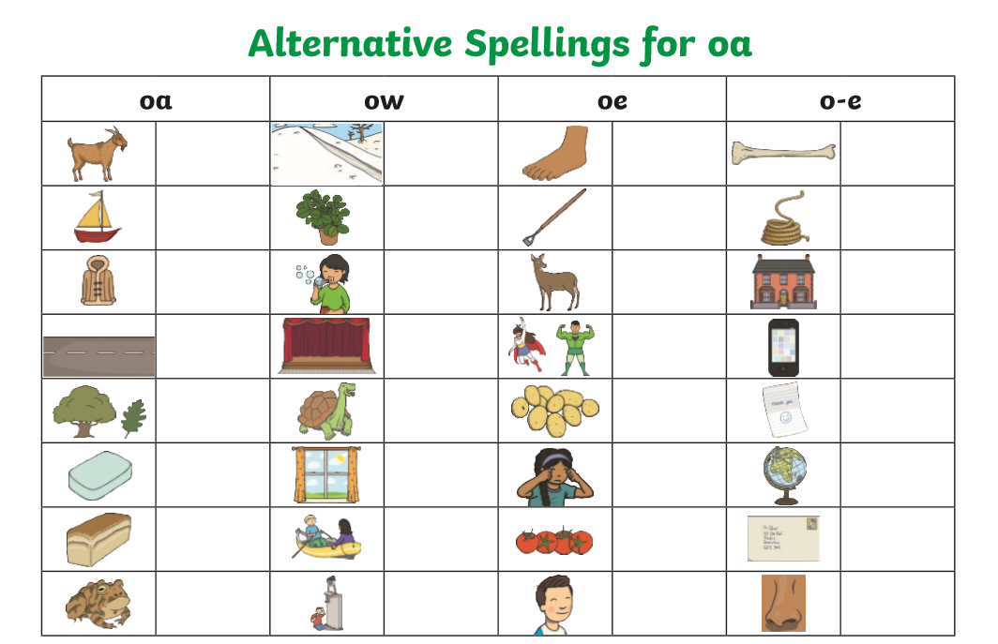
Task – Can you complete the alternative spelling grid.
Tomorrow we are going to be focussing on the ‘oe’ sound.

