Slide 1
Thursday 28th January 2021
Reading/Phonics

Slide 2
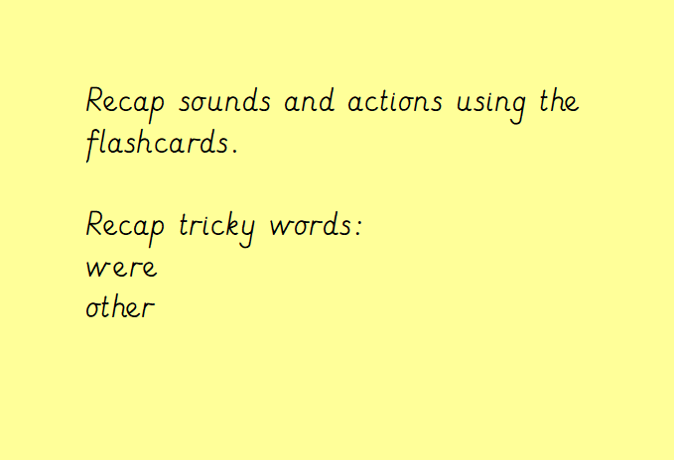

Slide 3
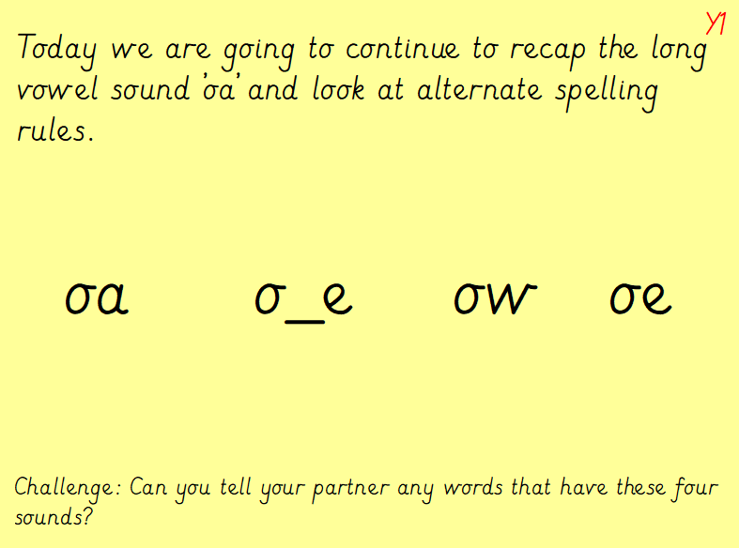

Slide 4
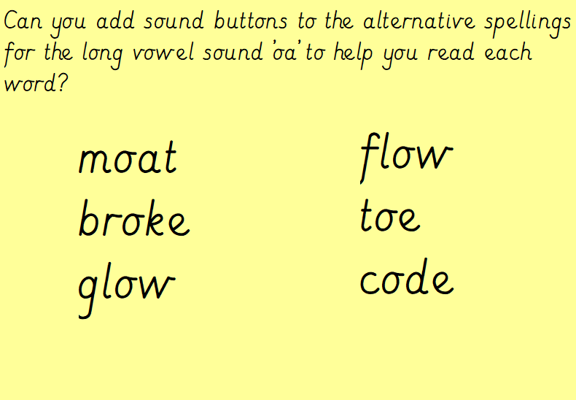

Slide 5
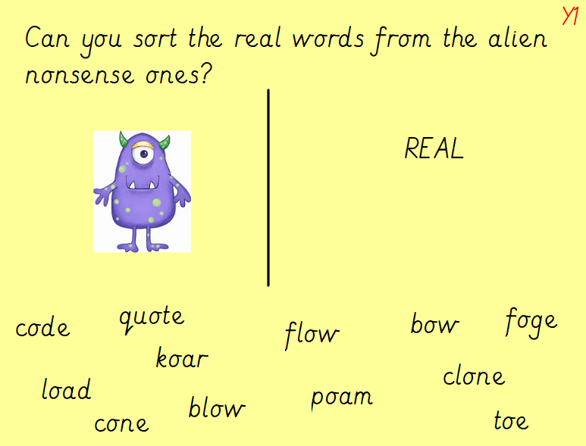

Slide 6
Task: With an adult play the ‘oa’, ‘oe’, ‘o_e’ and ‘ow’ word snap game.
Let’s see who can win the most cards.
Challenge: Once you have finished…
Can you write 5 sentences using the words with the alternative spelling for ‘oa’?

