Slide 1
Tuesday 9th February 2021
Phonics/Reading

Slide 2
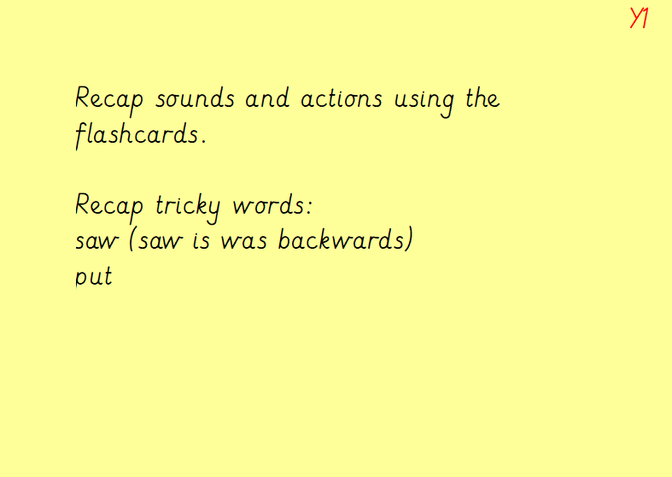

Slide 3
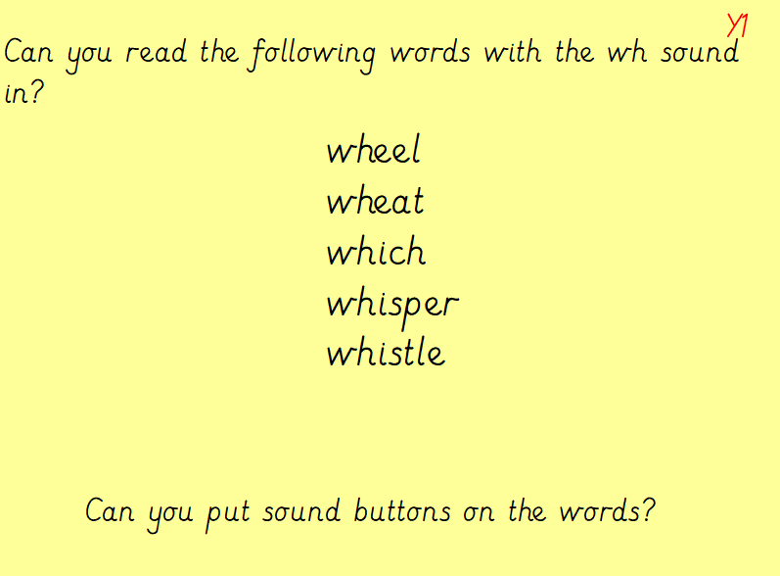

Slide 4
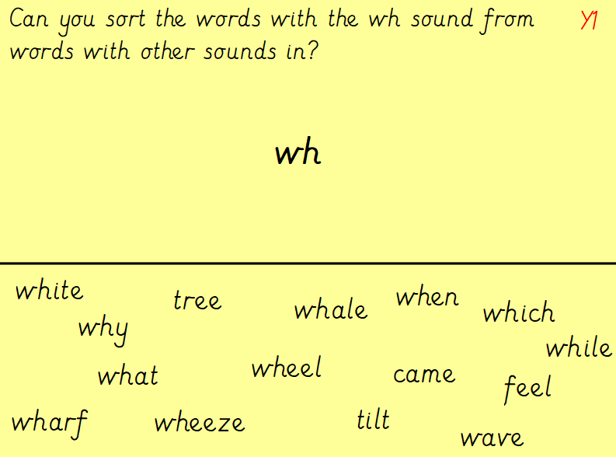

Slide 5
