Slide 1
Maths PowerPoint
WB 22.2.21

Slide 2
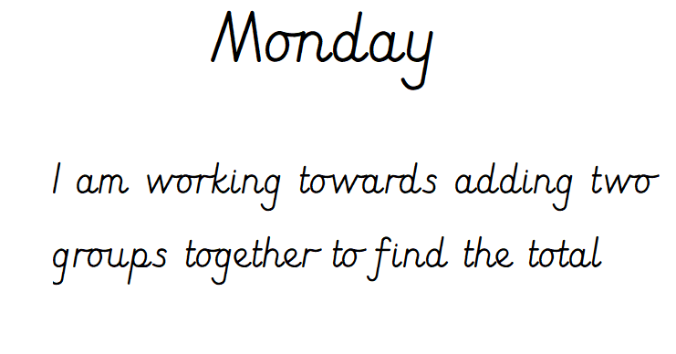

Slide 3
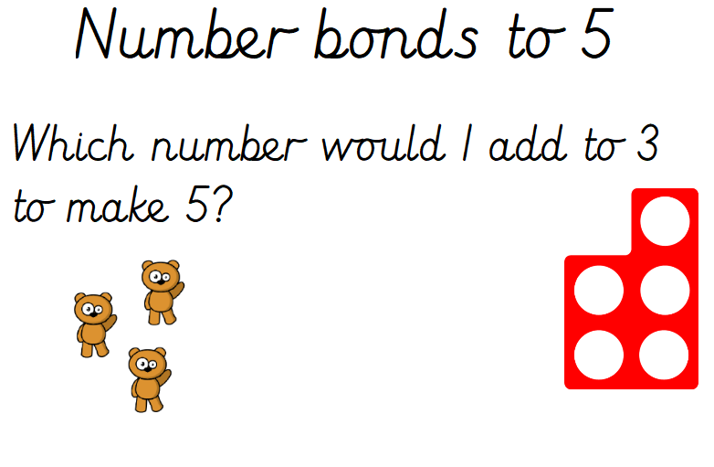
White rose starter

Slide 4
Starter
https://www.bbc.co.uk/teach/supermovers/ks1-maths-the-2-times-table-with-bridget-the-lioness/zrrx92p
Can you count in steps of two ?

Slide 5
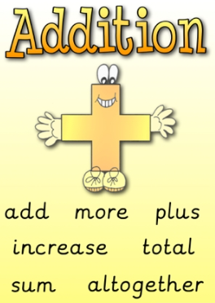
This week we are focusing on addition, adding, finding a total. Here are some words to help you when learning how to add.

Slide 6
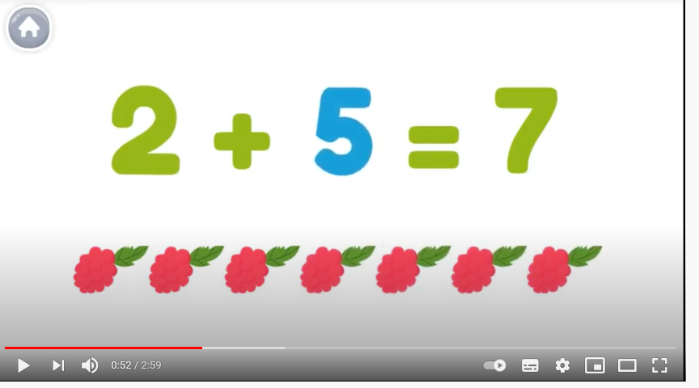
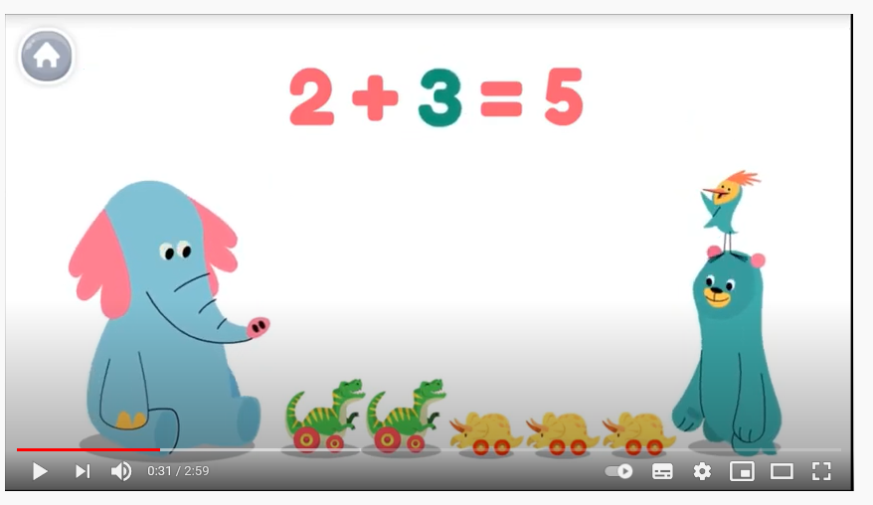
Watch the you tube clip to help you understand addition.
https://www.youtube.com/watch?v=GeCX_6xOCLQ

Slide 7
Main Input
What resources can you find around the house to help you find the answer to these questions.
2 + 1 =
2 + 2 =
4 + 1 =
3 + 2 =

Slide 8
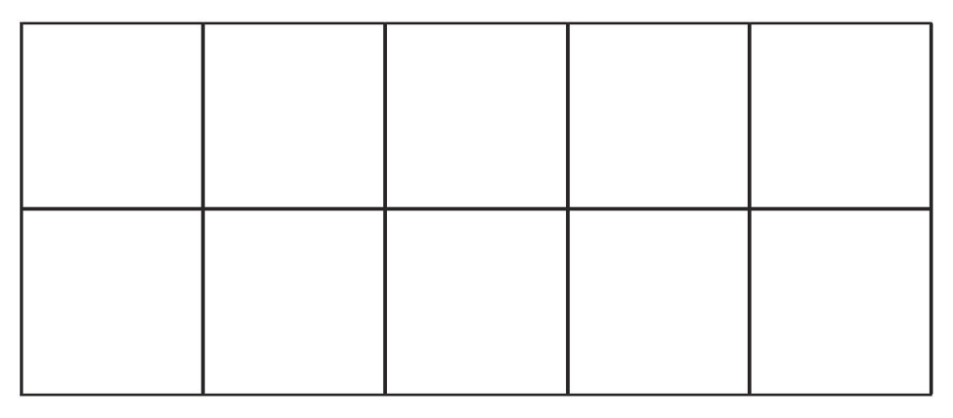

Main Activity
Today we will use a tens frames to help us work out the answer to these addition questions
2 + 1 =
3 + 2 =
4 + 1 =
2 + 2 =
4 + 2 =
3 + 3 =

