Slide 1
Writing
Friday 29th January 2021

Slide 2
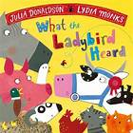
Today we are going to think about the end of the story.
https://www.youtube.com/watch?v=oTHkob841AE

Slide 3
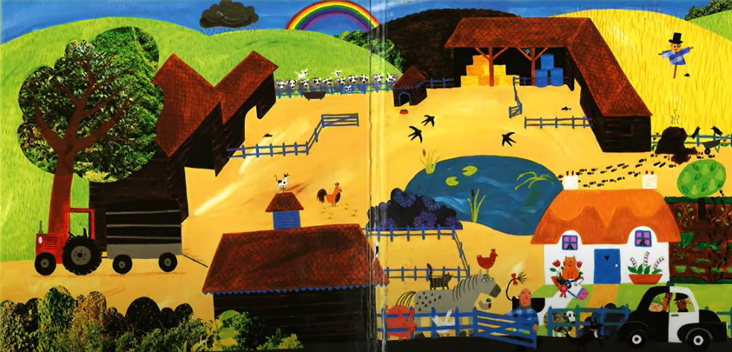
The ladybird managed to stop Hefty Hugh and Lanky Len from stealing the fine prize cow.
What do you think Hefty Hugh and Lanky Len should do?

Slide 4
Can you write a letter to the farmer from Lanky Len and Hefty Hugh? What do you think they might say?
What do we start a letter with?
What will you write in the letter?
How will you end your letter?

Slide 5
Main Activity:
Write a letter to the farmer to say sorry.
Remember to:
Sound out the words to spell using your phonic knowledge
Form your letters the correct way round
Write in sentences using capital letters, full stops and finger spaces.
Remember to start your letter with who it is to and end your letter with who it is from.

