Slide 1
Writing
Friday 4th February 2021

Slide 2
Today we are going to be thinking about what it is like to be a farmer.
What sort of jobs do you think a farmer has to do?

Slide 3
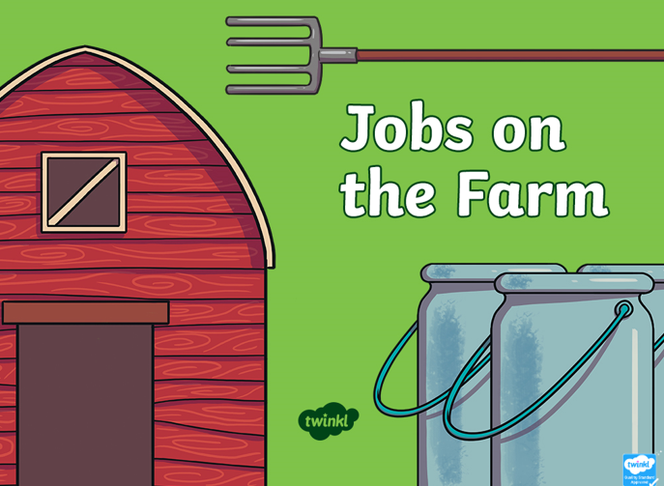
Find out about some of the jobs on the farm by looking at the PowerPoint.

Slide 4
Can you remember what the different jobs were?
Today we are going to write about the different jobs on a farm. You can write a list or some sentences to describe some of the jobs.

Slide 5
Main Activity:
Write a list or sentences to describe the different jobs that a farmer needs to do.
Remember to:
Sound out the words to spell using your phonic knowledge
Spell the words and, the and to correctly in your writing if you need them.
Form your letters the correct way round
Use a capital letter to start your sentences/each job on your list
Use a full stop at the end of every sentence
Use finger spaces between each word
Write each job on a new line if you are writing a list

