Slide 1
Writing
Friday 26th February 2021

Slide 2
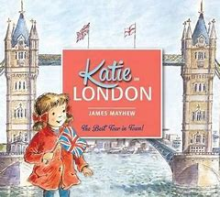
This week we have been reading the story ‘Katie in London’.
https://www.youtube.com/watch?v=5jv8RhfDwW0
In the story Katie went on a magical journey around London.

Slide 3
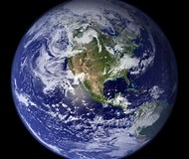
Where would you go on a journey if you could go anywhere in the world?

Slide 4
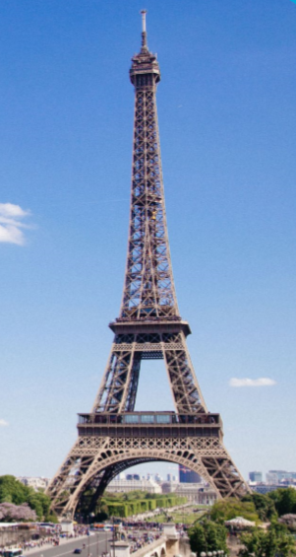
You might want to visit the Eiffel Tower in France…

Slide 5
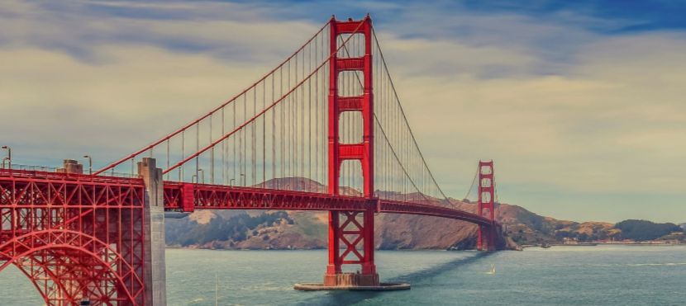
or the Golden Gate Bridge in the USA…

Slide 6
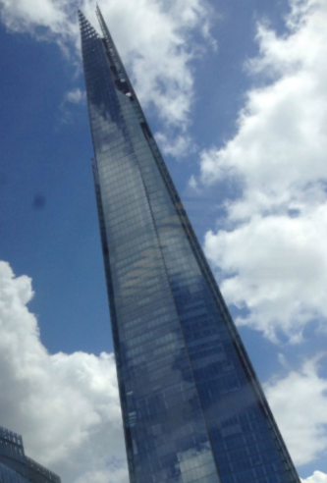
or the Shard in England…

Slide 7
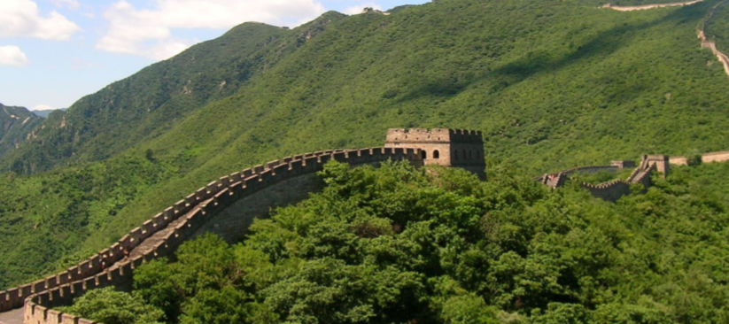
or the Great Wall of China …

Slide 8
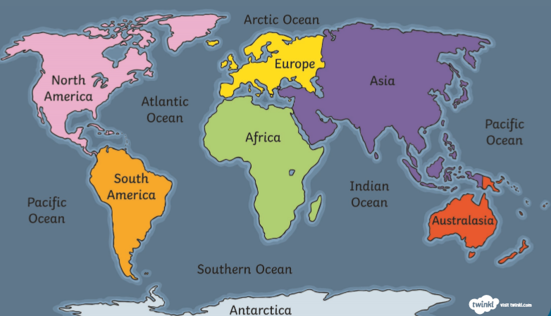
Where in the World would you go?

Slide 9
Where in the World would you go?
Today, we are going to write about where we would go on a magical journey.
I would go to Egypt to see the pyramids.

Slide 10
Main Activity:
Write about where you would go on a magical journey. You could draw a picture to show what you would do there.
Remember to:
Sound out the words to spell using your phonic knowledge
Spell your keywords correctly – the, to, no, go
Write in sentences using capital letters, finger spaces and full stops.
Think carefully about how you form your letters

