Slide 1
Writing
Friday 22nd January 2021

Slide 2
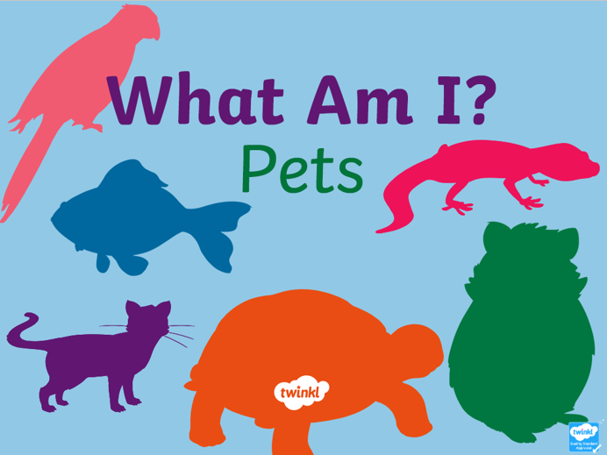
Complete the ‘What am I?’ Pets PowerPoint.
Listen to the clues. Can you guess what the animals are?

Slide 3
Choose at least one animal that you would like to describe. Write a set of clues for someone to guess what it is.
For example:
I am long.
I slither.
What am I?

Slide 4
Choose at least one animal that you would like to describe. Write a set of clues for someone to guess what it is.
Remember to:
Write in sentences
Use capital letters
Use finger spaces
Use full stops/question marks
Sound out words to spell
Spell the words and, to and the correctly (if you need them in your writing)

