Slide 1
Writing
Monday 18th January 2021

Slide 2
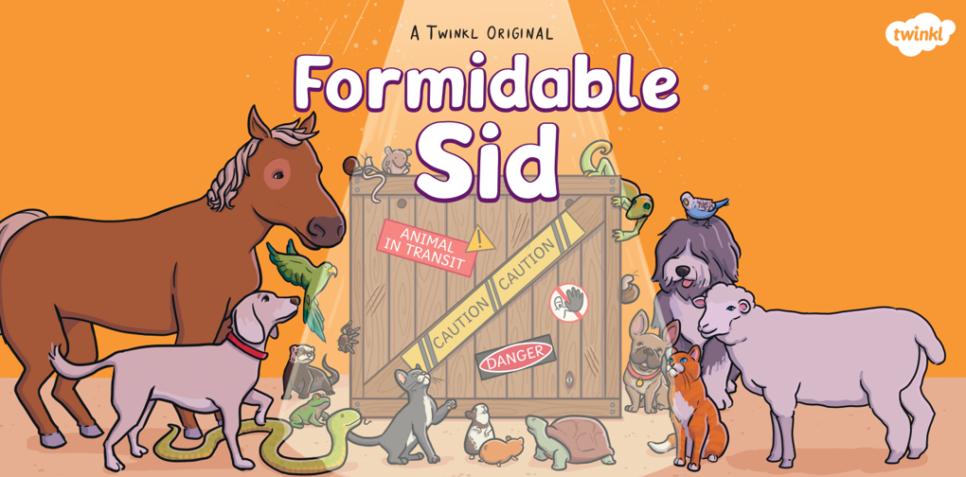
Read the Formidable Sid Power Point.

Slide 3
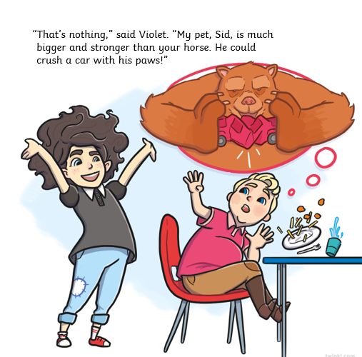
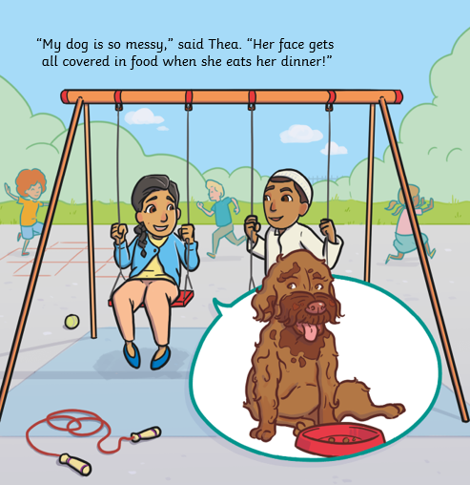
What happened in the story?
Was Sid as scary as Violet made out?
Can you remember any of the animals from the story?

Slide 4
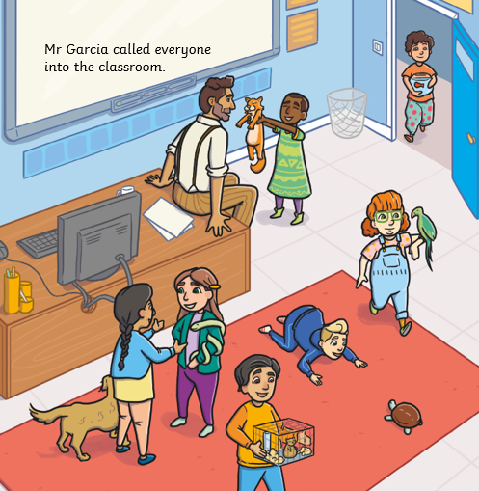
Can you name all of the animals on the picture?

Slide 5
Today we are going to write a list of all the animals in the story.
Remember to write each animal on a new line.
You need to sound out the words to spell.
Can you remember any of the other animals to add to the list?

