Slide 1
Writing
Monday 25th January 2021

Slide 2
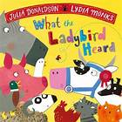
This week our work is based on ‘What the Ladybird Heard’ by Julia Donaldson.
The story is set on the farm. What animals do you think might be in the story?

Slide 3
Click on the link to hear the story being read online.
https://www.youtube.com/watch?v=oTHkob841AE

Slide 4
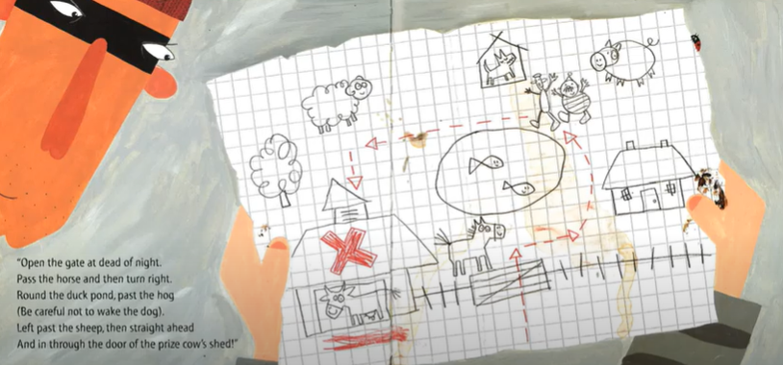
What did Hefty Hugh and Lanky Len use to help find their way around the farm?

Slide 5
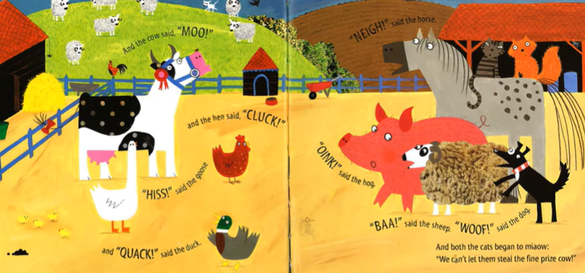
We are going to draw our own maps of the farm.
What animals were in the story? Can you remember where they lived?

Slide 6
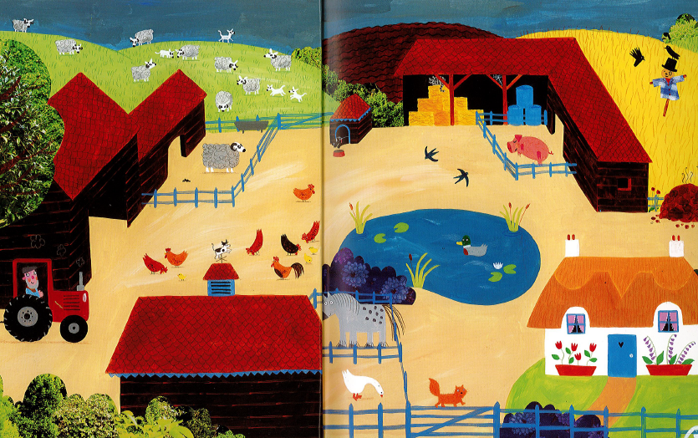
Can you label the picture?
pig

Slide 7
Main Activity:
Draw and label a map of the farm. You might want to make your farm the same as the one from the story or you might want to make your own.
Remember to:
Sound out the words to spell using your phonic knowledge
Form your letters the correct way round

