Slide 1
Writing
Monday 1st February 2021

Slide 2
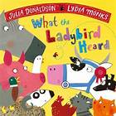
Last week we read ‘What the Ladybird Heard’ by Julia Donaldson.
Can you remember where the story was set?
The story is set on the farm. What animals do you think might be in the story?

Slide 3
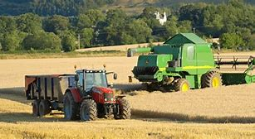
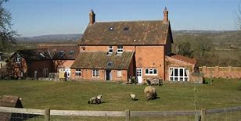
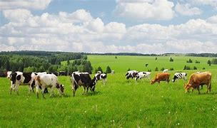
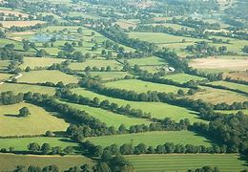
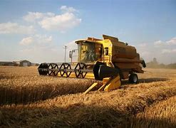
The story was set on the farm. What do you know about farms?

Slide 4
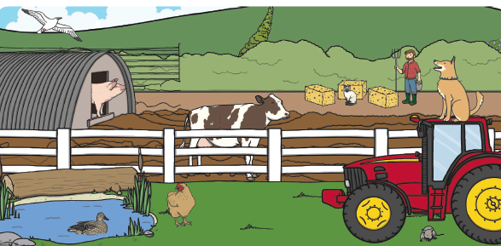
Look at the picture of the farm. What can you see?

Slide 5
Today we are going to write in sentences to describe what we can see on the picture

Slide 6
What is wrong with my sentence?
i can sEe a DUCK in. the pond

Slide 7
Did you spot the mistakes?
i can sEe a DUCK in. the pond
I can see a duck in the pond.

Slide 8
Can you think of your own sentences?

Slide 9
Main Activity:
Write a list or set of sentences to describe what you can see on the picture of the farm.
Remember to:
Sound out the words to spell using your phonic knowledge
Spell the words and, the and to correctly in your writing if you need them.
Form your letters the correct way round
Use a capital letter to start your sentences
Use a full stop at the end of every sentence
Use finger spaces between each word

