Slide 1
Writing
Monday 8th February 2021

Slide 2
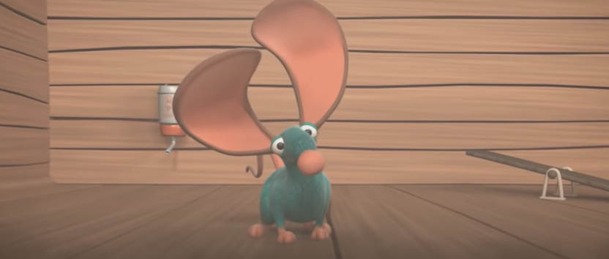
This week our work is based on the short video ‘Mouse for Sale’.
https://www.youtube.com/watch?v=OzYwE3Tst1Y&feature=emb_title

Slide 3
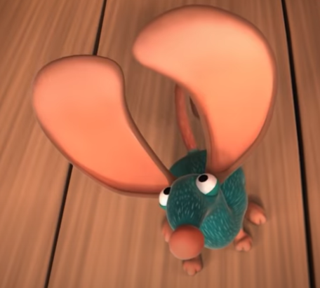
Snickers the mouse wanted someone to buy him. Today we are going to make a ‘For Sale’ poster for Snickers.
Can you describe Snickers?

Slide 4
For Sale
Big Ears
Round Nose
Snickers is a fun mouse who wants a new home. He has big ears and a round nose.

Slide 5
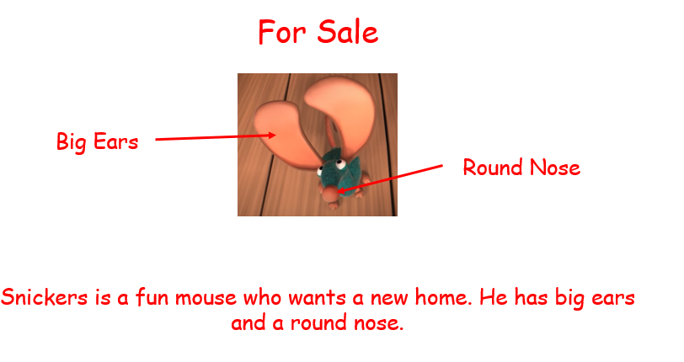
Your poster needs to have:
A title
A picture of the mouse
Labels and/or a description

Slide 6
Main Activity:
Main Activity: Make a ‘For Sale’ poster for Snickers the Mouse – what would you say to persuade people to buy him?
Remember to:
- Sound out the words to spell using your phonic knowledge
Spell the words and, the and to correctly in your writing if you need them.
Form your letters the correct way round
Include a heading
Draw a picture
If you are writing in sentences you will need a capital letter to start your sentence, finger spaces between each word and full stops at the end of every sentence.

