Slide 1
Writing
Monday 1st March 2021

Slide 2
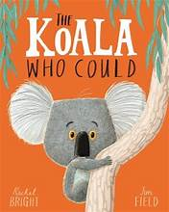
Tomorrow we are going to read the book
‘The Koala who could’.
What can you see?
What is the Koala holding?
Where do you think the story is set?

Slide 3
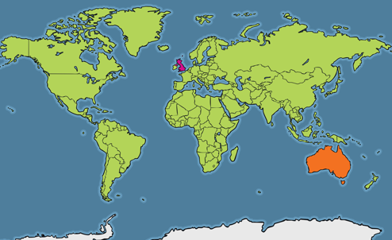
The story is set in Australia.
Where is the United Kingdom?
Where is Australia?

Slide 4
The story is set in Australia.
Where is the United Kingdom?
Where is Australia?

Slide 5
Today we are going to find out about Australia.

Slide 6
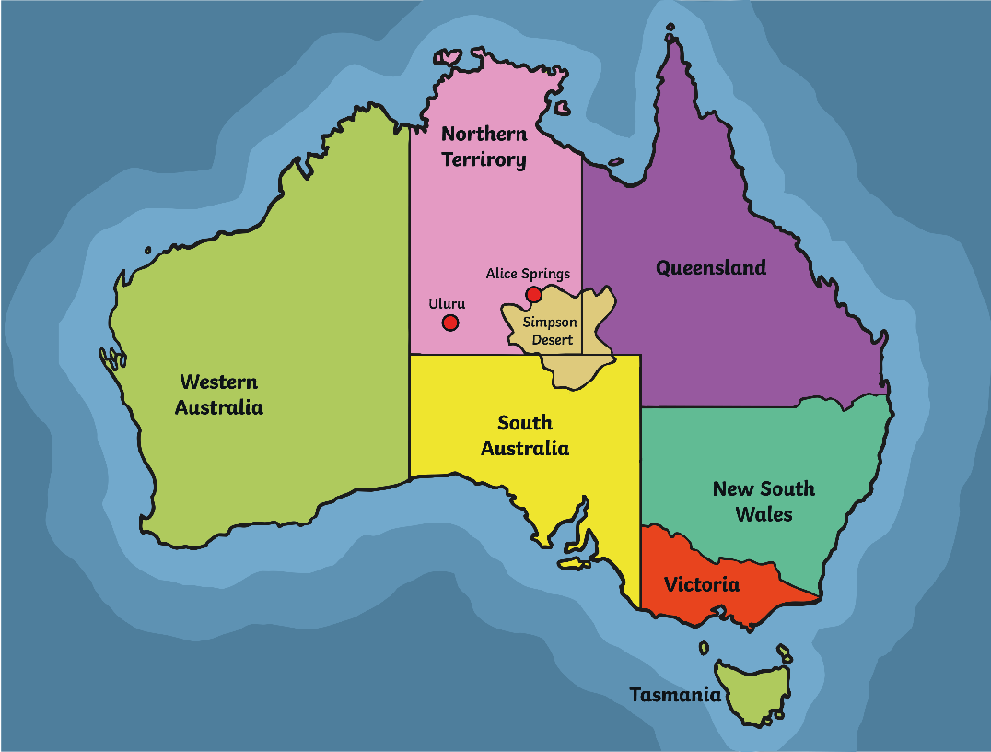
Australia is the world's sixth largest country.
Around 24 million people live in Australia, which is not that many considering how large it is! By comparison, 65 million people live in the United Kingdom.
However, you could fit the United Kingdom into Australia 22 times!

Slide 7
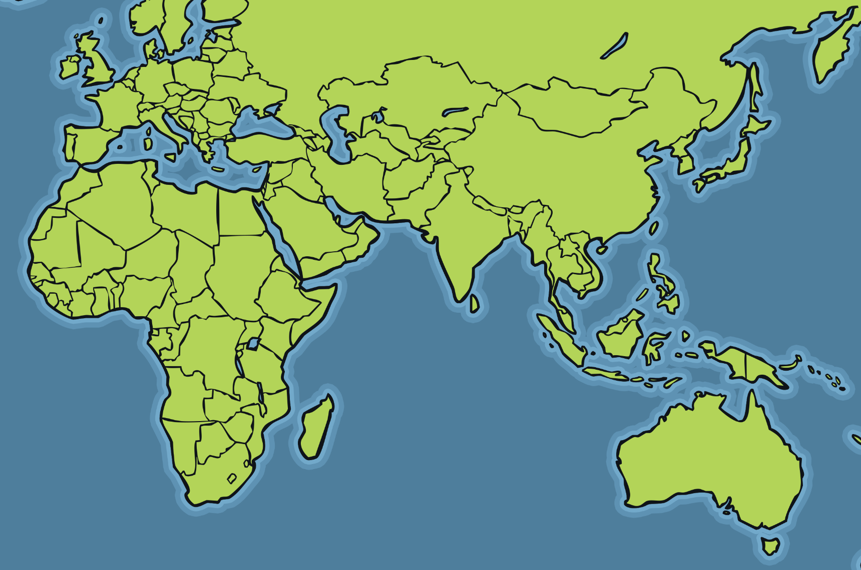
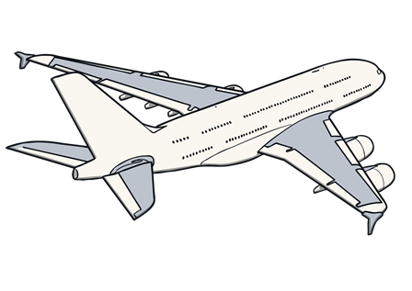
Today we are going to find out about Australia.
London
The name Australia means ‘south’. It is in the southern part (hemisphere’ of the world.
8988 miles
It would take you almost a whole day to fly from the United Kingdom to Australia.
Perth

Slide 8
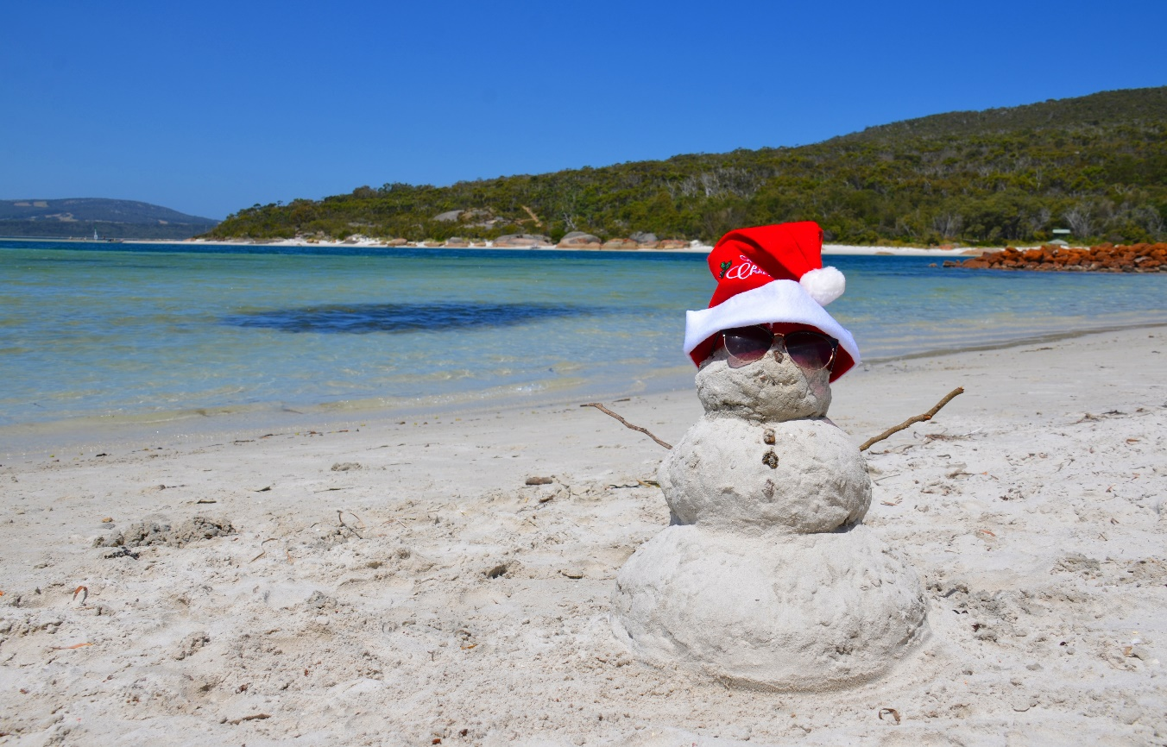
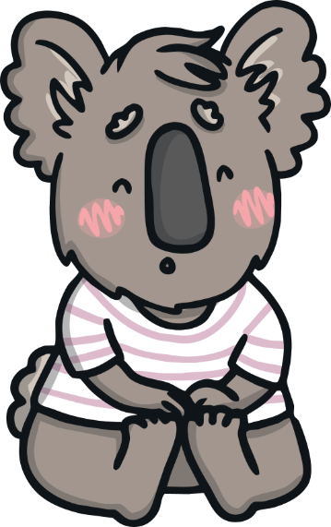
Australia’s seasons are the opposite to the seasons in the United Kingdom. When the UK is in winter, Australia is in their summer and when the UK is in summer, Australia is in their winter.
Mostly, summertime is very hot and dry.
Summer lasts from December to March.
People celebrate Christmas on the beach!

Slide 9
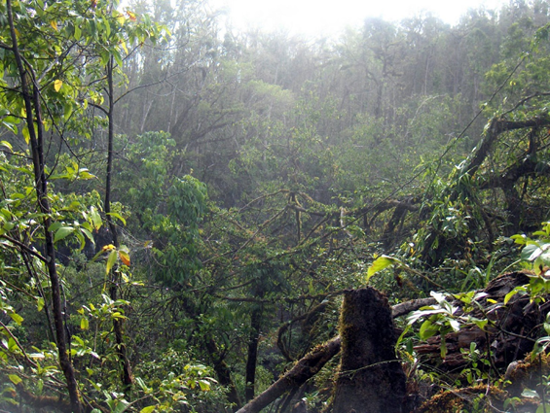
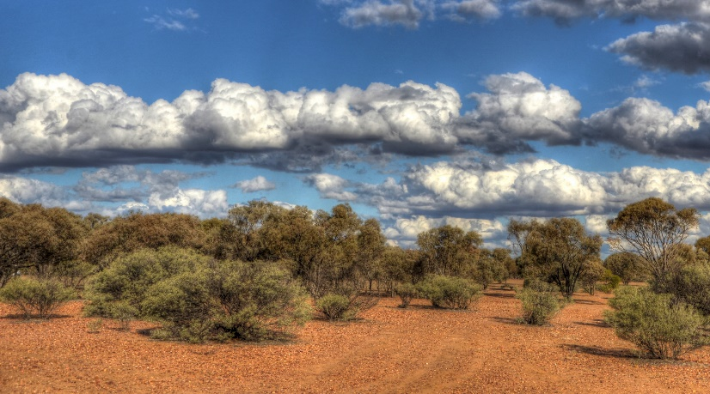
Most of Australia is made up of desert, called the Outback.
Temperatures in the Outback range from as high as 50°C on summer days, to -10°C during winter nights.
Australia also has rainforests.

Slide 10
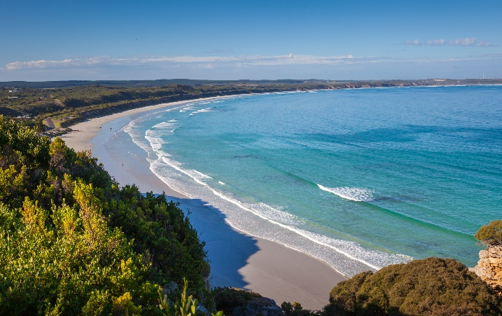
Most of Australia is made up of desert, called the Outback.
Temperatures in the Outback range from as high as 50°C on summer days, to -10°C during winter nights.
Australia is an island. It has coastline all around it and beautiful beaches.

Slide 11
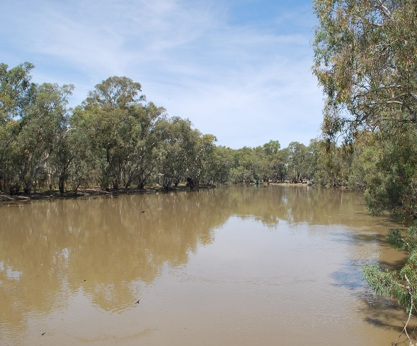
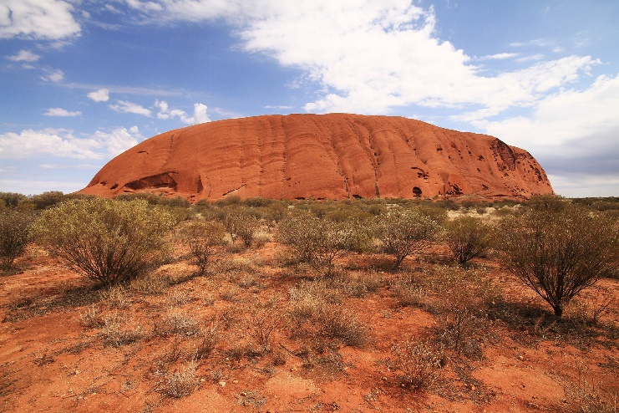
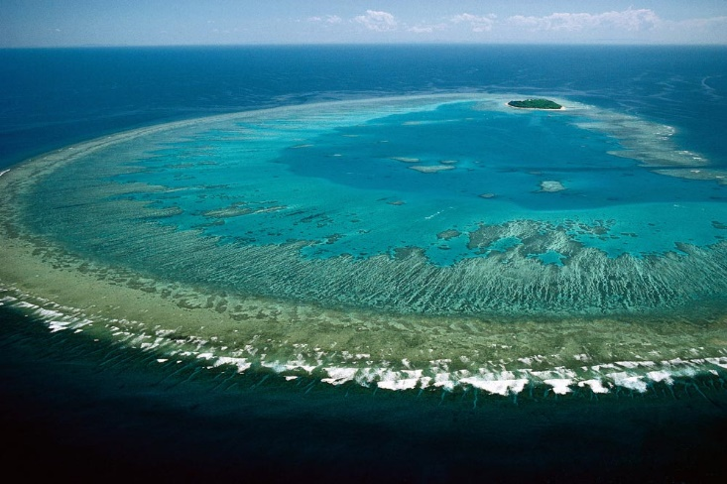
The Murray River is the longest river in Australia. It is 1558 miles long!
Ayers Rock is located in the centre of Australia. It is 348 metres high and over 600 million years old!
The Great Barrier Reef is the biggest coral reef in the world.
It is 1400 miles long and is home to more than 1500 species of fish!

Slide 12
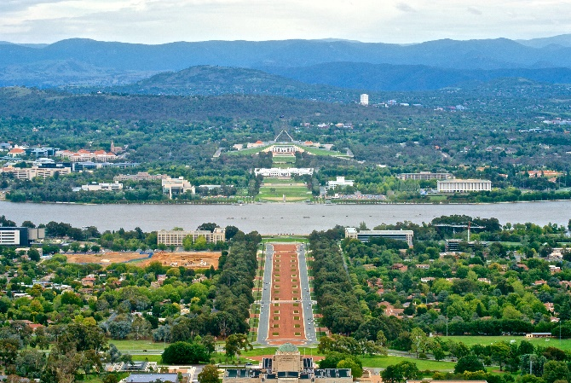
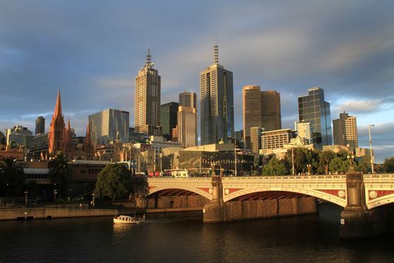
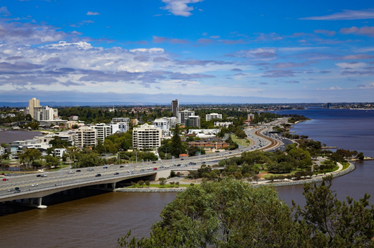
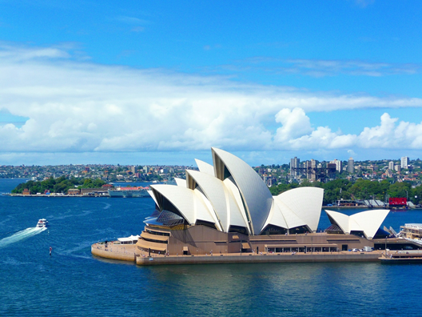
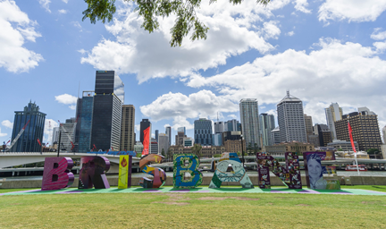
Canberra is the capital city of Australia.
There are also lots of other big cities, such as Sydney, Melbourne, Perth and Brisbane.
Canberra
Photo courtesy of Jason Tong (@wikimedia.org) - granted under creative commons licence – attribution
Melbourne
Perth
Sydney
Brisbane
Photo courtesy of Lenny K Photography (@flickr.com) - granted under creative commons licence – attribution

Slide 13
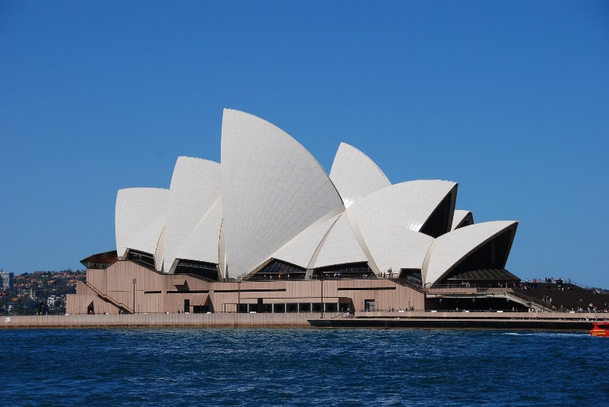
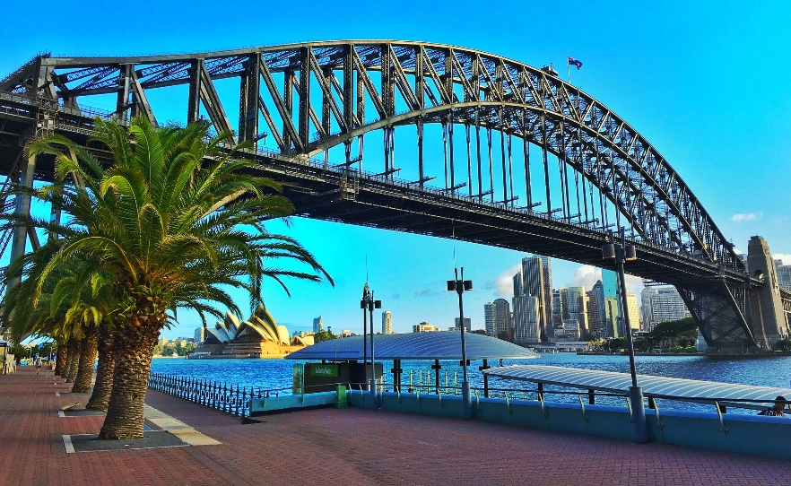
Sydney is the oldest city in Australia.
It is famous for one of the most recognisable landmarks in the world; the Sydney Opera House.
The Sydney Harbour Bridge is also very famous.

Slide 14
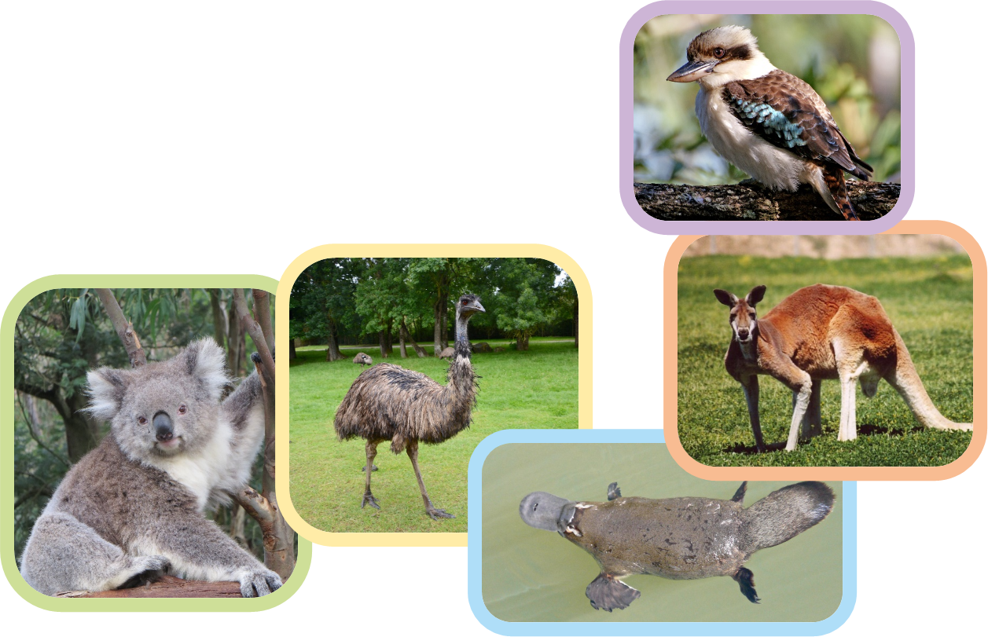
Australia has lots of unique wildlife. Some cannot be found naturally anywhere else in the world!
These include koalas, kangaroos, kookaburras, emus and platypuses.

Slide 15
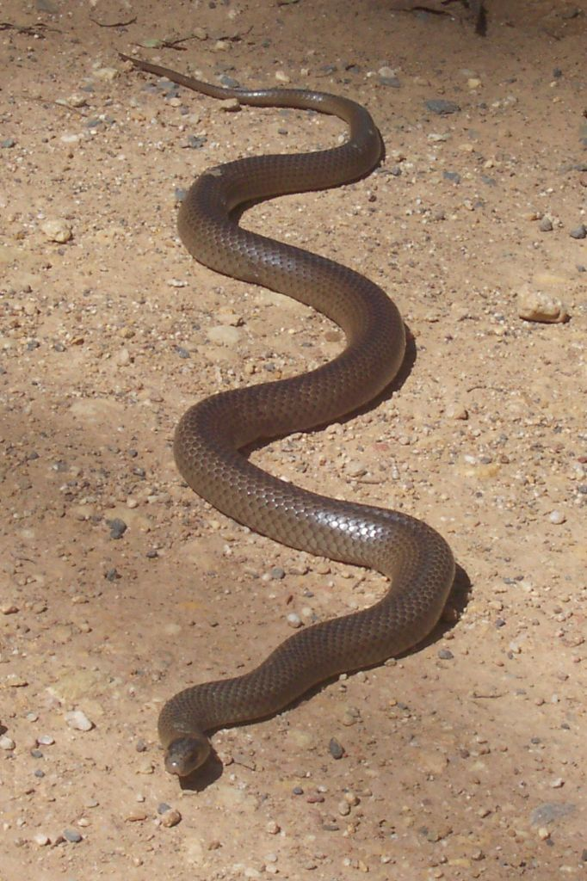
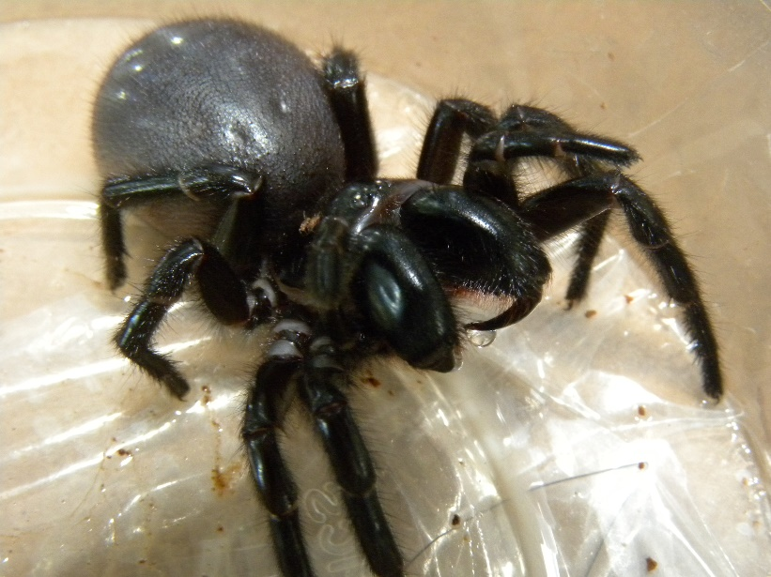
Australia is also home to lots of dangerous creatures, such as venomous snakes and spiders!
Sydney funnel web spider
Photo courtesy of Alan Couch (@flickr.com) - granted under creative commons licence – attribution
eastern brown snake

Slide 16
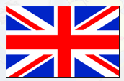
Main Activity:
Main Activity: Write some facts about Australia.
Remember to:
Sound out the words to spell using your phonic knowledge
Write your keywords correctly
Write in sentences using capital letters, finger spaces and full stops.

