Slide 1
Writing
Thursday 11th February 2021

Slide 2
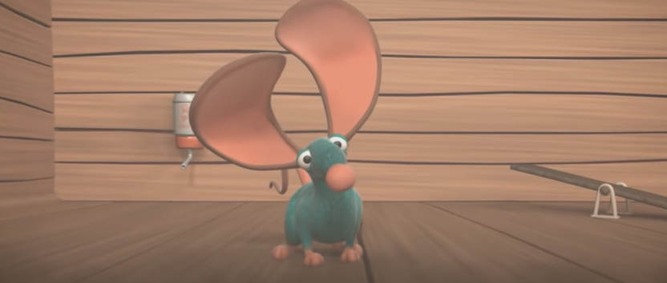
This week we have been thinking about the story ‘Mouse for Sale’.
https://www.youtube.com/watch?v=OzYwE3Tst1Y&feature=emb_title

Slide 3
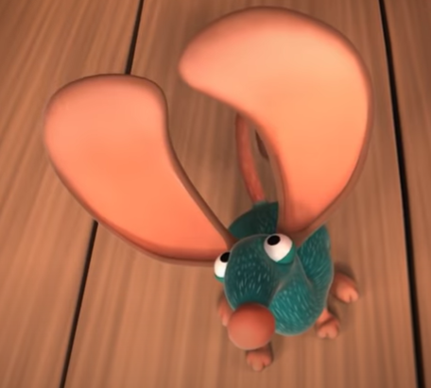
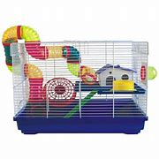
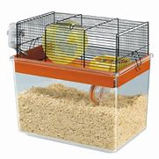
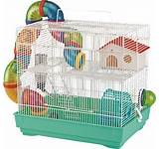
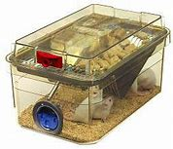
Today we are going to think about Snicker’s home.
What do you think his new home should be like?

Slide 4
Main Activity:
Design or make a model of a home for a pet mouse. You can draw and label a picture of your house or you could take a video of you showing your model and describing it.

