Slide 1
Writing
Thursday 25th February 2021

Slide 2
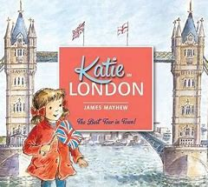
This week we have been reading the story ‘Katie in London’.
https://www.youtube.com/watch?v=5jv8RhfDwW0
In the story Katie visited Buckingham Palace – can you remember who lives there?

Slide 3
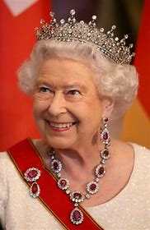
Queen Elizabeth II
Elizabeth was born on 21st April 1926 as Princess Elizabeth.
She was taught privately at home, not at school.
She married the Duke of Edinburgh on 20th November 1947 in Westminster Abbey.

Slide 4
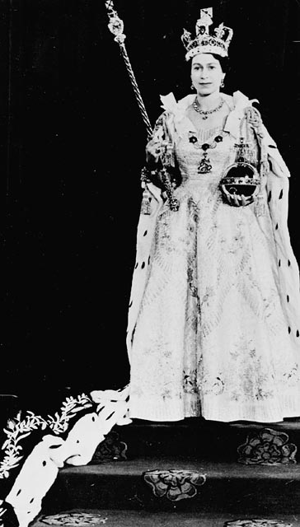
Princess Elizabeth becomes Queen Elizabeth II
In 1952, when she was 25, Elizabeth’s father King George VI died.
She became queen on 6th February 1952 and was crowned on 2nd June 1953.

Slide 5
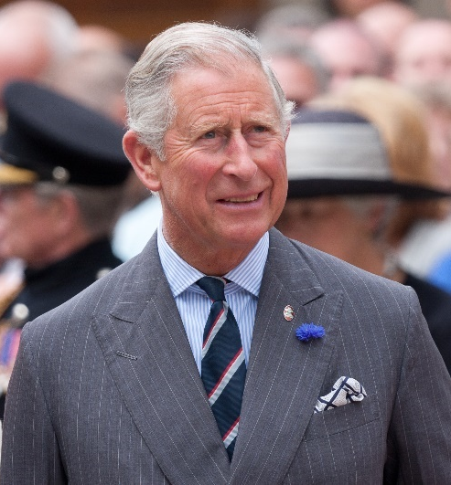
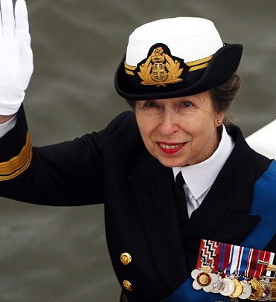
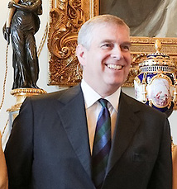
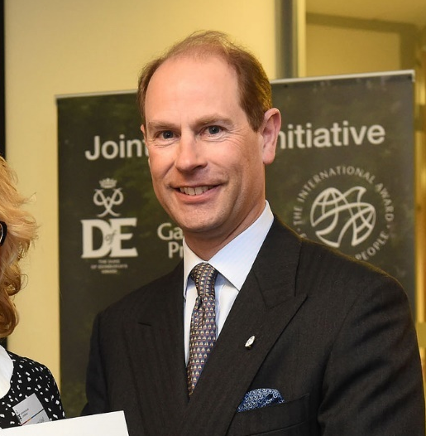
The Royal Family
Queen Elizabeth II and Philip, Duke of Edinburgh have four children:
In 1948, the Queen's first child Prince Charles was born – Prince of Wales.
In 1950, Princess Anne was born – Princess Royal.
In 1960, Prince Andrew was born – Duke of York.
In 1964, Prince Edward was born – Earl of Wessex.

Slide 6
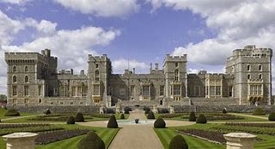
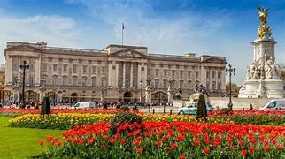
The Queen’s Homes
Her Majesty's official residence in London is Buckingham Palace.
She also spends lots of time at Windsor Castle.

Slide 7
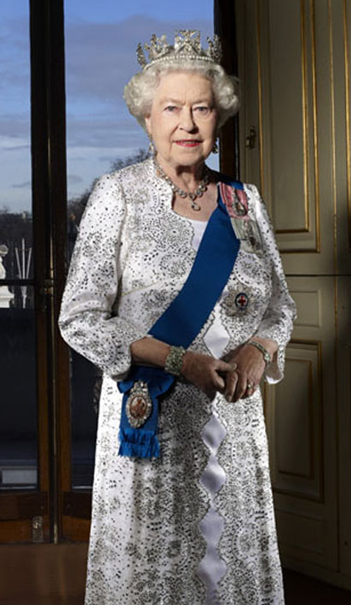
Fun Facts about the Queen
Her Majesty Queen Elizabeth II has served for 69 years and is the longest-reigning monarch. This means she has been Queen for the longest amount of time.
She has nine thrones!
She has ‘sat’ for her portrait to be painted over 130 times!
She sends telegrams to congratulate people who reach the age of 100.
Corgis are her favourite dogs.

Slide 8
Main Activity:
Draw a picture and write a fact about the Queen.
Remember to:
Sound out the words to spell using your phonic knowledge
Spell your keywords correctly – the, to, no, go
Write in sentences using capital letters, finger spaces and full stops.
Think carefully about how you form your letters

