Slide 1
Writing
Thursday 21st January 2021

Slide 2
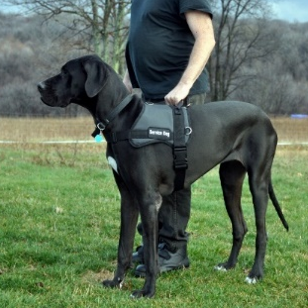
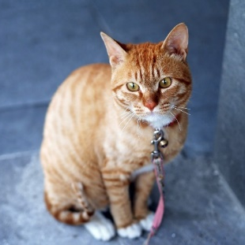
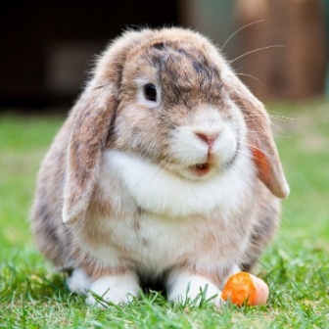
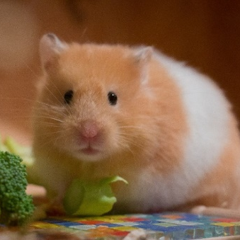
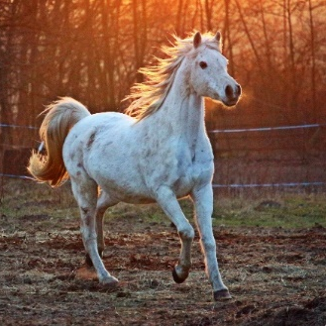
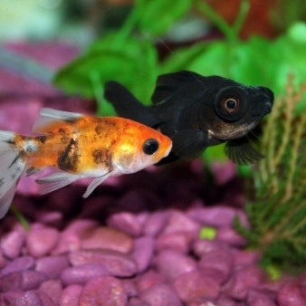
Today we are going to be finding out some facts about different pets.
How can we find out information about pets?

Slide 3
We can:
Read information (non-fiction) books
Ask an expert
Research on the internet

Slide 4
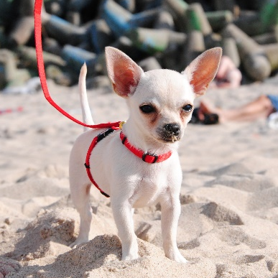

Dogs
There are lots of different types of dogs in the world! They range from very small, like a Chihuahua…
to very big, like a Great Dane!
Dogs take lots of time and patience to train and look after. They need lots of walks and exercise, and lots of toys to keep them from getting bored. Most dogs are very friendly and like to be around people.
Would you like to have a pet dog?

Slide 5

Cats
Cats are usually quiet pets. They love to play with toys. Cats like to be stroked but you need to be gentle with them.
Cats like to have lots of space so some people let their cats out of their house to go outside on their own.
Cats mostly eat dry or wet food which is made of meat.
Would you like to have a pet cat?

Slide 6
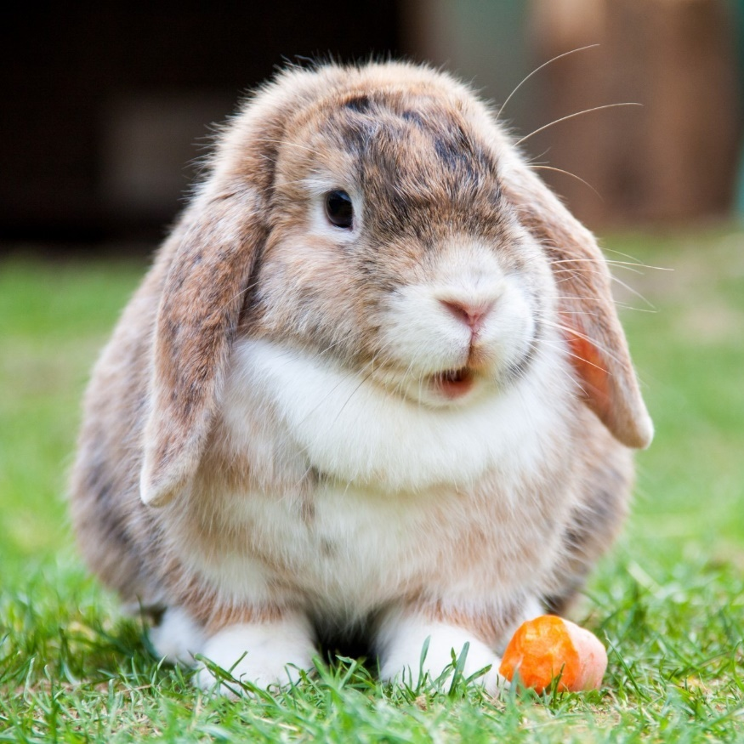
Rabbits
Rabbits are very popular pets. Many rabbits like to be stroked and some will let you pick them up. They like being with other rabbits so it’s best to keep two rabbits together in the same hutch.
They need lots of space to hop around and stretch out. Some people let their rabbits out in their garden. Rabbits like lots of fresh vegetables to eat, such as cabbage and broccoli.
Would you like to have a pet rabbit?

Slide 7

Hamsters
Hamsters are small animals. They are usually kept in a cage with sawdust and hay for their bed. Some hamster cages have tunnels and wheels for the hamster to run around in. This helps to stop them getting bored.
Hamsters like to eat seeds, cereals and fresh fruits, such as apples. They often keep their food in ‘pouches’ in their cheeks so they can move it from place to place.
Would you like to have a pet hamster?

Slide 8

Horses
Horses need lots of special care. They are big animals so they need lots of space to rest and run around in.
Horses are usually kept in special homes outside called stables. Horses need to be groomed regularly and checked to make sure they stay healthy, especially their hooves.
Horses eat mostly grass and hay. They can also eat some fruits and vegetables as snacks, such as apples and carrots.
Would you like to have a pet horse?

Slide 9
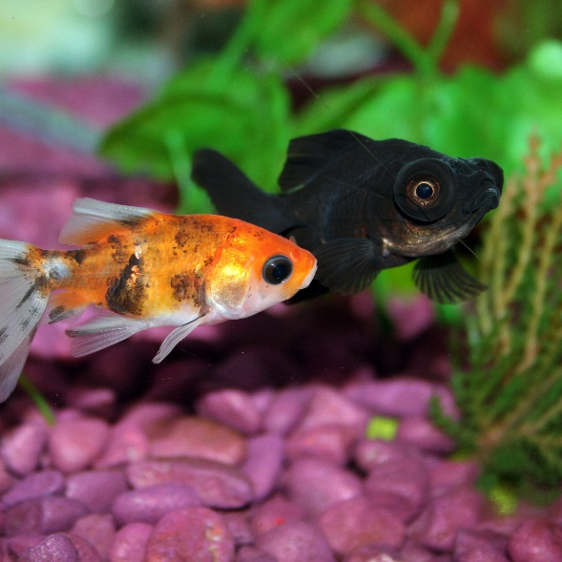
Fish
Fish are very popular pets. They are good for people who don’t have enough space at home to have bigger pets, such as dogs and cats.
Fish need to be kept in a tank called an aquarium. The tanks need to be cleaned often so that the water stays fresh and the fish stay healthy. Some fish, such as tropical fish, need a special heater in their tank to keep the water warm. They may also need salt water, rather than fresh water.
Fish eat special flakes or pellets you can buy from pet shops.
Would you like to have a pet fish?

Slide 10
What did you find out about the different pets?

Slide 11
Choose one of the animals to write some facts about.
Remember to:
Write in sentences
Use capital letters
Use finger spaces
Use full stops
Sound out words to spell
Spell the words and, to and the correctly (if you need them in your writing)

