Slide 1
Writing
Tuesday 26th January 2021

Slide 2
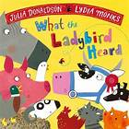
Today we are going to be thinking about the different characters in the story.
Listen to the story again and think about what the characters might say and do.
https://www.youtube.com/watch?v=oTHkob841AE

Slide 3
Can you think of the different characters in the story?

Slide 4
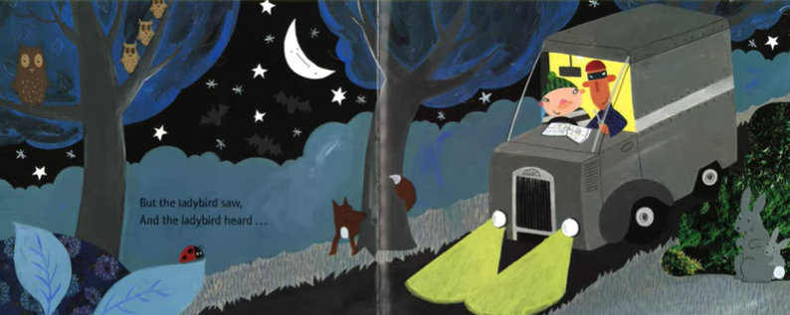
At the beginning of story the ladybird heard and saw Lanky Len and Hefty Hugh in the van. What do you think the ladybird might say to them?
We can use speech bubbles to show what a character is saying.

Slide 5
I will stop you from stealing the cow!

Slide 6
Main Activity:
Write a speech bubble for a character in the story. You can choose the character that you would like.
Remember to:
Sound out the words to spell using your phonic knowledge
Form your letters the correct way round
Use capital letters, finger spaces and full stops

