Slide 1
Writing
Tuesday 9th January 2021

Slide 2
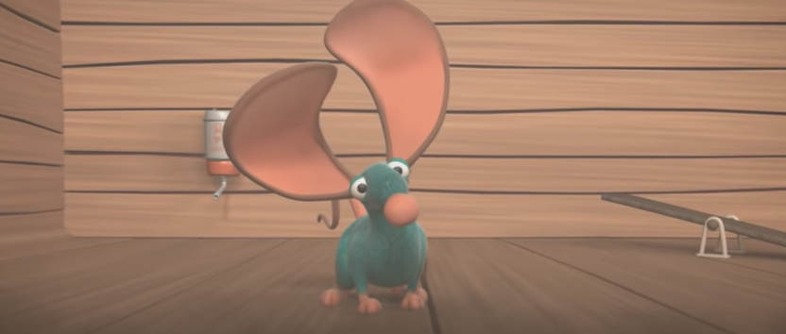
In the story yesterday, Snickers the mouse was trying to get the boys attention.
https://www.youtube.com/watch?v=OzYwE3Tst1Y&feature=emb_title

Slide 3
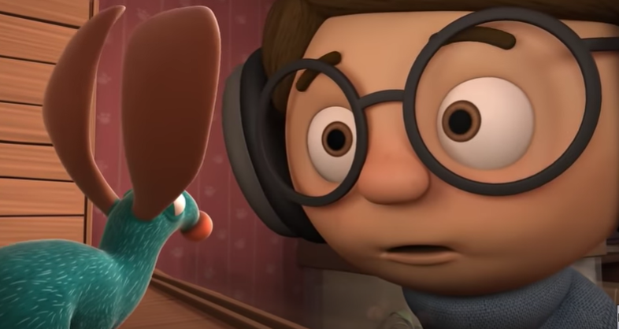
Today we are going to think about what the mouse might say.

Slide 4
Can you write a speech bubble?

Slide 5
Main Activity:
What do you think Snickers the mouse might say? Can you write a speech bubble?
Remember to:
Sound out the words to spell using your phonic knowledge
Form your letters the correct way round
Use capital letters, finger spaces and full stops

