Slide 1
Writing
Tuesday 23rd February 2021

Slide 2
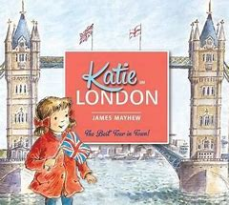
Yesterday, we read the story ‘Katie in London’.
https://www.youtube.com/watch?v=5jv8RhfDwW0
Can you remember some of the places that Katie visited?

Slide 3
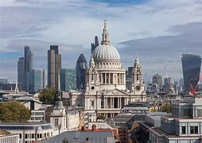
Can you remember what this landmark was called?

Slide 4
St. Paul’s Cathedral
St Paul’s Cathedral is one of the largest churches in the world.
It was built after a big fire in London called ‘The Great Fire of London’.

Slide 5
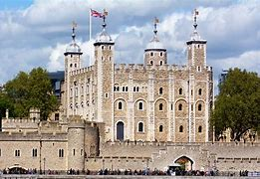
Can you remember what this landmark was called?

Slide 6
Tower of London
The Tower of London is a Castle in London. It has been a home for Kings and Queens and has also been a prison!
The crown jewels are kept in the Tower of London.

Slide 7
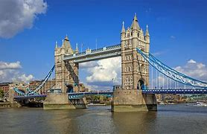
Can you remember what this landmark was called?

Slide 8
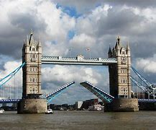
Tower Bridge
Tower Bridge was built to make it easier for people to cross the River Thames. It has two towers. It can be lifted to allow river traffic to pass.

Slide 9
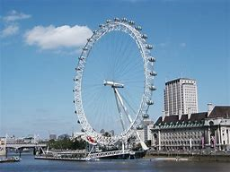
Can you remember what this landmark was called?

Slide 10
The London Eye
The London Eye is 135 meters high. It takes 30 minutes for the wheel to go all of the way round. The wheel has 32 capsules.

Slide 11
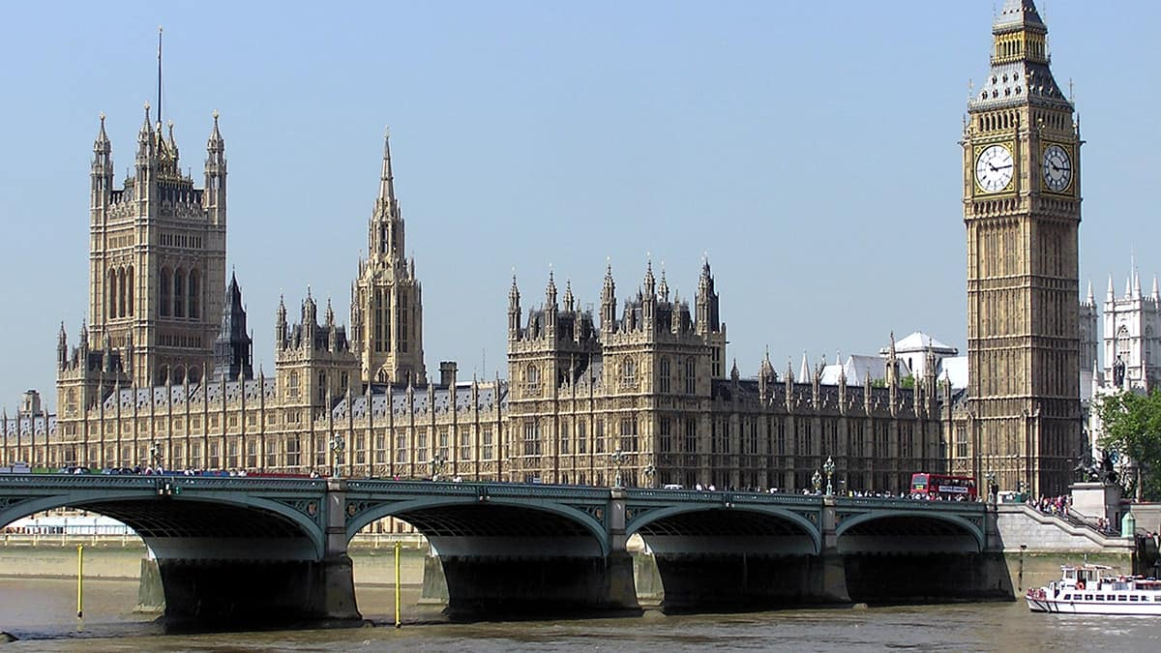
Can you remember what this landmark was called?

Slide 12
The Houses of Parliament
The Houses of Parliament are some of the most important buildings in the United Kingdom. It is where the decisions are made on how to run the county. It also has the Elizabeth Tower which contains the famous bell – Big Ben!

Slide 13
Main Activity:
Draw a plan of one of the buildings in London that Katie visited. Remember to label your plan. You might want to build a model of the building that you have chosen.
Remember to:
Sound out the words to spell using your phonic knowledge
Think carefully about how you form your letters

