Slide 1
Writing
Tuesday 19th January 2021

Slide 2
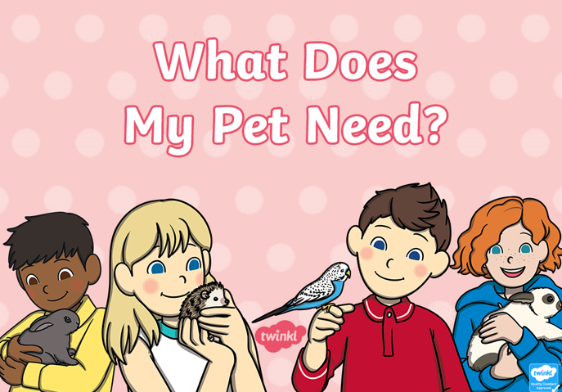
Today we are going to be thinking about what different animals need.
Work through the ‘What does my pets need?’ PowerPoint to identify the things that the different pets need.

Slide 3
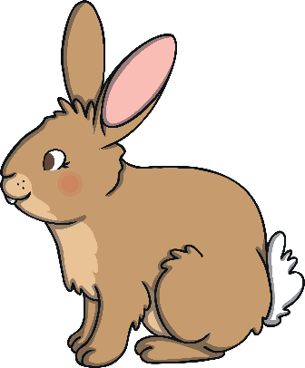
What different things do you think you would need if you had a pet rabbit?

Slide 4
We have written a list of things that a rabbit might need.
Can you spot the mistakes that we have made?
Hutch
hay
Water bottle Food bowl
ToYS

Slide 5
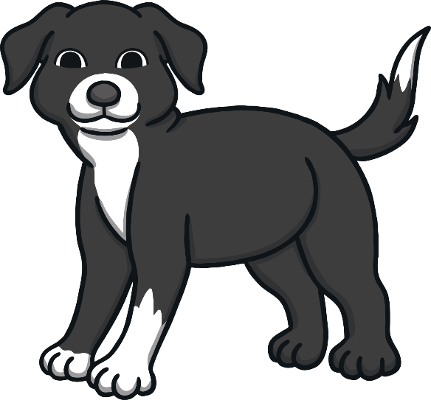
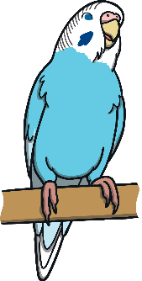
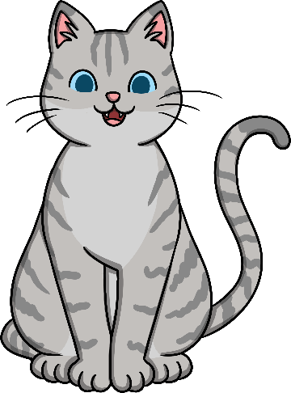


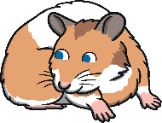
Choose at least two animals to write a list of things that they would need if you had them as a pet.
You might want to choose animals from one of the pictures below or you might want to think of your own.

