Slide 1
Writing
Tuesday 2nd February 2021

Slide 2
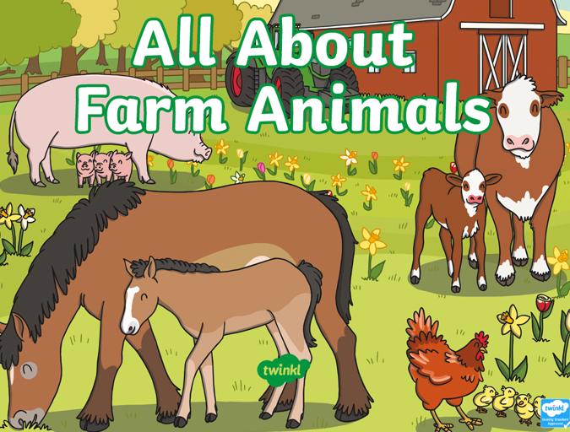
Today we are going to find out about farm animals.
Work through the ‘All About Farm Animals’ PowerPoint to find out some farm animal facts.

Slide 3
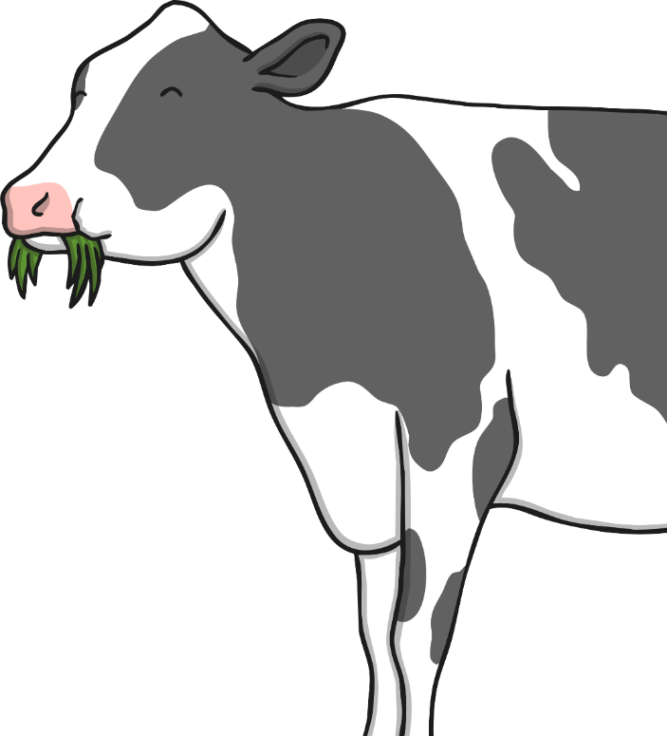
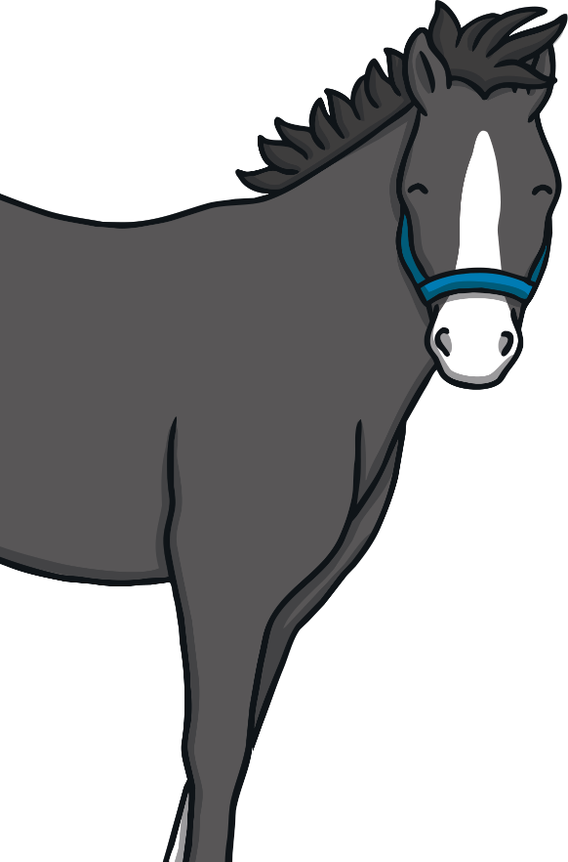
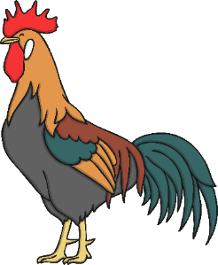
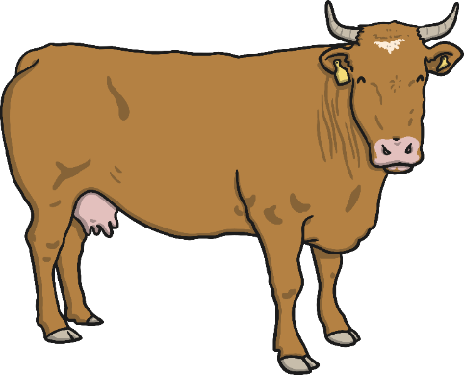
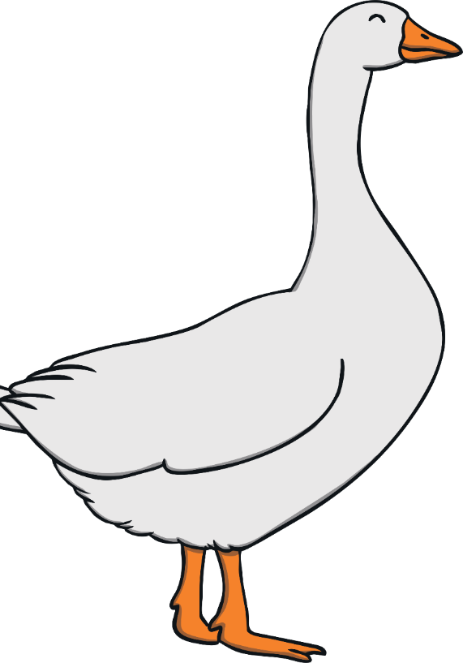
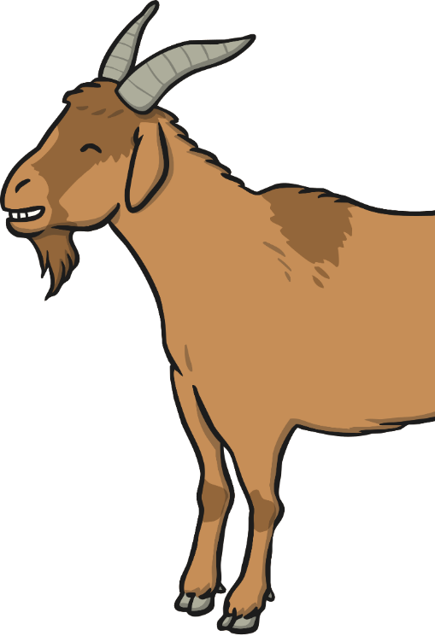
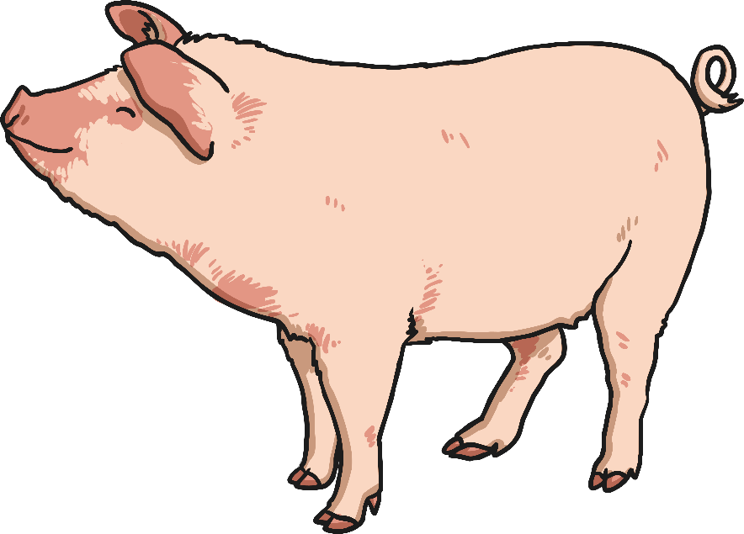
In the PowerPoint we found out about the following animals.
Can you remember some of the facts?

Slide 4
We are going to write some of the facts down.
Pigs like to roll in the mud to keep cool.
Can you think of any other facts?

Slide 5
Main Activity:
Choose one of the animals that we have learnt about today and write some facts about them.
Remember to:
Sound out the words to spell using your phonic knowledge
Spell the words and, the and to correctly in your writing if you need them.
Form your letters the correct way round
Use a capital letter to start your sentences
Use a full stop at the end of every sentence
Use finger spaces between each word

