Slide 1
Writing
Wednesday 27th January 2021

Slide 2
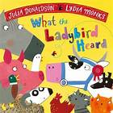
Today we are thinking about Hefty Hugh and Lanky Len from
‘What the Ladybird Heard’ by Julia Donaldson.
https://www.youtube.com/watch?v=oTHkob841AE

Slide 3
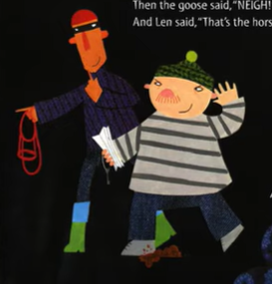
Can you think of words to describe the characters?
What do they look like? What type of person are they?
Hefty Hugh
Tall
Blue top
Lanky Len
Short
Sneaky

Slide 4
Main Activity:
Write a list of words to describe Hefty Hugh and Lanky Len. You can write about what the characters look like, what they are wearing, what type of person they are …
Remember to:
Sound out the words to spell using your phonic knowledge
Form your letters the correct way round

