Slide 1
Writing
Wednesday 3rd February 2021

Slide 2
Today we are going to make and describe a farm animal.
What animals might you see on the farm?

Slide 3
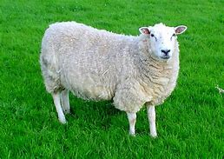
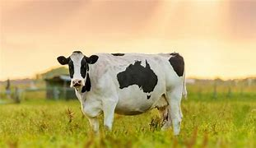
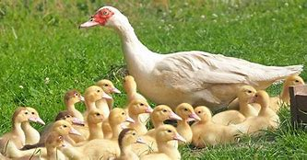
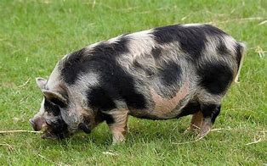
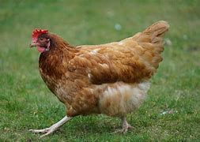
Here are some of the animals that you might find:

Slide 4
Create a picture or model of your favourite farm animal.

Slide 5
Main Activity:
Create a picture or model of a farm animal. Can you write about your animal? Complete a piece of writing to go with your work. You might want to write a label, record yourself describing your animal or write a description.
Remember to:
Sound out the words to spell using your phonic knowledge
Spell the words and, the and to correctly in your writing if you need them.
Form your letters the correct way round
Use a capital letter to start your sentences
Use a full stop at the end of every sentence
Use finger spaces between each word

