Slide 1
Writing
Wednesday 10th January 2021

Slide 2
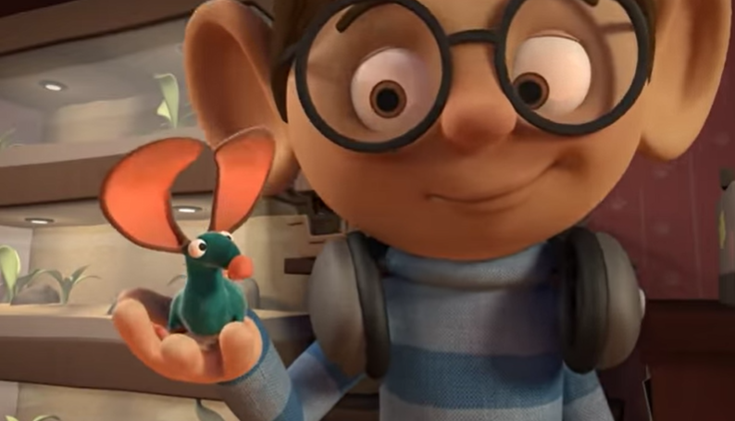
In the story ‘Mouse for Sale’, the boy left the shop with the mouse but didn’t buy anything.
https://www.youtube.com/watch?v=OzYwE3Tst1Y&feature=emb_title

Slide 3
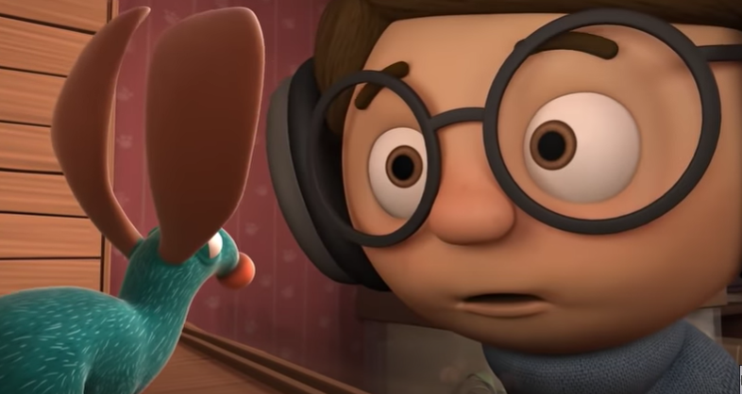
What things do you think the boy would need for his new pet mouse?
Today we are going to write a list.
Can you remember what you need to
include in a list?

Slide 4
List for a Pet Mouse
Cage
Food dish
Food
Water bottle
Exercise wheel
A list needs:
A title
Each item needs to start on a new line
A capital letter for the beginning letter

Slide 5
What is wrong with the list?
List for a Pet Mouse
cage
Food dishFood
Waterbottle
ExeRcise wHeel.

Slide 6
Did you spot the mistakes?
List for a Pet Mouse
cage
Food dishFood
Waterbottle
ExeRcise wHeel.

Slide 7
Main Activity:
What do you think the boy will need to buy for his new pet mouse?
Remember to:
Write a title for you list
Start each item on a new line
Sound out the words to spell using your phonic knowledge
Form your letters the correct way round
Use capital letters and finger spaces

