Slide 1
Writing
Wednesday 3rd March 2021

Slide 2

This week we are reading ‘The Koala who could’
https://www.youtube.com/watch?v=VcdVsRfUbjk

Slide 3
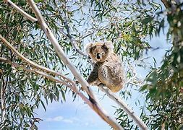
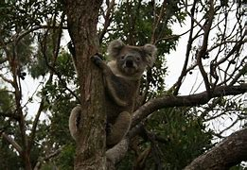
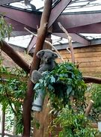
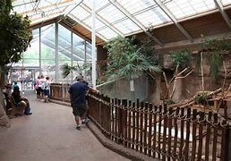
Kevin the Koala needs a new home. Where do you think he would like to live?

Slide 4
Can you design a new home for Kevin the Koala?

Slide 5
Main Activity:
Design and build a new home for Kevin the Koala.
Remember to:
Sound out the words to spell using your phonic knowledge
Write keywords correctly
Think carefully about how you form your letters

