Slide 1
Writing
Wednesday 20th January 2021

Slide 2
Today we are going to be thinking about questions.
Questions are sentences that ask something. They end in a question mark.
?

Slide 3
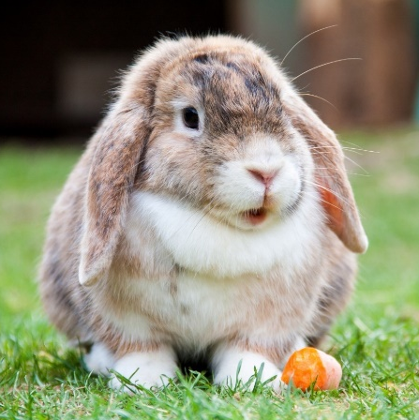
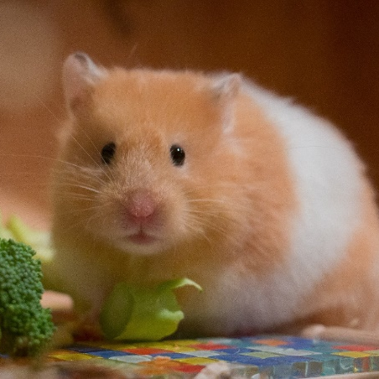
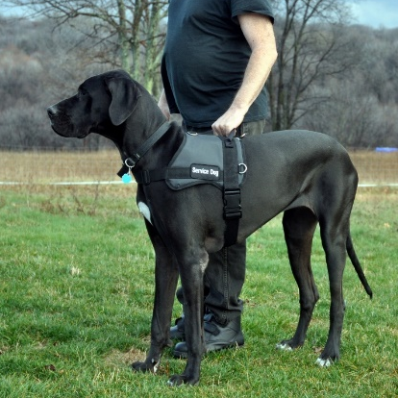
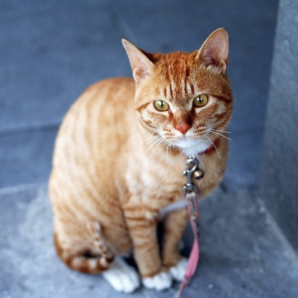
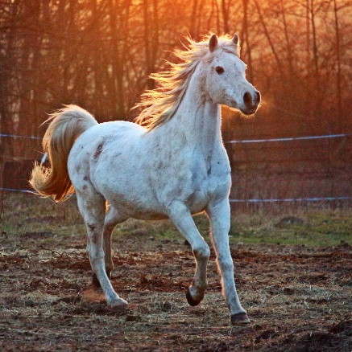
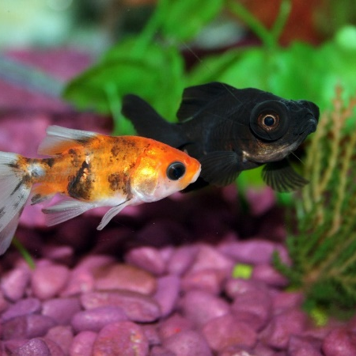
Tomorrow, we are going to find out facts about the following pets:

Slide 4
Choose one of the pets that you would like to find out about.
What would you like to find out?

Slide 5
Questions normally begin with words such as:
Who
What
When
Where
Why
How
Can
Are
Questions end with a question mark:
?

Slide 6
I would like to find out about a hamster.
The first question that I want to ask is:
What do hamsters eat?
Remember, a question is a sentence that asks something. A question ends in a question mark.

Slide 7

Here are some more questions that I would like to find out about hamsters.
Can you spot the mistakes that I have made?
How often do you need to feed hamsters.

Slide 8
Here are some more questions that I would like to find out about hamsters.
Can you spot the mistakes that I have made?
how long do hamsters sleep for?

Slide 9
Here are some more questions that I would like to find out about hamsters.
Can you spot the mistakes that I have made?
What dohamsters like to do?

Slide 10
Here are some more questions that I would like to find out about hamsters.
Can you spot the mistakes that I have made?
What do haMsTers NeEd?

Slide 11
Here are some more questions that I would like to find out about hamsters.
Can you spot the mistakes that I have made?
Are hamsters friendly.

Slide 12




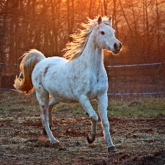

Choose one of the pets that you would like to find out about.
What would you like to find out?
You can choose to record yourself asking the questions or you can write them down.
Remember (if you choose to write your questions) to:
Use capital letters
Use finger spaces
Use question marks
Sound out words to spell
Spell the words and, to and the correctly (if you need them in your writing)

