Slide 1
Maths
WB 11.1.21

Slide 2
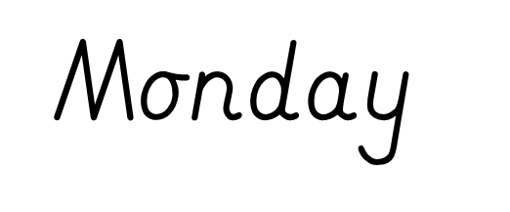

Slide 3
Starter-
Lets think about numbers that bond together to make the number 5
https://www.youtube.com/watch?v=We0SUCcY_NY
Can you write down your number bonds to 5?
Notes:
Number bonds to 5 are 2 number that add together to make 5. 0+5, 1+4, 2+3, 3+2, 4+1, 5+0

Slide 4
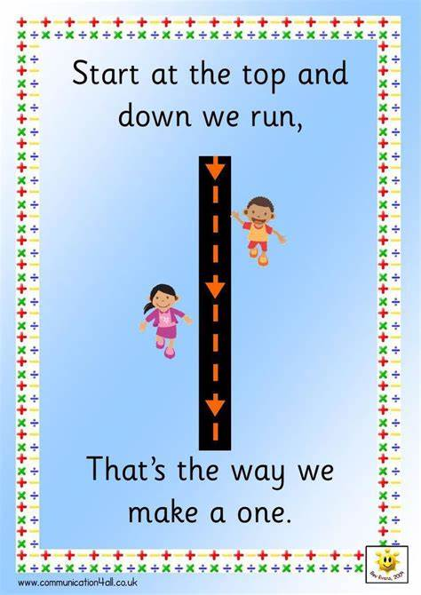
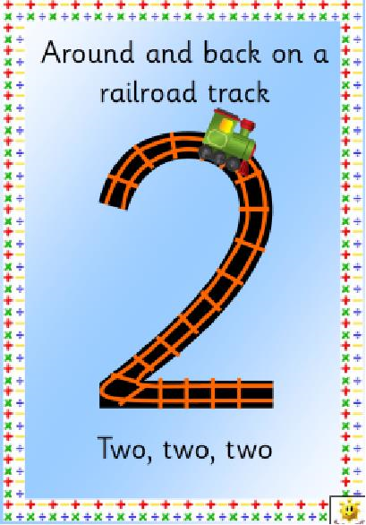
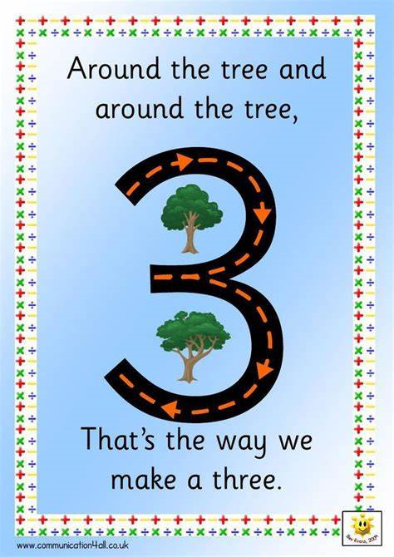
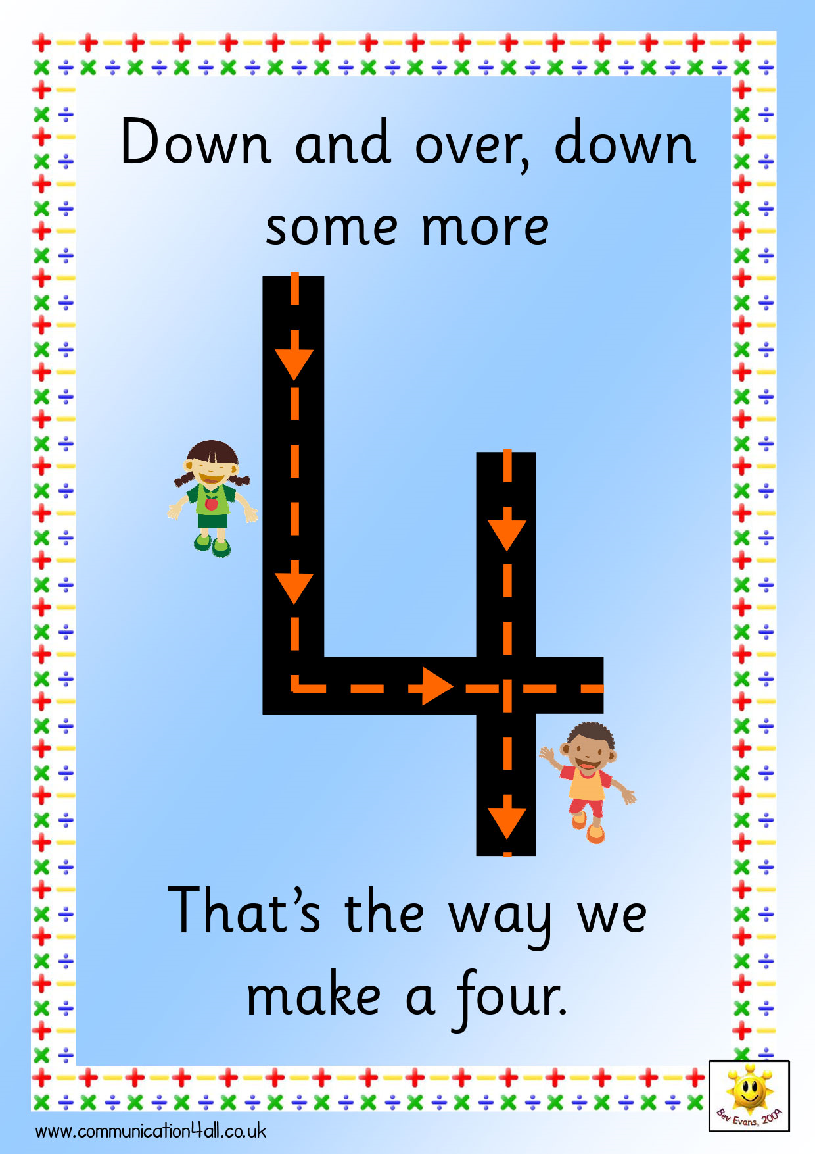
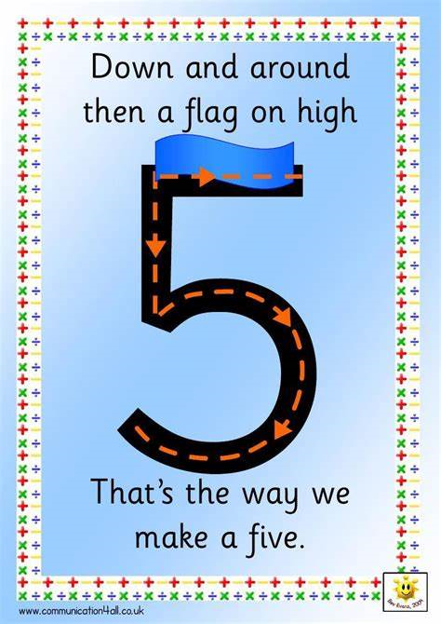
Lets look closely at the numbers 1-5, use our rhymes to help you.
Can you practise writing these numbers?

Slide 5
4
Look at this number, can you count out this many counters?
Can you do this for a range of numbers between 1 and 5.
Notes:
Children will complete 1:1 correspondence counting – counting each object carefully and precisely

Slide 6
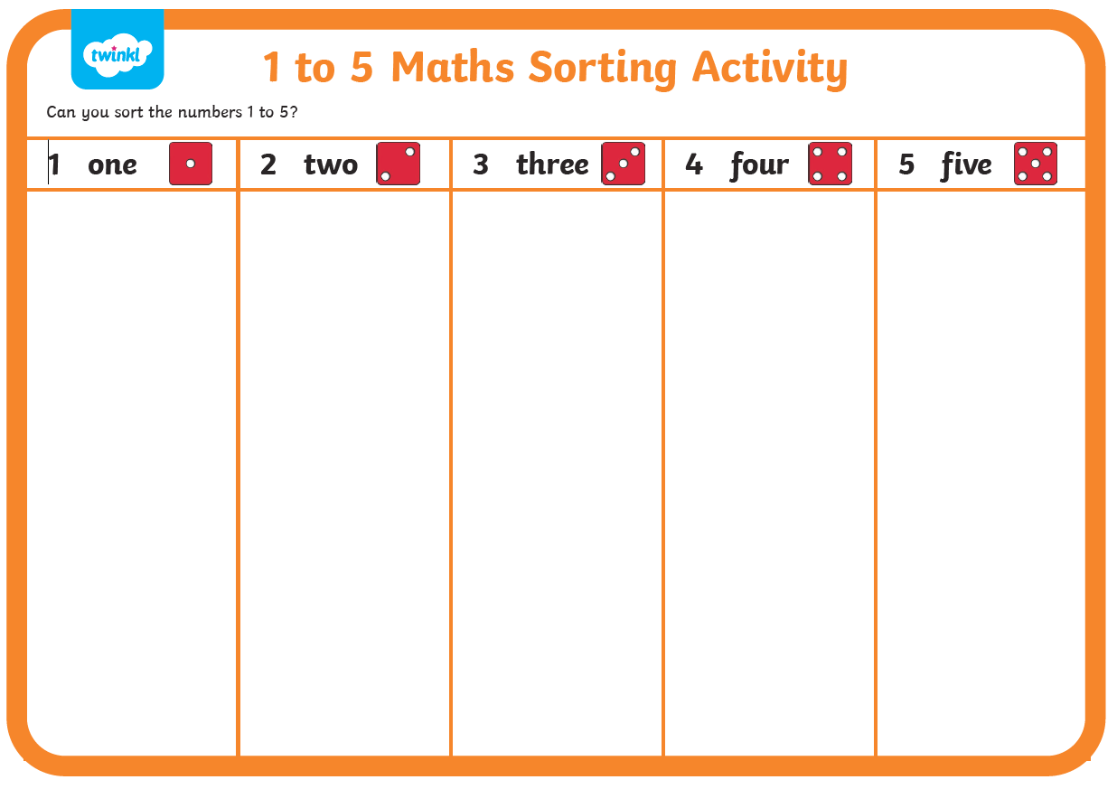



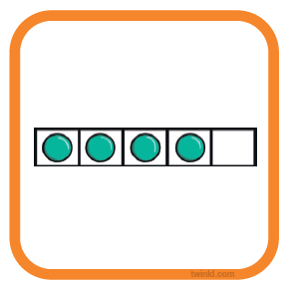

Complete number representation game
Use the cards and match them to the correct picture on the board.
Have we put the pictures in the correct place?

