Slide 1
Phonics
Friday 5th February 2021

Slide 2
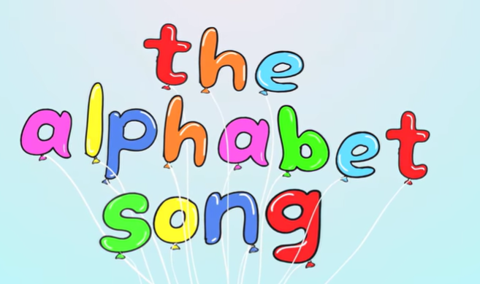

Can you sing the alphabet song?
Remember to say the names of the letters not the sounds.
https://www.youtube.com/watch?v=0FfcNgYCW18

Slide 3
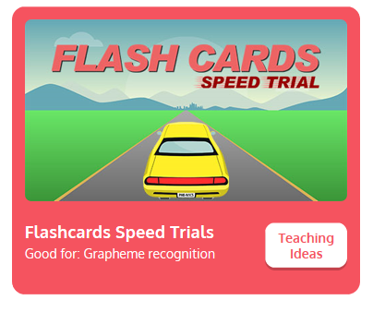
Practise your sounds using Flashcards Speed Trial on Phonics Play
Pick individual graphemes – Sets 1-9
Username: jan21
Password: home
https://www.phonicsplay.co.uk/resources/phase/2/flashcards-speed-trials

Slide 4
Can you read our tricky words:
we

Slide 5
Can you read our tricky words:
me

Slide 6
Can you read our tricky words:
he

Slide 7
Can you read our tricky words:
be

Slide 8
Can you read our tricky words:
she

Slide 9
Can you read our new tricky word?
was

Slide 10

Practise reading your keywords using Tricky Word Trucks on Phonics Play
Pick Individual Tricky Words: all Phase 2 + he, she, we, me, be, was
Username: jan21
Password: home
https://www.phonicsplay.co.uk/resources/phase/2/tricky-word-trucks

Slide 11
Can you spell the tricky word?
go

Slide 12
Can you spell the tricky word?
no

Slide 13
Practise writing the tricky words no and go.
You might want to put the words in to a sentence.

Slide 14
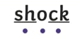
Main Activity:
Read the captions and sentences on the following pages.
Remember to look for our keywords.
he
we
me
she
be
was
You can use sound buttons to help blend the sounds together to read.

Slide 15
Can you read the caption?
A goat on a moat.

Slide 16
Can you read the caption?
Sixteen trees

Slide 17
Can you read the sentence?
Gail got wet in the rain.

Slide 18
Can you read the sentence?
The light was bright.

