Slide 1
Phonics
Friday 12th February 2021

Slide 2
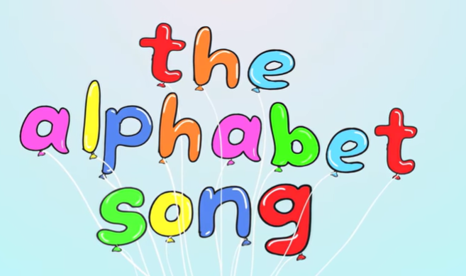

Can you sing the alphabet song?
Remember to say the names of the letters not the sounds.
https://www.youtube.com/watch?v=0FfcNgYCW18

Slide 3
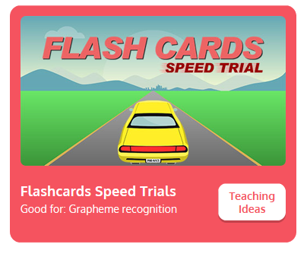
Practise your sounds using Flashcards Speed Trial on Phonics Play
Pick individual graphemes – Sets 1-10
Username: jan21
Password: home
https://www.phonicsplay.co.uk/resources/phase/2/flashcards-speed-trials

Slide 4
Can you read our tricky words:
he

Slide 5
Can you read our tricky words:
we

Slide 6
Can you read our tricky words:
me

Slide 7
Can you read our tricky words:
was

Slide 8
Can you read our tricky words:
she

Slide 9
Can you read our tricky words:
be

Slide 10
Can you read our new tricky word?
my

Slide 11

Practise reading your keywords using Tricky Word Trucks on Phonics Play
Pick Individual Tricky Words: all Phase 2 + he, she, we, me, be, was, my
Username: jan21
Password: home
https://www.phonicsplay.co.uk/resources/phase/2/tricky-word-trucks

Slide 12
Can you spell the tricky word?

Slide 13
go

Slide 14
Can you spell the tricky word?

Slide 15
the

Slide 16
Can you spell the tricky word?

Slide 17
Can you spell the tricky word?
no

Slide 18
Can you spell the tricky word?

Slide 19
Can you spell the tricky word?
to

Slide 20
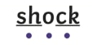
Main Activity:
Read the captions and sentences on the following pages.
Remember to look for our keywords.
he
we
me
she
be
was
my
You can use sound buttons to help blend the sounds together to read.

Slide 21
Can you read the sentence?
Mark and Carl got the tools.

Slide 22
Can you read the caption?
looking at books

Slide 23
Can you read the caption?
Gurdeep had a chat

