Slide 1
Phonics
Friday 5th March 2021

Slide 2
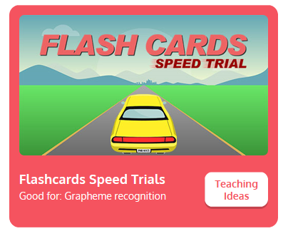
Practise your sounds using Flashcards Speed Trial on Phonics Play
Pick individual graphemes – Sets 1-11
Username: jan21
Password: home
https://www.phonicsplay.co.uk/resources/phase/2/flashcards-speed-trials

Slide 3

Practise reading your keywords using Tricky Word Trucks on Phonics Play
Pick Individual Tricky Words: all Phase 2 and all Phase 3
Username: jan21
Password: home
https://www.phonicsplay.co.uk/resources/phase/2/tricky-word-trucks

Slide 4
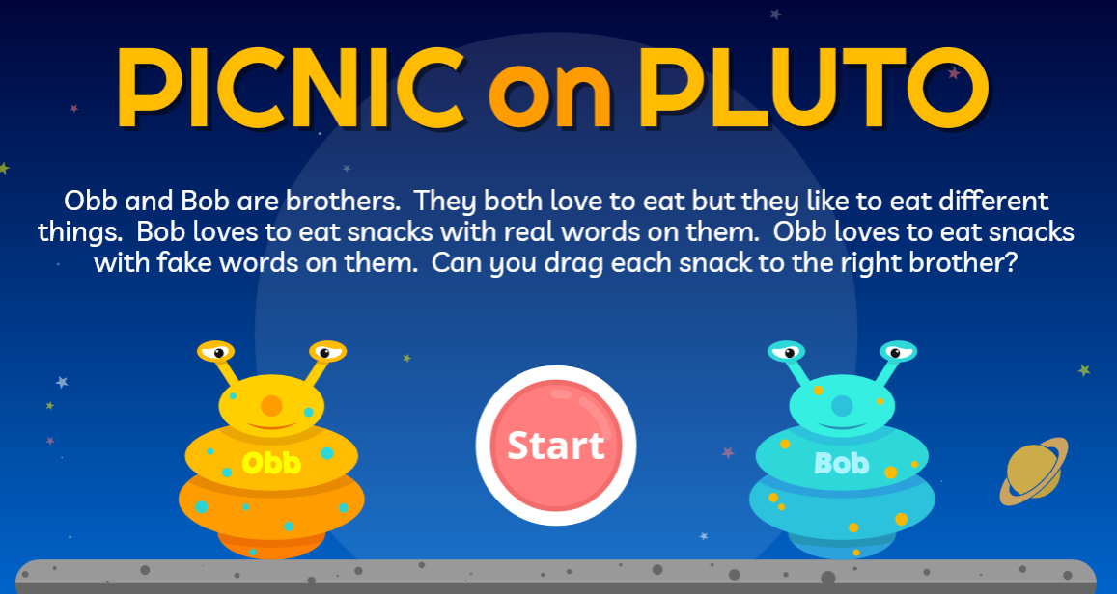
Can you blend the sounds to read the words? Decide if the words are real or ‘alien’ words.
Play Phase 3 – revise all Phase 3
https://www.phonicsplay.co.uk/resources/phase/3/picnic-on-pluto
Username: jan21
Password: home

Slide 5

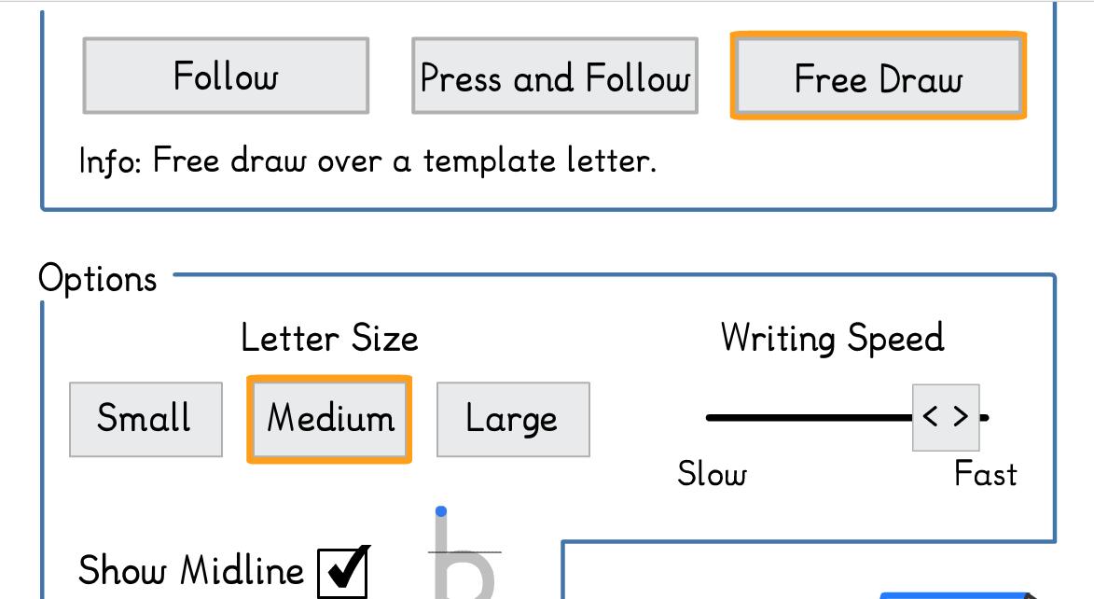
Main Activity:
Practise forming your letters for the letters k, l, m, n, o, p, q, r, s and t
Click on the link to Doorway Online.
https://www.doorwayonline.org.uk/literacy/letterformation/
You need to click on ‘Free Draw’.
You could also practise writing your letters on some paper.

