Slide 1
Phonics
Friday 29th January 2021

Slide 2
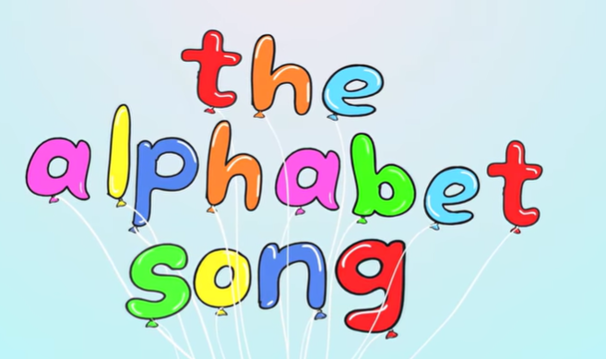

Can you sing the alphabet song?
Remember to say the names of the letters not the sounds.
https://www.youtube.com/watch?v=0FfcNgYCW18

Slide 3
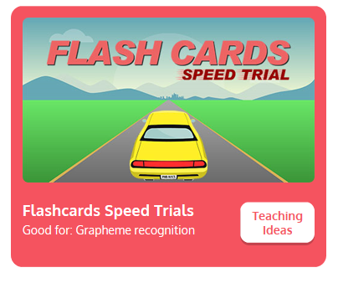
Practise your sounds using Flashcards Speed Trial on Phonics Play
Pick individual graphemes – Sets 1-7 + ch, sh, th, ng
Username: jan21
Password: home
https://www.phonicsplay.co.uk/resources/phase/2/flashcards-speed-trials

Slide 4
Today we are going to be looking at some tricky words to read:
we

Slide 5
Today we are going to be looking at some tricky words to read:
me

Slide 6
Today we are going to be looking at some tricky words to read:
be

Slide 7
Can you point to the words that say we?
How many can you find?
me
we
we
we
me
be
be
be
me
we
me
we
be
me
me

Slide 8
Can you point to the words that say me?
How many can you find?
me
we
we
we
me
be
be
be
me
we
me
we
be
me
me

Slide 9
Can you point to the words that say be?
How many can you find?
me
we
we
we
me
be
be
be
me
we
me
we
be
me
me

Slide 10

Practise reading your keywords using Tricky Word Trucks on Phonics Play
Pick Individual Tricky Words: all Phase 2 + he, she, we, me, be
Username: jan21
Password: home
https://www.phonicsplay.co.uk/resources/phase/2/tricky-word-trucks

Slide 11
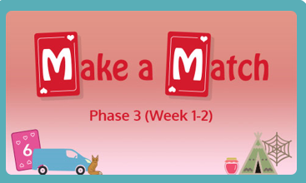
Practise using your blending skills to find the pairs on Phonics Play – Phase 3 - Make a Match
Blend the sounds to read the words and match them to the picture.
Username: jan21
Password: home
https://www.phonicsplay.co.uk/resources/phase/3/matching-ph3w12

Slide 12
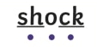
Read the sentences on the following pages.
Remember to look for our keywords.
he
we
me
she
be
You can use sound buttons to help blend the sounds together to read.

Slide 13
Can you read the sentence?
A moth can be fat, but its wings are thin.

Slide 14
Can you read the sentence?
Natasha sang a song to me.

Slide 15
Can you read the sentence?
We can get the big bed into the van.

