Slide 1
Phonics
Monday 18th January 2021

Slide 2
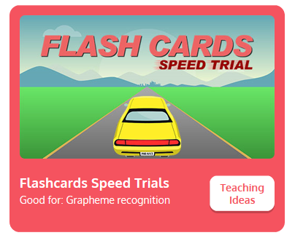
Practise your sounds using Flashcards Speed Trial on Phonics Play
Pick individual graphemes – Sets 1-6
Username: jan21
Password: home
https://www.phonicsplay.co.uk/resources/phase/2/flashcards-speed-trials

Slide 3

Practise reading your keywords using Tricky Word Trucks on Phonics Play
Choose Phase 2 Tricky Words
Username: jan21
Password: home
https://www.phonicsplay.co.uk/resources/phase/2/tricky-word-trucks

Slide 4
Today we are looking at the sound y
https://www.youtube.com/watch?v=futQOvUnHVs
Can you draw the letter in the air?

Slide 5
Watch the video and find the words that use the y sound.
https://www.bbc.co.uk/bitesize/topics/zvq9bdm/articles/zfcwcqt
Watch the video of Geraldine the Giraffe looking at the y sound:
https://www.youtube.com/watch?v=nBajQHNOvj4

Slide 6
Can you identify the different sounds in the words and blend them to read them?
yap

Slide 7
Can you identify the different sounds in the words and blend them to read them?
yes

Slide 8
Can you identify the different sounds in the words and blend them to read them?
yet

Slide 9
Can you identify the different sounds in the words and blend them to read them?
yell

Slide 10
Can you identify the different sounds in the words and blend them to read them?
yum-yum

