Slide 1
Phonics
Monday 25th January 2021

Slide 2
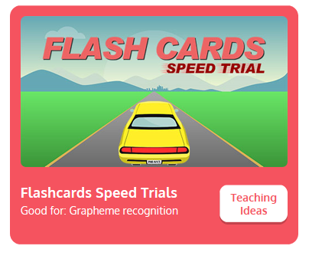
Practise your sounds using Flashcards Speed Trial on Phonics Play
Pick individual graphemes – Sets 1-7
Username: jan21
Password: home
https://www.phonicsplay.co.uk/resources/phase/2/flashcards-speed-trials

Slide 3

Practise reading your keywords using Tricky Word Trucks on Phonics Play
Pick Individual Tricky Words: all Phase 2 + he, she
Username: jan21
Password: home
https://www.phonicsplay.co.uk/resources/phase/2/tricky-word-trucks

Slide 4
This week we are looking at consonant digraphs – two consonants that go together to make 1 sound.
Today’s sound is:
ch
https://www.youtube.com/watch?v=gLHpZyIu7ps
Can you draw the digraph in the air?

Slide 5
Watch the video and find the words that use the ch sound.
https://www.bbc.co.uk/bitesize/topics/zvq9bdm/articles/zjp3pg8
Watch the video of Geraldine the Giraffe looking at the ch sound:
https://www.youtube.com/watch?v=SEoednLrsMY

Slide 6
Can you identify the different sounds in the words and blend them to read them?
chug

Slide 7
Can you identify the different sounds in the words and blend them to read them?
check

Slide 8
Can you identify the different sounds in the words and blend them to read them?
such

Slide 9
Can you identify the different sounds in the words and blend them to read them?
much

Slide 10
Can you identify the different sounds in the words and blend them to read them?
chill

Slide 11
Can you identify the different sounds in the words and blend them to read them?
rich

