Slide 1
Phonics
Monday 1st February 2021

Slide 2
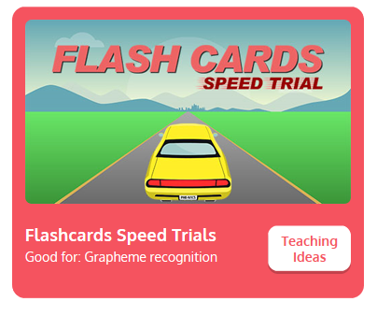

Practise your sounds using Flashcards Speed Trial on Phonics Play
Pick individual graphemes – Sets 1-8
Username: jan21
Password: home
https://www.phonicsplay.co.uk/resources/phase/2/flashcards-speed-trials

Slide 3

Practise reading your keywords using Tricky Word Trucks on Phonics Play
Pick Individual Tricky Words: all Phase 2 + he, she, me, we, be
Username: jan21
Password: home
https://www.phonicsplay.co.uk/resources/phase/2/tricky-word-trucks

Slide 4
This week we are looking at vowel digraphs – two vowels that go together to make 1 sound.
Today’s sound is:
ai
https://www.youtube.com/watch?v=_0lNTYRpNqU
Can you draw the digraph in the air?

Slide 5
Watch the video and find the words that use the ai sound.
https://www.bbc.co.uk/bitesize/topics/zvq9bdm/articles/z4xsxyc
Watch the video of Geraldine the Giraffe looking at the ai sound:
https://www.youtube.com/watch?v=Fbmpw192MSg

Slide 6
Main Activity
Can you blend the sounds in the words to read them?
Remember to look out for two letters that make one sound.
pain

Slide 7
Can you identify the different sounds in the words and blend them to read them?
wait

Slide 8
Can you identify the different sounds in the words and blend them to read them?
Gail

Slide 9
Can you identify the different sounds in the words and blend them to read them?
aim

Slide 10
Can you identify the different sounds in the words and blend them to read them?
paint

Slide 11
Can you identify the different sounds in the words and blend them to read them?
main

Slide 12
Can you identify the different sounds in the words and blend them to read them?
bait

Slide 13
Can you read the caption by identifying and blending the sounds in the words? Remember to look out for keywords to read by sight.
In the mail.

