Slide 1
Phonics
Monday 8th February 2021

Slide 2
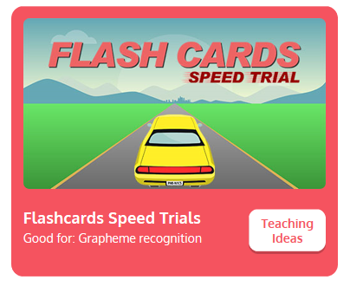

Practise your sounds using Flashcards Speed Trial on Phonics Play
Pick individual graphemes – Sets 1-9
Username: jan21
Password: home
https://www.phonicsplay.co.uk/resources/phase/2/flashcards-speed-trials

Slide 3

Practise reading your keywords using Tricky Word Trucks on Phonics Play
Pick Individual Tricky Words: all Phase 2 + he, she, me, we, be, was
Username: jan21
Password: home
https://www.phonicsplay.co.uk/resources/phase/2/tricky-word-trucks

Slide 4
This week we are looking at vowel digraphs – two vowels that go together to make 1 sound.
Today’s sound is:
oo
https://www.youtube.com/watch?v=opQ7gMO9ysc
Can you draw the digraph in the air?

Slide 5
Watch the video and find the words that use the oo sound.
https://www.bbc.co.uk/bitesize/topics/zvq9bdm/articles/z4tyt39
Watch the video of Geraldine the Giraffe looking at the long oo sound:
https://www.youtube.com/watch?v=UfMKV_9agiY
Watch the video of Geraldine the Giraffe looking at the short oo sound:
https://www.youtube.com/watch?v=vR47jG-imRo

Slide 6
Main Activity
Can you blend the sounds in the words to read them?
Remember that in some of the words the ‘oo’ digraph might be making the short or long sound.
too
look

Slide 7
Can you identify the different sounds in the words and blend them to read them?
zoom

Slide 8
Can you identify the different sounds in the words and blend them to read them?
good

Slide 9
Can you identify the different sounds in the words and blend them to read them?
cool

Slide 10
Can you identify the different sounds in the words and blend them to read them?
wood

Slide 11
Can you identify the different sounds in the words and blend them to read them?
rooftop

Slide 12
Can you identify the different sounds in the words and blend them to read them?
hood

Slide 13
Can you read the caption by identifying and blending the sounds in the words? Remember to look out for keywords to read by sight.
tools in the shed

