Slide 1
Phonics
Monday 22nd February 2021

Slide 2
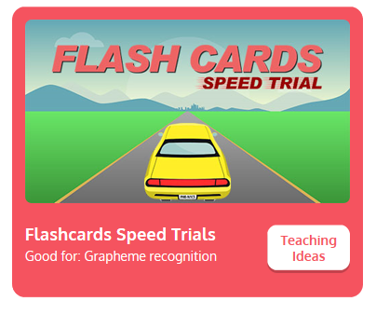
Practise your sounds using Flashcards Speed Trial on Phonics Play
Pick individual graphemes – Sets 1-10
Username: jan21
Password: home
https://www.phonicsplay.co.uk/resources/phase/2/flashcards-speed-trials

Slide 3

Practise reading your keywords using Tricky Word Trucks on Phonics Play
Pick Individual Tricky Words: all Phase 2 + he, she, me, we, be, was, my
Username: jan21
Password: home
https://www.phonicsplay.co.uk/resources/phase/2/tricky-word-trucks

Slide 4

This week we are looking at a digraph – two vowels that go together to make 1 sound.
Today’s sound is:
ow
Can you draw the digraph in the air?

Slide 5
Watch the video and find the words that use the ow sound.
https://www.bbc.co.uk/bitesize/topics/zvq9bdm/articles/z64j47h
Watch the video of Geraldine the Giraffe looking at the ow digraph:
https://www.youtube.com/watch?v=GJtvjxBYg7I

Slide 6
Main Activity
Can you blend the sounds in the words to read them?
now

Slide 7
Can you identify the different sounds in the words and blend them to read them?
down

Slide 8
Can you identify the different sounds in the words and blend them to read them?
how

Slide 9
Can you identify the different sounds in the words and blend them to read them?
bow

Slide 10
Can you identify the different sounds in the words and blend them to read them?
pow

Slide 11
Can you read the sentence by identifying and blending the sounds in the words? Remember to look out for keywords to read by sight.
Bow down to the King and Queen.

