Slide 1
Phonics
Monday 1st March 2021

Slide 2
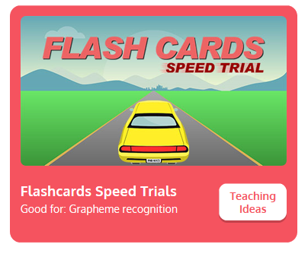
Practise your sounds using Flashcards Speed Trial on Phonics Play
Pick individual graphemes – Sets 1-11
Username: jan21
Password: home
https://www.phonicsplay.co.uk/resources/phase/2/flashcards-speed-trials

Slide 3

Practise reading your keywords using Tricky Word Trucks on Phonics Play
Pick Individual Tricky Words: all Phase 2 + he, she, me, we, be, was, my, you
Username: jan21
Password: home
https://www.phonicsplay.co.uk/resources/phase/2/tricky-word-trucks

Slide 4
This week we are looking at a trigraph – three letters that go together to make 1 sound.
Today’s sound is:
ure
Can you draw the digraph in the air?

Slide 5
Watch the video and find the words that use the ure sound.
https://www.bbc.co.uk/bitesize/topics/zvq9bdm/articles/zh828xs
Watch the video of Geraldine the Giraffe looking at the ure trigraph:
https://www.youtube.com/watch?v=YwCzf71flBA

Slide 6
Main Activity
Can you blend the sounds in the words to read them?
sure

Slide 7
Can you identify the different sounds in the words and blend them to read them?
pure

Slide 8
Can you identify the different sounds in the words and blend them to read them?
cure

Slide 9
Can you identify the different sounds in the words and blend them to read them?
secure

