Slide 1
Phonics
Monday 11th January 2021

Slide 2
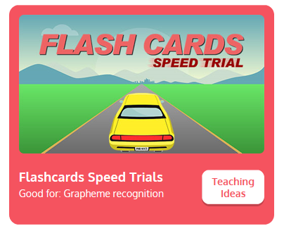
Practise your sounds using Flashcards Speed Trial on Phonics Play
Choose Phase 2 to revise the graphemes.
Username: jan21
Password: home
https://www.phonicsplay.co.uk/resources/phase/2/flashcards-speed-trials

Slide 3

Practise reading your keywords using Tricky Word Trucks on Phonics Play
Choose Phase 2 Tricky Words
Username: jan21
Password: home
https://www.phonicsplay.co.uk/resources/phase/2/tricky-word-trucks

Slide 4

Today we are looking at the sound j
https://www.youtube.com/watch?v=wkvSJS_sBQY
Can you draw the letter in the air?

Slide 5
Can you find the words that begin with the j sound?
https://www.bbc.co.uk/bitesize/topics/zvq9bdm/articles/zv3cy9q
Watch the video of Geraldine the Giraffe looking at the j sound:
https://www.youtube.com/watch?v=spp1ea9_xl4

Slide 6
Can you identify the different sounds in the words and blend them to read them?
jam

Slide 7
Can you identify the different sounds in the words and blend them to read them?
Jill

Slide 8
Can you identify the different sounds in the words and blend them to read them?
jet

Slide 9
Can you identify the different sounds in the words and blend them to read them?
jog

Slide 10
Can you identify the different sounds in the words and blend them to read them?
Jack

Slide 11
Can you identify the different sounds in the words and blend them to read them?
Jen

Slide 12
Can you identify the different sounds in the words and blend them to read them?
jet-lag

Slide 13
Can you identify the different sounds in the words and blend them to read them?
jacket

